Slide 1
CS8792-CRYPTOGRAPHY AND NETWORK SECURITY Unit-I
Department: Computer Science and Engineering
&
Information Technology
Batch/Year : 2017-2021/IV
Created by:
Dr.A.Thilagavathy
Dr.G.Amudha
Dr.D.Praveena
Ms. S. A. Angarayarkanni
Mr. A. Madhu
Date: 29-07-2020

Slide 2
CS8792 CRYPTOGRAPHY AND NETWORK SECURITY
SYLLABUS
CS8792CRYPTOGRAPHY AND NETWORK SECURITY 3 0 0 3
UNIT I INTRODUCTION 9
Security trends - Legal, Ethical and Professional Aspects of Security, Need for Security at Multiple levels, Security Policies - Model of network security – Security attacks, services and mechanisms – OSI security architecture – Classical encryption techniques: substitution techniques, transposition techniques, steganography).- Foundations of modern cryptography: perfect security – information theory – product cryptosystem – cryptanalysis.
UNIT II SYMMETRIC KEY CRYPTOGRAPHY 9
MATHEMATICS OF SYMMETRIC KEY CRYPTOGRAPHY: Algebraic structures – Modular arithmetic-Euclid‟s algorithm- Congruence and matrices -Groups, Rings, Fields- Finite fields- SYMMETRIC KEY CIPHERS: SDES – Block cipher Principles of DES – Strength of DES – Differential and linear cryptanalysis – Block cipher design principles – Block cipher mode of operation – Evaluation criteria for AES – Advanced Encryption Standard –RC4–Key distribution.
UNIT III PUBLIC KEY CRYPTOGRAPHY 9 MATHEMATICS OF ASYMMETRIC KEY CRYPTOGRAPHY: Primes – Primality Testing –Factorization – Euler‘s totient function, Fermat‘s and Euler‘s Theorem – Chinese Remainder Theorem – Exponentiation and logarithm ASYMMETRIC KEY CIPHERS: RSA cryptosystem – Key distribution – Key management – Diffie Hellman key exchange - ElGamal cryptosystem – Elliptic curve arithmetic - Elliptic curve cryptography.
UNIT IV MESSAGE AUTHENTICATION AND INTEGRITY 9 Authentication requirement – Authentication function – MAC – Hash function – Security of hash function and MAC – SHA –Digital signature and authentication protocols – DSS- Entity Authentication: Biometrics, Passwords, Challenge Response protocols- Authentication applications – Kerberos, X.509
UNIT V SECURITY PRACTICE AND SYSTEM SECURITY 9 Electronic Mail security – PGP, S/MIME – IP security – Web Security – SYSTEM SECURITY: Intruders – Malicious software – viruses – Firewalls.

Slide 3
LEGAL, ETHICAL AND PROFESSIONAL ASPECTS OF SECURITY
Computer crime, or cybercrime, is a term used broadly to describe criminal activity in which computers or computer networks are a tool, a target, or a place of criminal activity.
The term cybercrime has a association of the use of networks specifically, whereas computer crime may or may not involve networks.
Types of Computer Crime
1. Computers as targets:
This form of crime targets a computer system, to
acquire information stored on that computer system, to control the target system
without authorization or payment (theft of service), or to alter the integrity of data or
interfere with the availability of the computer or server.
This form of crime involves an attack on data integrity, system integrity, data confidentiality, privacy, or availability.
2. Computers as storage devices:
Computers can be used to further unlawful activity by using a computer or a computer device as a passive storage medium.
Example, the computer can be used to store stolen password lists, credit card or calling card numbers, proprietary corporate information
3. Computers as communications tools:
Many of the crimes falling within this category are simply traditional crimes that are committed online.
Examples include the illegal sale of prescription drugs, controlled substances, and guns, fraud, gambling.

Slide 4
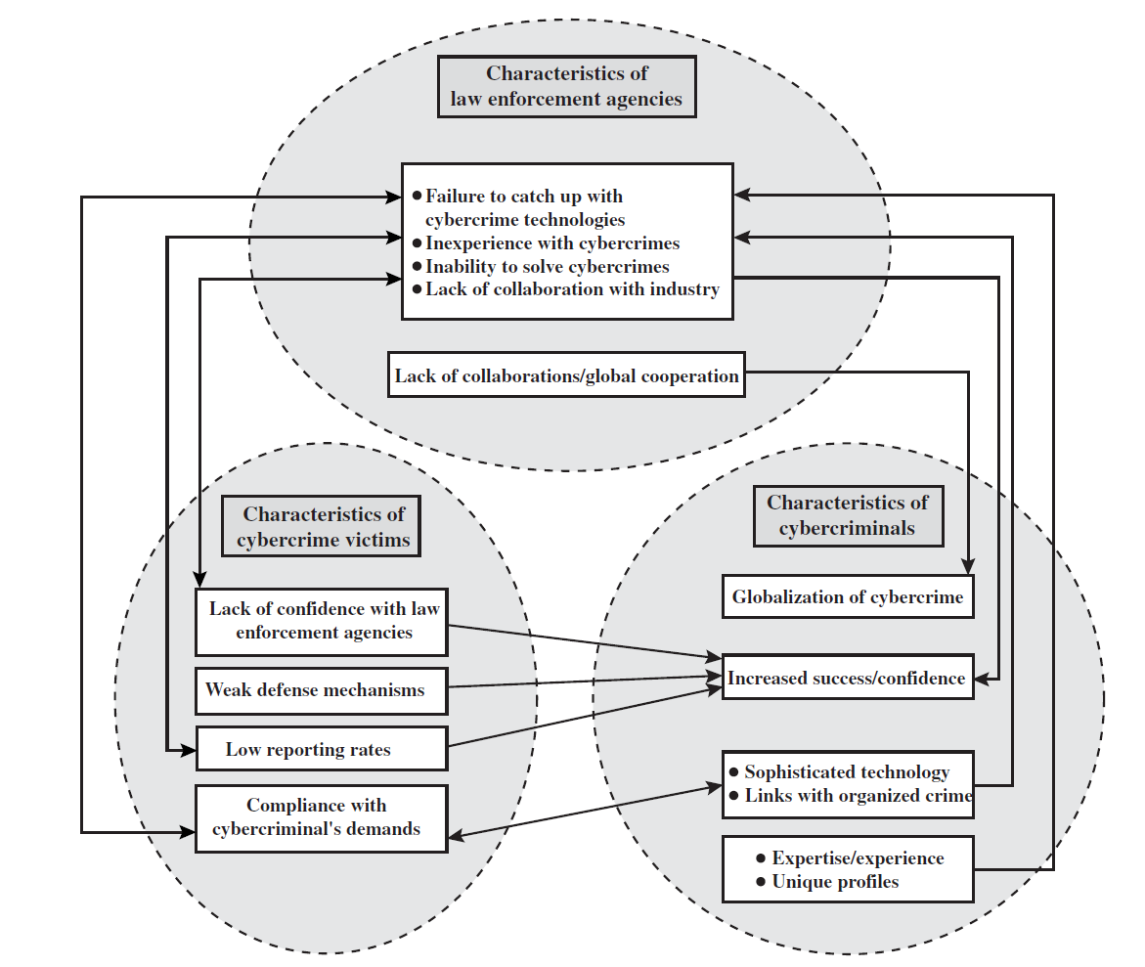
Law Enforcement Challenges
The cycle of cybercrime, involving law enforcement agencies, cybercriminals, and cybercrime victims are depicted in figure below:
Figure : Cycle of Cybercrimes
Difficulties faced by law enforcement agencies:
Proper investigation requires a better grasp of the technology.
Lack of experience in dealing with this kind of crime.
Lack of resources.
Some cybercrime investigations require considerable computer processing power, communications capacity, and storage capacity, which may be beyond the budget of individual authority.
The global nature of cybercrime is an additional obstacle

Slide 5
It is difficult to profile cybercriminals in the way that is often done with other types of repeat offenders.
The cybercriminal tends to be young and very computer-savvy, but the range of behavioral characteristics is wide.
There exist no cybercriminal databases that can point investigators to likely suspects.
The success of cybercriminals, and the relative lack of success of law enforcement, influence the behavior of cybercrime victims.
No much investment in technical, physical, and human-factor resources to prevent attacks.
Reporting rates tend to be low because of a lack of confidence in law enforcement.
INTELLECTUAL PROPERTY
The U.S. legal system, and legal systems generally, distinguish three primary types of property:
Real property: Land and things permanently attached to the land, such as trees, buildings, and stationary mobile homes.
Personal property: Personal effects, moveable property and goods, such as cars, bank accounts, wages, securities, a small business, furniture, insurance policies, jewelry, patents, pets.
Intellectual property: Any intangible asset that consists of human knowledge and ideas. Examples include software, data, novels, sound recordings, the design of a new type of mousetrap, or a cure for a disease.
Types of Intellectual Property
Copyrights
Trademarks
Patents

Slide 6
COPYRIGHTS
Copyright law protects the tangible or fixed expression of an idea, not the idea itself. A creator can claim copyright, and file for the copyright at a national government copyright office, if the following conditions are fulfilled:
The proposed work is original.
The creator has put this original idea into a concrete form, such as hard copy software, or multimedia form.
Examples: Literary works, Musical works, Dramatic works, choreographic works, Architectural works, Software-related works.
The copyright owner has the following exclusive rights, protected against infringement:
Reproduction right: Lets the owner make copies of a work
Modification right: Also known as the derivative-works right, concerns modifying a work to create a new or derivative work
Distribution right: Lets the owner publicly sell, rent, lease, or lend copies of the work.
Public-performance right: Applies mainly to live performances
Public-display right: Lets the owner publicly show a copy of the work directly or by means of a film, slide, or television image
PATENTS
A patent for an invention is the grant of a property right to the inventor. There are three types of patents:
Utility patents: May be granted to anyone who invents or discovers any new and useful process, machine, article of manufacture, or composition of matter, or any new and useful improvement thereof;

Slide 7
Design patents: May be granted to anyone who invents a new, original, and ornamental design for an article of manufacture;
Plant patents: May be granted to anyone who invents or discovers and reproduces any distinct and new variety of plant.
TRADEMARKS
A trademark is a word, name, symbol, or device that is used in trade with goods to indicate the source of the goods and to distinguish them from the goods of others.
Intellectual Property Relevant to Network and Computer Security
A number of forms of intellectual property are relevant in the context of network and computer security. Here are some of the most prominent:
Software: This includes programs produced by vendors of commercial software (e.g., operating systems, utility programs, applications) as well as shareware, proprietary software created by an organization for internal use, and software produced by individuals. For all such software, copyright protection is available if desired. In some cases, a patent protection may also be appropriate.
Databases: A database may consist of data that is collected and organized in such a fashion that it has potential commercial value. An example is an economic forecasting database. Such databases may be protected by copyright.
Digital content: This category includes audio files, video files, multimedia, courseware, Web site content, and any other original digital work that can be presented in some fashion using computers or other digital devices.
Algorithms: An example of a patentable algorithm, previously cited, is the RSA public-key cryptosystem.

Slide 8
ETHICAL ISSUES
Ethics refers to a system of moral principles that relates to the benefits and harms of particular actions, and to the rightness and wrongness of motives and ends of those actions
ETHICAL ISSUES RELATED TO COMPUTERS AND INFORMATION SYSTEMS
Ethical issues arise as the result of the roles of computers, such as the following:
Repositories and processors of information: Unauthorized use of otherwise unused computer services or of information stored in computers raises questions of appropriateness or fairness.
Producers of new forms and types of assets: For example, computer programs are entirely new types of assets, possibly not subject to the same concepts of ownership as other assets.
Instruments of acts: To what degree must computer services and users of computers, data, and programs be responsible for the integrity and appropriateness of computer output?
Symbols of intimidation and deception: The images of computers as thinking machines, absolute truth producers, infallible, subject to blame, and as anthropomorphic replacements of humans who err should be carefully considered.

Slide 9
Potential Ethical Dilemmas for Information Systems
Balancing professional responsibilities with ethical or moral responsibilities come under the following issues:
Technology Intrusion | Privacy internal to the firm Privacy external to the firm Computer surveillance Employee monitoring Hacking
Ownership Issues | Moonlighting Proprietary rights Conflicts of interest Software copyrights Use of company assets for personal benefit Theft of data, software, or hardware
Legal Issues and Social Responsibilities | Embezzlement, fraud and abuse, such as through EFTs or ATMs Accuracy and timeliness of data Over-rated system capabilities and “smart” computers Monopoly of data
Personnel Issues | Employee sabotage Ergonomics and human factors Training to avoid job obsolescence

Slide 10
Digital Rights Management (DRM)
Digital Rights Management refers to systems and procedures that ensurethat holders of digital rights are clearly identified and receive the stipulated payment for their works. The systems and procedures may also impose further restrictions on the use of digital objects, such as inhibiting printing or prohibiting further distribution.
Objectives of DRM systems
Provide persistent content protection against unauthorized access to the digital content, limiting access to only those with the proper authorization.
Support a variety of digital content types (e.g., music files, video streams, digital books, images).
Support content use on a variety of platforms, (e.g., PCs, PDAs, iPods, mobile phones).
Support content distribution on a variety of media, including CD-ROMs, DVDs, and flash memory.
DRM Components
Content provider: Holds the digital rights of the content and wants to protect these rights
Distributor: Provides distribution channels, such as an online shop or a Web retailer.
Consumer: Uses the system to access the digital content by retrieving downloadable or streaming content through the distribution channel and then paying for the digital license
Clearinghouse: Handles the financial transaction for issuing the digital license to the consumer and pays royalty fees to the content provider and distribution fees to the distributor accordingly

Slide 11
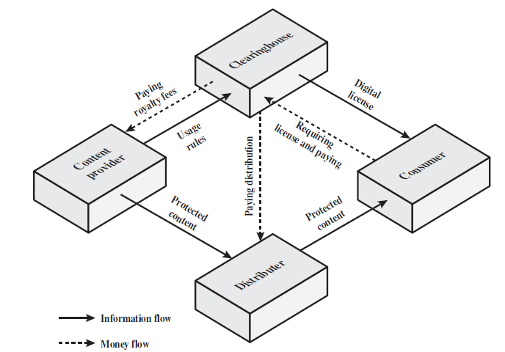
The DRM components is depicted in the figure below.
Figure: DRM Components
DRM System Architecture
The system is accessed by parties in three roles.
Rights holders are the content providers, who either created the content or have acquired rights to the content.
Service providers include distributors and clearing houses.
Consumers are those who purchase the right to access to content for specific uses
The system interface to the services provided by the DRM system are
Identity management: Mechanisms to uniquely identify entities, such as parties and content
Content management: Processes and functions needed to manage the content lifestyle
Rights management: Processes and functions needed to manage rights, rights holders, and associated requirements

Slide 12
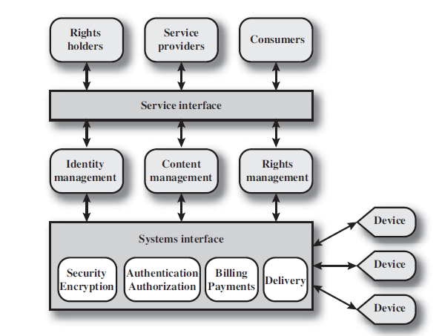
The DRM system architecture is shown in figure below.
Figure : DRM System Architechture
The common functions include
security/encryption module provides functions to encrypt content and to sign license agreements.
authentication and authorization functions identify all parties in the relationship and is used by identity management service .
Billing/payments functions deal with the collection of usage fees from consumers and the distribution of payments to rights holders and distributors.
Delivery functions deal with the delivery of content to consumers.

Slide 13
Multi-Level Security Domains
A Security Domain can have a multi-level policy for one or more security services;
Example: A Domain Security Policy may allow supporting low & moderate confidentiality services and moderate & high integrity services;
Two entities from a multi-level domain must be assured that an appropriate level protection is provided for the keys and metadata by the CKMS (Crypto Key Management System) in accordance with the multi-level policy.
Multi-Level Security: Selectable based on requirements and costs (e.g., processing time) ;
Scalable Security: Selects acceptable level of protection while minimizing costs;
Selectable Security: CKMS Multi-Domain Policy Enforcement supports selectable security;
Negotiated Security for Transaction: Based on the policies of two or more entities participating in a sensitive transaction; Requires creation of a new temporary or permanent Security Policy for the transaction.
Security Policies
Organizational policies must identify goals, threats, risks;
Information policies must establish data categories, labels, sensitivity levels, handling restrictions, roles, responsibilities;
Data Security policies must specify human, physical, communications, and computer protections for data;
CKMS Policies should be configurable and automated to manage keys that protect sensitive applications and data.

Slide 14
Global secure applications must support various policies.
Goal: Automated security policy specification, negotiation, and enforcement is desirable for sensitive applications among mutually suspicious but cooperating organizations. Key Management based on automated dynamic Domain Security Policy support will help meet this goal.
Security Policy Specifications
A Security Policy should be written so that people can understand and follow it;
A Security Policy should be encoded so that an automated system can enforce it;
A formal specification of a security policy can be understandable to humans and automatically enforced by a CKMS.
Security-Domain Based Cryptographic Key Management
Goal: Automated negotiation of key management based on the domain security policies of two or more mutually suspicious participants in a sensitive transaction.
Assumption: Security is proportional to cost, the services used, and the protection provided.
Approach: Develop an automated Policy Negotiation method using formal syntax specifications of compatible Security Policies.
Information Management Policy
Highest-Level Organizational Policy for Managing and Protecting Information in all forms (paper, computer data, electronic storage);
Established by the Organization’s CEO or CIO;
Policy is provided to all the Organization’s employees so they can follow the policy

Slide 15
Based primarily on organization’s goals and objectives;
Based often on industry standards of good practice (e.g., health patient privacy rules);
Assigns Information Management Roles and Responsibilities to individuals;
Foundation for Information Security Policy
Information Security Policy
Establishes high-level rules for protecting organization’s information independent of the storage media (e.g., paper, electronic)
Establishes information sensitivity levels
Establishes security labels for information
Protection services are based on threats
Level of protection is based on risks to information that could result in its loss, or its unauthorized disclosure or modification
Data Security Policy
Based on the Information Security Policy
Rules for protecting electronic information
Governs use of Computers & Applications
Covers use of communication networks
Specifies data security levels, labels, etc.
Basis of Cryptographic Data Protection
Basis of Cryptographic Key Management
CKMS Security Policy
Based on an organization’s Data Security Policy, specifically on data cryptographic protection;
Protecting a cryptographic key and its associated metadata is required to protect the information protected by the key;

Slide 16
Often based on CKMS Profiles (e.g., Federal) of organizations using the services of the CKMS;
CKMS Technical Capabilities must support and be used to enforce the CKMS Security Policy.
Specifies detailed CKMS requirements for protecting cryptographic keys and their associated metadata within the CKMS;
Based on, and supports, the sensitive data and applications’ protection requirements;
Governs key and metadata protection and management throughout the entire lifecycle of a cryptographic key.
Relationships among Policies
Policy statements should be layered from high to low ranging from high level goals to details on how to implement and enforce the policy; e.g. Simple high-level policy: Protect sensitive data;
Simple mid-level policy: Encrypt sensitive data during communication and in long-term storage;
Simple low-level policy: Encrypt and Label data with AES-128 whenever it is stored outside a physically secure facility;
Simple CKMS policy: Use a validated FIPS140-2 Cryptographic Module whenever encrypting the application data and the Key used to encrypt it.
DOC/NIST’s Information and Data Security Policies include all aspects of protecting information and data. These include:
Confidentiality – Protecting Data from unauthorized disclosure;

Slide 17
Integrity –Protecting Electronic Data from unauthorized, unanticipated, or unintentional modification;
Availability – Electronic Data must be available on a timely basis.
The potential impact on DOC, NIST, Federal employees, and private individuals is categorized as:
low (limited),
moderate (serious), or
high (catastrophic or severe)

Slide 18
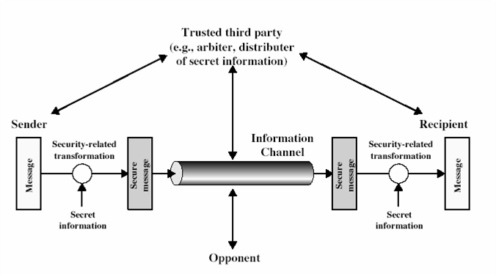
A MODEL FOR NETWORK SECURITY
A message that needs to be transferred from one party to another across some sort of internet must cooperate for the exchange of the message. The two parties i.e., the sender and receiver are also called as principals. For the transfer of messages,
A logical information channel needs to be established between the sender and the receiver.
communication protocols (e.g., TCP/IP) must be used by the sender and receiver.
A model for network security is shown in Figure 1.
Figure 1: Model for network security.

Slide 19
All the techniques for providing security have two components:
1. A security-related transformation on the information to be sent.
Examples:
the encryption of the message, which scrambles the message so that it is unreadable by the opponent,
addition of a code based on the contents of the message, which can be used to verify the identity of the sender
2. Some secret information shared by the two principals (sender and receiver)
Examples:
An Encryption key used along with the transformation to scramble the message before its transmission and unscramble it on reception.
A trusted third party may be needed to achieve secure transmission. For example, a third party may be responsible for distributing the secret information to the two principals while keeping it from any opponent.
Basic tasks in designing a particular security service:
Design an algorithm for performing the security-related transformation. The algorithm should be such that an opponent cannot defeat its purpose.
Generate the secret information to be used with the algorithm.
Develop methods for the distribution and sharing of the secret information.
Specify a protocol to be used by the two principals that makes use of the security algorithm and the secret information to achieve a particular security service.
The security mechanisms needed to cope with unwanted access is shown in Figure 2. The hacker is someone who simply gets satisfaction from breaking and entering a computer system. Viruses and worms are two examples of software attacks. Such attacks are introduced into a system by means of a disk that contains the unwanted logic provided along with useful software

Slide 20
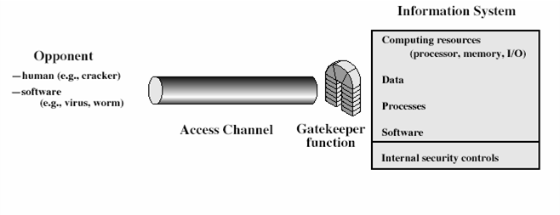
The gatekeeper function includes password-based login procedures that are designed to allow only authorized users and deny all others. The second level of security consists of a variety of internal security controls that detects the presence of unwanted intruders.
Figure 2: Network Access Security Model
Another type of unwanted access is the placement of logic in a computer system that that can affect application programs as well as utility programs, such as editors and compilers. Programs can present two kinds of threats:
Information access threats intercept or modify data on behalf of users who should not have access to that data.
Service threats exploit service flaws in computers to inhibit use by legitimate users.
Figure 2: Network Access Security Model

Slide 21
THE OSI SECURITY ARCHITECTURE
To assess the security needs of an organization effectively, the manager responsible for security needs some systematic way of defining the requirements for security and characterization of approaches to satisfy those requirements. One approach is to consider three aspects of information security:
Security attack – Any action that compromises the security of information owned by an organization.
Security mechanism – A mechanism that is designed to detect, prevent or recover from a security attack.
Security service – A service that enhances the security of the data processing systems and the information transfers of an organization. The services are intended to counter security attacks and they make use of one or more security mechanisms to provide the service.
SECURITY ATTACK
A useful means of classifying security attacks, used both in X.800 and RFC 2828, is in terms of passive attacks and active attacks. A passive attack attempts to learn or make use of information from the system but does not affect system resources. An active attack attempts to alter system resources or affect their operation.
Security attacks could be broadly categorized as
Passive attacks
Release of message contents
Traffic analysis
Active attacks
Masquerade (Fabrication)
Replay
Modification
Denial of service

Slide 22
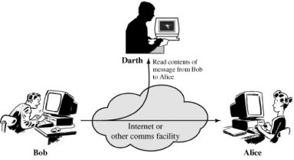
Passive attacks:
Passive attacks are in the nature of eavesdropping on, or monitoring of, transmissions. Passive attacks are very difficult to detect because they do not involve any alteration of data. However, it is feasible to prevent the success of these attacks. The goal of the opponent is to obtain information that is being transmitted.
Passive attacks are of two types:
Release of message contents: A telephone conversation, an e-mail message and a transferred file may contain sensitive or confidential information. We would like to prevent the opponent from learning the contents of these transmissions.
Figure 3: Release of message contents
2) Traffic analysis: Even though encryption protection exists in place, an opponent might still be able to observe the pattern of the message. The opponent could determine the location and identity of communication hosts and could observe the frequency and length of messages being exchanged. This information might be useful in guessing the nature of communication that was taking place

Slide 23
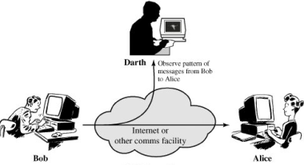
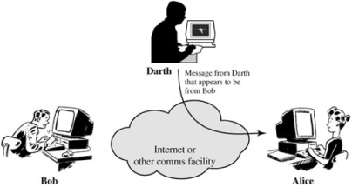
Figure 4: Traffic Analysis
Active attacks:
These attacks involve some modification of the data stream or the creation of a false stream. It is quite difficult to prevent active attacks absolutely, because to do so would require physical protection of all communication facilities and paths at all times. Instead, the goal is to detect them and to recover from any disruption or delays caused by them.
These attacks can be classified in to four categories:
Masquerade (Fabrication) – One entity pretends to be a different entity.
Figure 5: Masquerade

Slide 24
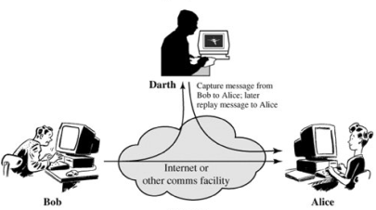
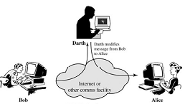
2) Replay – involves passive capture of a data unit and its subsequent transmission to produce an unauthorized effect.
Figure 6: Replay
3) Modification – Some portion of message is altered or the messages are delayed or recorded, to produce an unauthorized effect.
Figure 7: Modification
4) Denial of service – Prevents or inhibits the normal use or management of communication facilities. Another form of service denial is the disruption of an entire network, either by disabling the network or overloading it with messages so as to degrade performance.

Slide 25
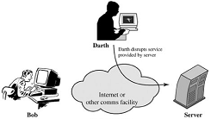
Figure 8: Denial of service
SECURITY SERVICES
X.800 defines a security service as a service provided by a protocol layer of communicating open systems, which ensures adequate security of the systems or of data transfers. As per RFC 2828, the definition is “ a processing or communication service that is provided by a system to give a specific kind of protection to system resources; security services implement security policies and are implemented by security mechanisms”.
The classification of security services are as follows:
1. Confidentiality: Ensures that the information in a computer system and transmitted information are accessible only for reading by authorized parties. Example: printing, displaying and other forms of disclosure.
2. Authentication: Ensures that the origin of a message or electronic document is correctly identified, with an assurance that the identity is not false. the function of the authentication service is to assure the recipient that the message is from the source that it claims to be from.

Slide 26
Two specific authentication services are defined in X.800:
Peer entity authentication: Provides for the corroboration of the identity of a peer entity in an association. It is provided for use at the establishment of, or at times during the data transfer phase of, a connection. It attempts to provide confidence that an entity is not performing either a masquerade or an unauthorized replay of a previous connection.
Data origin authentication: Provides for the corroboration of the source of a data unit. It does not provide protection against the duplication or modification of data units. This type of service supports applications like electronic mail where there are no prior interactions between the communicating entities.
3) Integrity: Ensures that only authorized parties are able to modify computer system assets and transmitted information. Modification includes writing, changing status, deleting, creating and delaying or replaying of transmitted messages.
4) Non repudiation: Requires that neither the sender nor the receiver of a message be able to deny the transmission.
5) Access control: Requires that access to information resources may be controlled by or the target system.
6) Availability: Requires that computer system assets be available to authorized parties when needed.
X.800 divides the security services into five categories and fourteen specific services
1) AUTHENTICATION:
The assurance that the communicating entity is the one that it claims to be.
Peer Entity Authentication: Used in association with a logical connection to provide confidence in the identity of the entities connected.

Slide 27
Data Origin Authentication: In a connectionless transfer, provides assurance that the source of received data is as claimed.
2 ) ACCESS CONTROL:
The prevention of unauthorized use of a resource (i.e., this service controls who can have access to a resource, under what conditions access can occur, and what those accessing the resource are allowed to do.
3)DATA CONFIDENTIALITY: The protection of data from unauthorized disclosure.
Connection Confidentiality: The protection of all user data on a connection.
Connectionless Confidentiality: The protection of all user data in a single data block.
Selective-Field Confidentiality: The confidentiality of selected fields within the user data on a connection or in a single data block.
Traffic Flow Confidentiality: The protection of the information that might be derived from observation of traffic flows.
4) DATA INTEGRITY:
The assurance that data received are exactly as sent by an authorized entity (i.e.,
contain no modification, insertion, deletion, or replay).
Connection Integrity with Recovery: Provides for the integrity of all user data on a connection and detects any modification, insertion, deletion, or replay of any data within an entire data sequence, with recovery attempted.
Connection Integrity without Recovery: As above, but provides only detection without recovery.
Selective-Field Connection Integrity: Provides for the integrity of selected fields within the user data of a data block transferred over a connection and takes the form of determination of whether the selected fields have been modified, inserted, deleted, or replayed.

Slide 28
Connectionless Integrity:
Provides for the integrity of a single connectionless data block and may take the form of detection of data modification. Additionally, a limited form of replay detection may be provided.
Selective-Field Connectionless Integrity:
Provides for the integrity of selected fields within a single connectionless data block; takes the form of determination of whether the selected fields have been modified.
5) NONREPUDIATION:
Provides protection against denial by one of the entities involved in a communication of having participated in all or part of the communication.
Nonrepudiation, Origin: Proof that the message was sent by the specified party.
Nonrepudiation, Destination: Proof that the message was received by the specified party.
SECURITY MECHANISMS
The security mechanisms defined by X.800 are divided into those that are implemented in a specific protocol layer, such as TCP or an application-layer protocol, and those that are not specific to any particular protocol layer or security service. X.800 distinguishes between reversible encipherment mechanisms and irreversible encipherment mechanisms.
A reversible encipherment mechanism is simply an encryption algorithm that allows data to be encrypted and subsequently decrypted. Irreversible encipherment mechanisms include hash algorithms and message authentication codes, which are used in digital signature and message authentication applications.

Slide 29
Specific security mechanisms are encipherment, digital signatures, access controls, data integrity, authentication exchange, traffic padding, routing control and notarization.
Pervasive security mechanisms are trusted functionality, security labels, event detection, security audit trails, security recovery.
SPECIFIC SECURITY MECHANISMS
Encipherment
The use of mathematical algorithms to transformdata into a form that is not readily intelligible. Thetransformation and subsequent recovery of thedata depend on an algorithm and zero or moreencryption keys.
Digital Signature
Data appended to, or a cryptographic transformationof, a data unit that allows a recipient of the data unitto prove the source and integrity of the data unit and protect against forgery (e.g., by the recipient).
Access Control
A variety of mechanisms that enforce access rights toresources.
Data Integrity
A variety of mechanisms used to assure the integrityof a data unit or stream of data units.

Slide 30
Authentication Exchange
A mechanism intended to ensure the identity of anentity by means of information exchange.
Traffic Padding
The insertion of bits into gaps in a data stream tofrustrate traffic analysis attempts.
Routing Control
Enables selection of particular physically secureroutes for certain data and allows routing changes,especially when a breach of security is suspected.
Notarization
The use of a trusted third party to assure certainproperties of a data exchange.
PERVASIVE SECURITY MECHANISMS
Trusted Functionality
That which is perceived to be correct with respectto some criteria (e.g., as established by a securitypolicy).
Security Label
The marking bound to a resource (which may be adata unit) that names or designates the security attributes of that resource.

Slide 31
Event Detection
Detection of security-relevant events.
Security Audit Trail
Data collected and potentially used to facilitate asecurity audit, which is an independent review and examination of system records and activities.
Security Recovery
Deals with requests from mechanisms, such as eventhandling and management functions, and takes recovery actions.
Classical encryption techniques
Cryptographic systems are characterized along three independent dimensions:
The type of operations used for transforming plaintext to ciphertext.
All encryption algorithms are based on two general principles:
Substitution, in which each element in the plaintext (bit, letter, group of bits or letters) is mapped into another element, and
Transposition, in which elements in the plaintext are rearranged. The fundamental requirement is that no information be lost (that is, that all operations are reversible). Most systems, referred to as product systems, involve multiple stages of substitutions and transpositions.
2. The number of keys used.
Symmetric encryption : If both sender and receiver use the same key, the system is referred to as symmetric, single-key, secret-key, or conventional encryption.
Asymmetric encryption: If the sender and receiver use different keys, the system is referred to as asymmetric, two-key, or public-key encryption.

Slide 32
3. The way in which the plaintext is processed.
Block cipher processes the input one block of elements at a time, producing an output block for each input block.
Stream cipher processes the input elements continuously, producing output one element at a time, as it goes along.
Some basic concepts are defined below:
Cryptography : The art or science encompassing the principles and methods of transforming an intelligible message into one that is unintelligible, and then retransforming that message back to its original form .
Plaintext : The original intelligible message
Cipher text: The transformed message
Cipher : An algorithm for transforming an intelligible message into one that is unintelligible by transposition and/or substitution methods
Key: Some critical information used by the cipher, known only to the sender& receiver
Encipher (encode) : The process of converting plaintext to cipher text using a cipher and a key
Decipher (decode) : the process of converting cipher text back into plaintext using a cipher and a key
Cryptanalysis : The study of principles and methods of transforming an unintelligible message back into an intelligible message without knowledge of the key. Also called code breaking
Cryptology : Both cryptography and cryptanalysis

Slide 33
SYMMETRIC CIPHER MODEL
A symmetric encryption scheme has five ingredients :
Plaintext: This is the original intelligible message or data that is fed into the algorithm as input.
Encryption algorithm: The encryption algorithm performs various substitutions and transformations on the plaintext.
Secret key: The secret key is also input to the encryption algorithm.The key is a value independent of the plaintext and of the algorithm. The algorithm will produce a different output depending on the specific key being used at the time. The exact substitutions and transformations performed by the algorithm depend on the key.
Ciphertext: This is the scrambled message produced as output. It depends on the plaintext and the secret key. For a given message, two different keys will produce two different ciphertexts. The ciphertext is an apparently random stream of data and, as it stands, is unintelligible.
Decryption algorithm: This is essentially the encryption algorithm run in reverse. It takes the ciphertext and the secret key and produces the original plaintext.
Here the original message, referred to as plaintext, is converted into apparently random nonsense, referred to as cipher text. The encryption process consists of an algorithm and a key. The key is a value independent of the plaintext. Changing the key changes the output of the algorithm. Once the cipher text is produced, it may be transmitted. Upon reception, the cipher text can be transformed back to the original plaintext by using a decryption algorithm and the same key that was used for encryption.

Slide 34
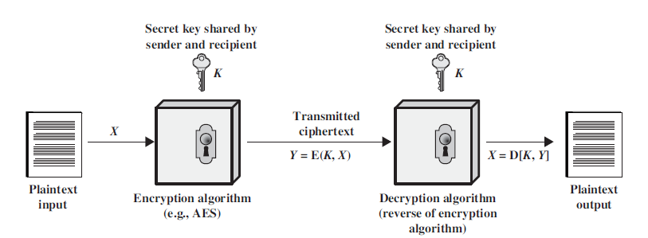
The security depends on several factors. First, the encryption algorithm must be powerful enough that it is impractical to decrypt a message on the basis of cipher text alone. Beyond that, the security depends on the secrecy of the key, not the secrecy of the algorithm.
Two requirements for secure use of symmetric encryption:
a strong encryption algorithm
a secret key known only to sender / receiver
Y = E_{K}(X)
X = D_{K}(Y)
assume encryption algorithm is known
implies a secure channel to distribute key
Figure : Simplified Model of Symmetric Encryption
A source produces a message in plaintext, X = [X1, X2, … , XM] where M are the number of letters in the message. A key of the form K = [K1, K2, …, KJ] is generated. If the key is generated at the source, then it must be provided to the destination by means of some secure channel.

Slide 35
With the message X and the encryption key K as input, the encryption algorithm forms the cipher text Y = [Y1, Y2, …, YN]. This can be expressed as
Y = E_{K}(X)
The intended receiver, in possession of the key, is able to invert the transformation:
X = D_{K}(Y)
An opponent, observing Y but not having access to K or X, may attempt to recover X or K or both. It is assumed that the opponent knows the encryption and decryption algorithms. If the opponent is interested in only this particular message, then the focus of effort is to recover X by generating a plaintext estimate. Often if the opponent is interested in being able to read future messages as well, in which case an attempt is made to recover K by generating an estimate. The essential elements of a symmetric encryption scheme is shown in the figure below:
Figure: Model of Symmetric Cryptosystem

Slide 36
Cryptanalysis
The process of attempting to discover X or K or both is known as cryptanalysis. The strategy used by the cryptanalysis depends on the nature of the encryption scheme and the information available to the cryptanalyst.
There are various types of cryptanalytic attacks based on the amount of information known to the cryptanalyst.
Cipher text only – A copy of cipher text alone is known to the cryptanalyst.
Known plaintext – The cryptanalyst has a copy of the cipher text and the corresponding plaintext.
Chosen plaintext – The cryptanalysts gains temporary access to the encryption machine. They cannot open it to find the key, however; they can encrypt a large number of suitably chosen plaintexts and try to use the resulting cipher texts to deduce the key.
Chosen cipher text – The cryptanalyst obtains temporary access to the decryption machine, uses it to decrypt several string of symbols, and tries to use the results to deduce the key.
Chosen text: Plaintext message chosen by cryptanalyst, with its corresponding ciphertext generated, purported ciphertext chosen by cryptanalyst, with its corresponding decrypted plaintext.
SUBSTITUTION TECHNIQUES
1. Caesar cipher (or) shift cipher
2. Playfair cipher
3. Hill cipher
4. Polyalphabetic ciphers
4.1 Vigenere cipher
4.2 Vernam cipher
4.3 One Time Pad cipher
TRANSPOSITION TECHNIQUES
1. Rail fence
2. Row Transposition Ciphers

Slide 37
A substitution technique is one in which the letters of plaintext are replaced by other letters or by numbers or symbols. If the plaintext is viewed as a sequence of bits, then substitution involves replacing plaintext bit patterns with cipher text bit patterns.
Caesar cipher (or) Shift cipher
The earliest known use of a substitution cipher and the simplest was by Julius Caesar. The Caesar cipher involves replacing each letter of the alphabet with the letter standing 3 places further down the alphabet.
Example 1:
Plain text: pay more money
Cipher text: SDB PRUH PRQHB
Example 2:
Plain text : Return to home
Cipher text : UHWXUQ WR KRPH
Note that the alphabet is wrapped around, so that letter following ‘z’ is ‘a’.
For each plaintext letter p, substitute the cipher text letter c such that
C = E(P) = (P+3) mod 26
A shift may be any amount, so that general Caesar algorithm is
C = E(P) = (P+k) mod 26
Where k takes on a value in the range 1 to 25. The decryption algorithm is simply
P = D(C) = (C-k) mod 26
Disadvantages
The encryption and decryption algorithm are known.
There are only 25 keys to try.
The language of the plain text is known

Slide 38
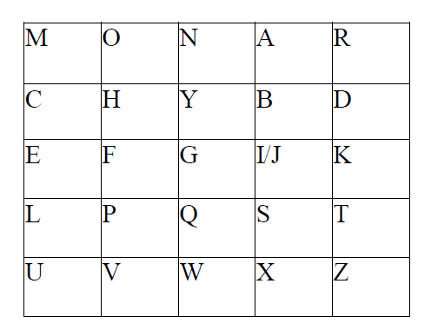
Playfair cipher
The best known multiple letter encryption cipher is the playfair, which treats digrams in the plaintext as single units and translates these units into cipher text digrams. The playfair algorithm is based on the use of 5x5 matrix of letters constructed using a keyword. Let the keyword be ‘monarchy’. The matrix is constructed by filling in the letters of the keyword (minus duplicates) from left to right and from top to bottom, and then filling in the remainder of the matrix with the remaining letters in alphabetical order. The letter ‘i’ and ‘j’ count as one letter. Plaintext is encrypted two letters at a time according to the following rules:
Repeating plaintext letters that would fall in the same pair are separated with a filler letter such as ‘x’.
Plaintext letters that fall in the same row of the matrix are each replaced by the letter to the right, with the first element of the row following the last.
Plaintext letters that fall in the same column are replaced by the letter beneath, with the top element of the column following the last.
Otherwise, each plaintext letter is replaced by the letter that lies in its own row and the column occupied by the other plaintext letter.
Example:
Plaintext = meet me at the school house
Splitting two letters as a unit =>me et me at th es ch ox ol ho us ex
Corresponding cipher text => CL KL CL RS PD IL HY AV MP HF XL IU

Slide 39
Example 2:
Plain text : Balloon
Repeating plain text letter that fall in the same pair are repeated with the filler letter ‘X’.
Plain text : ba lx lo on
Cipher text : IB SU PM NA
Strength of playfair cipher
Playfair cipher is a great advance over simple mono alphabetic ciphers.
Since there are 26 letters, 26x26 = 676 diagrams are possible, so identification of individual digram is more difficult.
Frequency analysis is much more difficult.
Advantage
It is difficult to identify particular diagrams.
Frequency analysis is more difficult.
Disadvantages
It is relatively easy to be broken.
The sufficient number of cipher text letter is very small.
Hill Cipher
Hill cipher is a poly-graphic substitution cipher based on linear algebra.
Hill used matrices and matrix multiplication to mix up the plain text.
Each letter is represented by a number modulo 26.
To encrypt a message, each block of ‘n’ letters is multiplied by an invertible n x n matrix, again modulus 26.
To decrypt the message, each block is multiplied by the inverse of the matrix used for encryption.

Slide 40
Example:

Slide 41
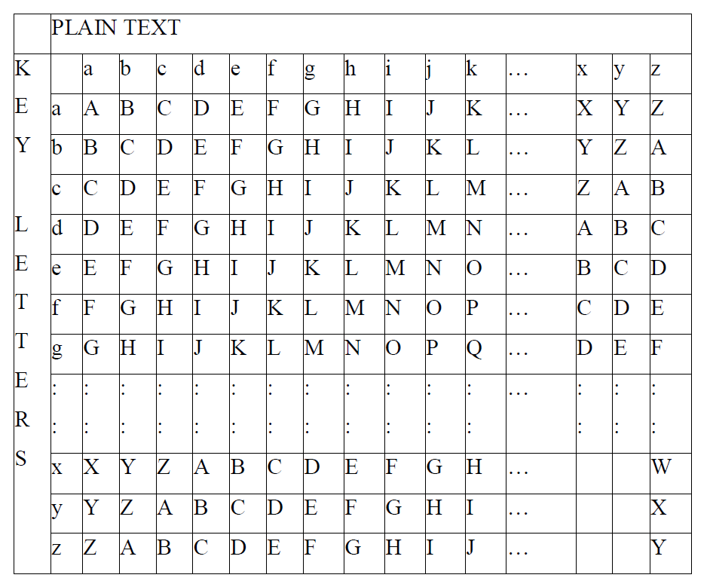
Polyalphabetic ciphers
Another way to improve on the simple monoalphabetic technique is to use different monoalphabetic substitutions as one proceeds through the plaintext message. The general name for this approach is polyalphabetic cipher. All the techniques have the following features in common.
A set of related monoalphabetic substitution rules are used
A key determines which particular rule is chosen for a given transformation.
To encrypt a message, a key is needed that is as long as the message, ignoring spaces and punctuation.
Example:
Plain text : Good Morning
Key : text
Solution : G o o d M o r n i n g
T e x t t e x t t e x
Cipher text : z s l w f s o g b r d
To encrypt, pick the letter in the plain text and its corresponding letter in the keyword. The plain text is considered as row index and the keyword letter as column index.

Slide 42
Here in the above example letter ‘G’ from row and letter ‘T’ from colum intersects and produces the letter ‘Z’.
For decryption, pick the letter from the keyword as column index and search for the cipher text. The intersection of corresponding row gives the plain text.
In our example letter ‘t ’ is considered as column index searching for cipher text z’. The corresponding row index produces the plain text ‘g’.
Cipher text : zslw fsogbrd
Key : text texttex
Plain text : Good morning
Advantage
Multiple cipher text letters are used for each plain text letters.
Vernam Cipher
The ultimate defense against such a cryptanalysis is to choose akeyword that is as long as the plaintext and has no statistical relationship to it. This cipher works on binary data (bits) rather than letters. The system can beexpressed succinctly as follows :
ci= pi ki
where
pi= ith binary digit of plaintext
ki= ith binary digit of key
ci= ith binary digit of ciphertext
= exclusive-or (XOR) operation
Thus, ciphertext is generated by performing the bitwise XOR of the plaintextand the key. Because of the use of the properties of the XOR, decryption simply involves the same bitwise operation:
pi= ci ki

Slide 43
Example:
Plaintext = 0 0 1 0 1 0 0 1
Key = 1 0 1 0 1 1 0 0
-------------------
Ciphertext = 1 0 0 0 0 1 0 1
One Time Pad Cipher:
An Army Signal Corp officer, Joseph Mauborgne, proposed an improvement to the Vernam cipher that yields the ultimate in security. Mauborgne suggested using a random key that is as long as the message, so that the key need not be repeated. In addition, the key is to be used to encrypt and decrypt a single message, and then is discarded. Each new message requires a new key of the same length as the new message. Such a scheme, known as a one-time pad, is unbreakable.
It produces random output that bears no statistical relationship to the plaintext. Because the ciphertext contains no information whatsoever about the plaintext, there is simply no way to break the code.
Suppose that we are using a Vigenère scheme with 27 characters in which the twenty-seventh character is thespace character, but with a one-time key that is as long as the message.
Consider the ciphertext
ANKYODKYUREPFJBYOJDSPLREYIUNOFDOIUERFPLUYTS
Two different decryptions using two different keys:
Ciphertext: ANKYODKYUREPFJBYOJDSPLREYIUNOFDOIUERFPLUYTS
Key: pxlmvmsydofuyrvzwctnlebnecvgdupahfzzlmnyih
Plaintext: mr mustard with the candlestick in the hall

Slide 44
Ciphertext: ANKYODKYUREPFJBYOJDSPLREYIUNOFDOIUERFPLUYTS
Key: pftgpmiydgaxgoufhklllmhsqdqogtewbqfgyovuhwt
Plaintext: miss scarlet with the knife in the library.
Advantage
It is a highly source method because it generates random keys
Disadvantages
Sending the key securely is a problem.
Randomness is also a disadvantage.
TRANSPOSITION TECHNIQUES
All the techniques examined so far involve the substitution of a cipher text symbol for a plaintext symbol. A very different kind of mapping is achieved by performing some sort of permutation on the plaintext letters. This technique is referred to as a transposition cipher.
Rail fence:
It is simplest of such cipher, in which the plaintext is written down as a sequence of diagonals and then read off as a sequence of rows.
Plaintext = meet at the school house
To encipher this message with a rail fence of depth 2, the message is written as follows:
m e a t e c o l o s
e t t h s h o h u e
The encrypted message is
MEATECOLOSETTHSHOHUE

Slide 45
Row Transposition Cipher:
A more complex scheme is to write the message in a rectangle, row by row, and read the message off, column by column, but permute the order of the columns. The order of columns then becomes the key of the algorithm.
Example:
Plaintext = meet at the school house
Key = 4 3 1 2 5 6 7
Plaintext = m e e t a t t
h e s c h o o
l h o u s e z
Cipertext = ESOTCUEEHMHLAHSTOETOZ
STEGANOGRAPHY
A plaintext message may be hidden in any one of the two ways. The methods of steganography conceal the existence of the message, whereas the methods of cryptography render the message unintelligible to outsiders by various transformations of the text. A simple form of steganography, but one that is time consuming to construct is one in which an arrangement of words or letters within an apparently innocuous text spells out the real message. e.g., (i) the sequence of first letters of each word of the overall message spells out the real (hidden) message. (ii) Subset of the words of the overall message is used to convey the hidden message. Various other techniques have been used historically, some of them are
Character marking – selected letters of printed or typewritten text are overwritten in pencil. The marks are ordinarily not visible unless the paper is held to an angle to bright light.

Slide 46
Invisible ink – a number of substances can be used for writing but leave no visible trace until heat or some chemical is applied to the paper.
Pin punctures – small pin punctures on selected letters are ordinarily not visible unless the paper is held in front of the light.
Typewritten correction ribbon – used between the lines typed with a black ribbon, the results of typing with the correction tape are visible only under a strong light.
Drawbacks of Steganography
Requires a lot of overhead to hide a relatively few bits of information.
Once the system is discovered, it becomes virtually worthless.

Slide 47

MODERN CRYPTOGRAPHY
Modern cryptography is the cornerstone of computer and communications security. Its foundation is based on various concepts of mathematics such as number theory, computational-complexity theory, and probability theory.
Classic Cryptography | Modern Cryptography
It manipulates traditional characters, i.e., letters and digits directly. | It operates on binary bit sequences.
It is mainly based on ‘security through obscurity’. | It relies on publicly known mathematical algorithms for coding the information.
It requires the entire cryptosystem for communicating confidentially. | Modern cryptography requires parties interested in secure communication to possess the secret key only.

Slide 48
INFORMATION THEORY
The term information theory refers to a remarkable field of study developed by Claude Shannon in 1948.
Shannon was concerned with ``messages'' and their transmission, even in the presence of ``noise''.
Shannon defined a mathematical quantity called entropy which measures the amount of information in a message, if the message is one of a collection of possible messages, each with its own probability of occurrence. This entropy is the average number of bits needed to represent each possible message, using the best possible encoding. If there are n messages X = {X1, ... , Xn}, with probabilities of occurrence: p(X1), ... , p(Xn) (with sum equal 1), then the entropy H(X) of this set of messages is:
H(X) = p(X1) log2(1/p(X1)) + ... + p(Xn) log2(1/p(Xn)).
Intuitively, the entropy is just the weighted average of the number of bits required to represent each message, where the weights are the probabilities that each message might occur.
Law ENTROPY1: The entropy of a message is just the number of bits of information in the message, that is, the number of bits needed for the shortest possible encoding of the message.
It is possible to list reasonable properties of any entropy function and to prove that only the above formula gives a function with those properties

Slide 49
For example, if we have two messages X = {male, female}, each having probability 1/2, then the entropy is
H(X) = (1/2)(log2(1/(1/2)) + (1/2)(log2(1/(1/2)) = 1/2 + 1/2 = 1.
Thus in this case, as we would intuitively expect, there is one bit of information in such a message.
Suppose p(X1) = 1 and the remaining probabilities are zero. In this case the entropy works out to be 0 as one would expect, since one is only going to receive the message X1, so there is no information and no surprise in receiving this message. The actual message X1 might be complex, with many bits representing it, but its probability is 1, so only this message can occur, with no information or ``surprise'' on its receipt, even if it is complex.
As another example, suppose n = 3 and p(X1) = 1/2, p(X2) = 1/4, and p(X3) = 1/4. Then the entropy works out to be 1.5. It is possible to encode these messages as follows: X1: 0, X2: 10, and X3: 11. In this case the average code length is the same as the entropy. O
Finally, suppose there are 1000 equally probably messages. Then the entropy is:
H(X) = (1/1000)(log2(1/(1/1000)) + ... + (1/1000)(log2(1/(1/1000)) = (1/1000)log2(1000) + ... + (1/1000)log2(1000) = 1000 (1/1000) log2(1000) = log2(1000) = 9.965784285.
Thus the entropy value of these messages means that there are nearly 10 bits of information in each message. Similarly, if there are n equally likely messages, then the entropy of a message is log2n. The equal probable case gives the largest possible value for the entropy of a collection of messages.
Law ENTROPY2: A random message has the most information (the greatest entropy).

Slide 50
The Three Kinds of Codes.
The terms code and coding refer to ways of representing information. Here the term binary codes is used, that is, codes that use only the binary bits 0 and 1. There are three kinds of coding:
Source Coding: This usually involves data compression: representing the data with as few bits as possible. Notice that one always needs at least as many bits to encode a message as the entropy of the message. Example: The Huffman Code.
Channel Coding: Here one uses error detection and error correction to improve the reliability of the channel. This is accomplished by adding extra redundant bits. The rest of this chapter presents material on channel capacity and error correction codes. Example: The Hamming Code.
Secrecy Coding. For secrecy, one uses cryptography to scramble the message so that it may not be intelligible to an eavesdropper.
Law INFORMATION1:
In all coding theory, information transmission is essentially the same as information storage, since the latter is just transmission from now to then.
It's possible to have a single code that combines two or even all three of these functions, but the codes are usually kept separate. Normally one would compress a message (making the message smaller, to save storage or channel bandwidth), then transform it cryptographically for secrecy (without changing the message length), and finally add bits to the message to allow for error detection or correction.
Channel Capacity.
Shannon also introduced the concept of channel capacity, which is the maximum rate at which bits can be sent over an unreliable (noisy) information channel with arbitrarily good reliability.

Slide 51
The channel capacity is represented as a fraction or percentage of the total rate at which bits can be sent physically over the channel. Shannon proved that there always exist codes that will signal arbitrarily close to the channel capacity with arbitrarily good reliability.
Thus by choosing a larger and more complicated code, one can reduce the number of errors to as small a percentage as one would like, while continuing to signal as close as one wants to 100% of the channel capacity.
In practice the theory does not provide these good codes, though they are known to exist. It is not possible to signal with arbitrarily good reliability at a rate greater than the channel capacity.
The simplest example of such a channel is the binary symmetric channel. Here every time a bit is transmitted, there is a fixed probability p, with 0 <= p <= 1 such that a transmitted 0 is received as a 0 with probability p and received as a 1 with probability 1 - p. The errors occur at random.
For example, if p = 1 there are no errors at all on the channel, and the channel capacity is 1 (meaning 100%). If p = 0, the capacity is still 1 as long as you realize that all bits are reversed. If p = 0.5, then on receipt of a bit, both 0 and 1 are equally likely as the bit that was sent, so one can never say anything about the original message. In this case the channel capacity is 0 and no information can be sent over the channel.
For binary symmetric channels there is a simple formula for the capacity C
C = 1 + p log2(p) + (1 - p) log2(1 - p).
Alternatively, one can write this formula as:
C = 1 - H(X),
where X consists of two messages with probabilities p and 1 - p. This formula gives the amount of information lost during transmission on this noisy channel.

Slide 52
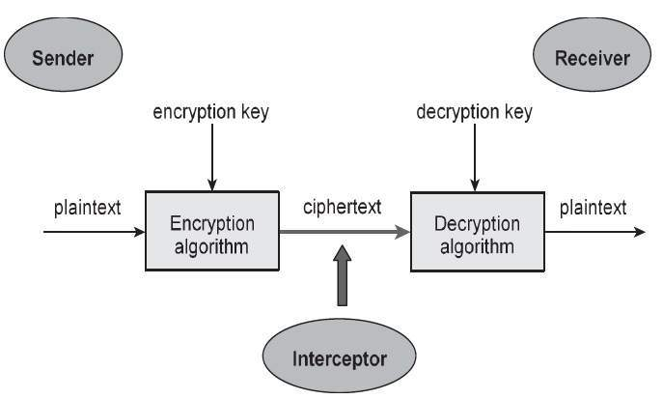
PRODUCT CRYPTOSYSTEM
A cryptosystem is an implementation of cryptographic techniques and their accompanying infrastructure to provide information security services.
A cryptosystem is also referred to as a cipher system.
Figure: Cryptosystem
Objectives of Cryptosystem
The objective of this simple cryptosystem is that
At the end of the process, only the sender and the receiver will know the plaintext.
A sender who wants to transfer some sensitive data to a receiver in such a way that any party intercepting or eavesdropping on the communication channel cannot extract the data.

Slide 53
Components of a Cryptosystem
Plaintext: It is the data to be protected during transmission.
Encryption Algorithm: It is a mathematical process that produces a ciphertext for any given plaintext and encryption key. It is a cryptographic algorithm that takes plaintext and an encryption key as input and produces a ciphertext.
Ciphertext : It is the scrambled version of the plaintext produced by the encryption algorithm using a specific encryption key. The ciphertext is not guarded. It flows on public channel. It can be intercepted or compromised by anyone who has access to the communication channel
Decryption Algorithm: It is a mathematical process, that produces a unique plaintext for any given ciphertext and decryption key. It is a cryptographic algorithm that takes a ciphertext and a decryption key as input, and outputs a plaintext. The decryption algorithm essentially reverses the encryption algorithm .
Encryption Key: It is a value that is known to the sender. The sender inputs the encryption key into the encryption algorithm along with the plaintext in order to compute the ciphertext.
Decryption Key: It is a value that is known to the receiver. The decryption key is related to the encryption key, but is not always identical to it. The receiver inputs the decryption key into the decryption algorithm along with the ciphertext in order to compute the plaintext.
Key space : For a given cryptosystem, a collection of all possible decryption keys is called a key space.
An interceptor (an attacker) is an unauthorized entity who attempts to determine the plaintext. He can see the ciphertext and may know the decryption algorithm. The attacker, however, must never know the decryption key.

Slide 54
Product cryptosystem : Product cryptosystem is a block cipher that repeatedly performs substitutions and permutations, one after the other, to produce ciphertext.
CRYPTANALYSIS
Cryptanalysis is the science of cracking codes and decoding secrets. It is used to violate authentication schemes, to break cryptographic protocols, and, to find and correct weaknesses in encryption algorithms.
It may be used in information warfare applications - for example, forging an encrypted signal to be accepted as authentic. Competitors who have been able to discover the key will now want to use it to their advantage, therefore they will want to send bogus encrypted messages to the source in order to gain information or gain an advantage. It could also be used to pretend to be the source in order to send bogus information to others, who now will think that it came from the official source.
Among the types of attacks are:
Ciphertext only attacks
Known plaintext attacks
Chosen plaintext attacks
Chosen ciphertext attacks
Man-in-the-middle attacks
Side channel attacks
Brute force attacks
Birthday attacks

Slide 55
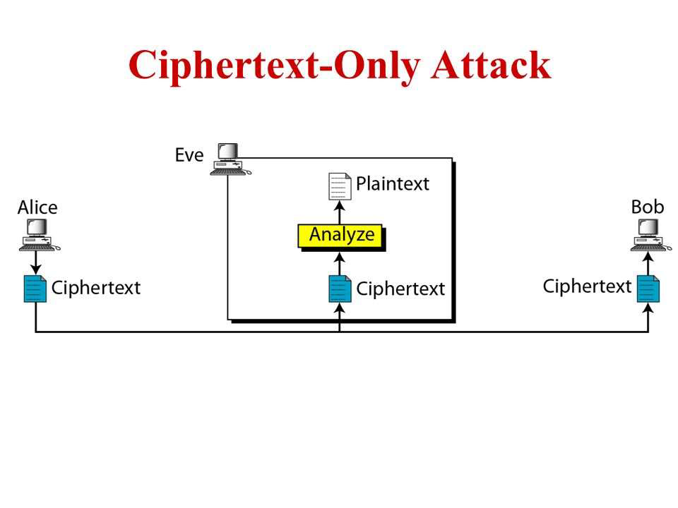
There are also a number of other technical and non-technical cryptography attacks to which systems can fall victim. Cryptanalytic attacks can be mounted not only against encryption algorithms, but also against digital signature algorithms, MACing algorithms and pseudo-random number generators.
Cipher-text only attack
A ciphertext only attack (COA) is a case in which only the encrypted message is available for attack, but because the language is known, a frequency analysis could be attempted. In this situation the attacker does not know anything about the contents of the message, and must work from ciphertext only
The attacker only has access to one or more encrypted messages but knows nothing about the
plaintext data
the encryption algorithm being used
any data about the cryptographic key being used
This is the type of challenge that intelligence agencies often face when they have intercepted encrypted communications from an opponent
Figure: Cipher-text only attack

Slide 56
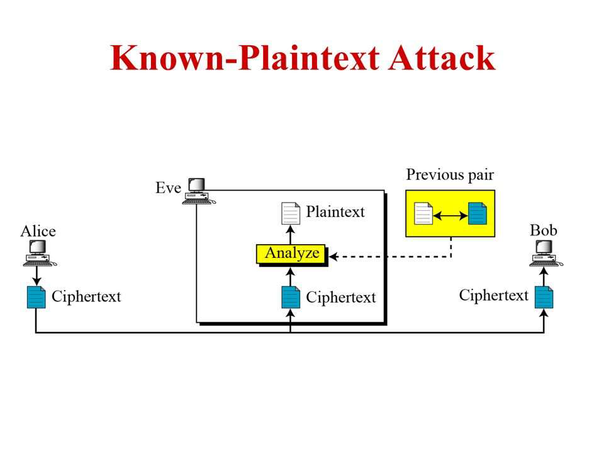
Known plaintext attack
In a known plaintext attack (KPA) both the plaintext and matching ciphertext are available for use in discovering the key.
The analyst may have access to some or all of the plaintext of the ciphertext.
The analyst's goal in this case is to discover the key used to encrypt the message and decrypt the message.
Once the key is discovered, an attacker can decrypt all messages that had been encrypted using that key.
Figure: Known plaintext attack
Chosen plaintext attack
A chosen plaintext attack (CPA) occurs when the attacker gains access to the target encryption device - if, for example, it is left unattended. The attacker then runs various pieces of plaintext though the device for encryption. This is compared to the plaintext to attempt to derive the key.
The analyst either knows the encryption algorithm or has access to the device used to do the encryption.
The analyst can encrypt the chosen plaintext with the targeted algorithm to derive information about the key

Slide 57
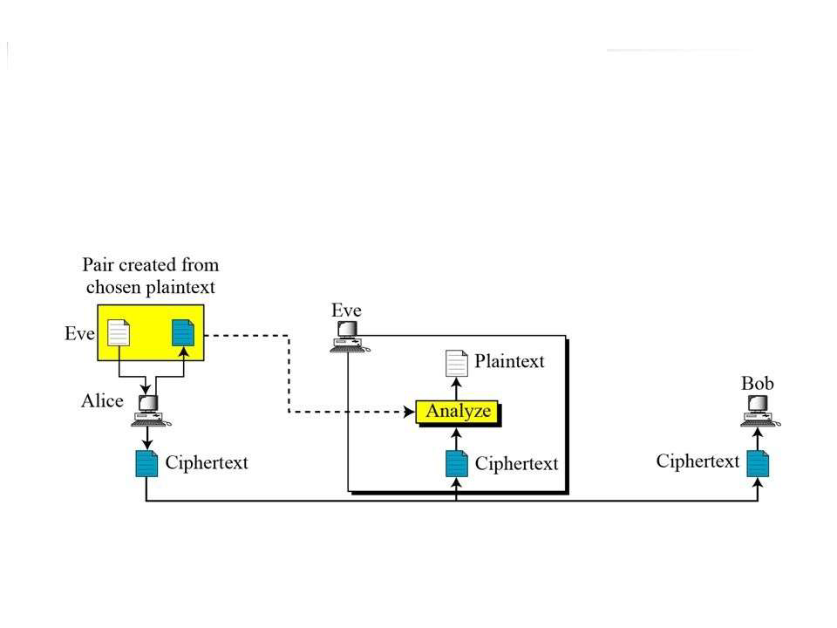
Figure: Chosen plaintext attack
Chosen Ciphertext Attack
In a chosen ciphertext attack (CCA), the cryptanalyst can choose different cipher texts to be decrypted and has access to the decrypted plaintext. This type of attack is generally applicable to attacks against public key cryptosystems. An adaptive chosen ciphertext attack involves the attacker selecting certain cipher texts to be decrypted, then using the results of these decryptions to select subsequent cipher texts. The modifications in the ciphertext help in deciphering the key from the decryptions.
Man-in-the-Middle Attack
Cryptographic communications and key exchange protocols are susceptible to an attack in which the attacker is able to place himself on the communication line between two parties.

Slide 58
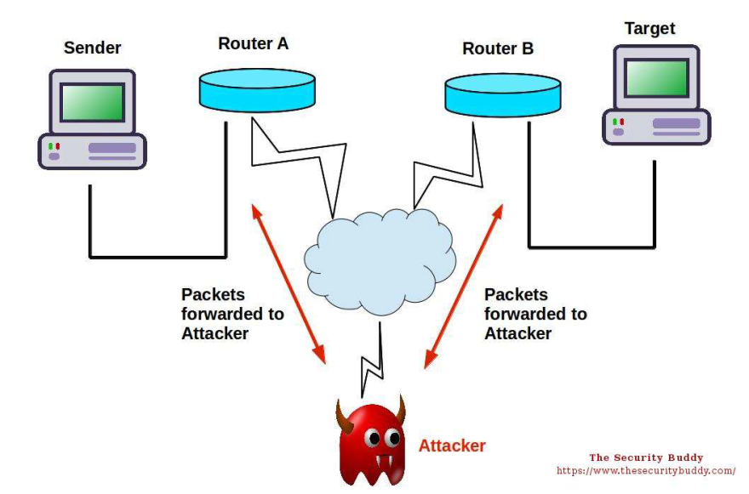
In this "man-in-the-middle attack" the attacker is able to position himself to intercept the key exchange between two parties. He performs his own key exchange with each. Then, with both parties thinking they have set up a secure channel, the attacker decrypts any communications with the proper key, and encrypts them with the other key for sending to the other party. The parties think that they are communicating securely, but in fact the adversary is reading everything.
Figure: man-in-the-middle attack
Preventing a man-in-the-middle attacks is possible if both sides compute a cryptographic hash function of the key exchange, sign it using a digital signature algorithm, and send the signature to the other side. The recipient then verifies that the hash matches the locally computed hash and the signature came from the desired other party.

Slide 59
Side Channel Attacks
Side channel attacks are a type of attacks based on implementation details such as timing, power, and radiation emissions. By carefully measuring the amount of time required to perform private key operations, attackers may be able to find fixed Diffie-Hellman exponents, factor RSA keys, and break other cryptosystems.
Against a vulnerable system, the attack is computationally inexpensive and often requires only known ciphertext. Actual systems are potentially at risk, including cryptographic tokens, network-based cryptosystems, and other applications where attackers can make reasonably accurate timing measurements.
Differential power analysis (DPA)
Differential power analysis (DPA) describes a new class of attacks against smart cards and secure cryptographic tokens. Discovered by researchers at Cryptography Research in San Francisco, DPA attacks exploit characteristic behaviors of transistor logic gates and software running on today's smart cards and other cryptographic devices. The attacks are performed by monitoring the electrical activity of a device, then using advanced statistical methods to determine secret information (such as secret keys and user PINs) in the device.
Brute force attack
A brute force attack is any type of attack that involves trying every possible combination of characters or data in order to find the key in order to decrypt an encrypted message.
A brute force attack is usually used as a last-resort tactic in a cryptanalysis scenario, as it very much involves extreme amounts of trial and error.

Slide 60
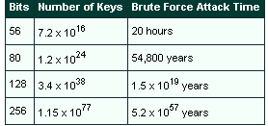
A brute force attack involves trying all possible keys until hitting on the one that results in plaintext. This can involve significant costs related to the amount of processing required to try quadrillions (in the case of DES) of keys. The time required is a factor of how many keys can be tried per unit of time, which is a factor of how many computers can be assigned to the task in parallel.
The table below shows the times required for a brute force attack on various key lengths using "Deep Crack" technology.
Deep Crack technology was developed in 1998 by the EFF (Electronic Frontier Foundation). They built a machine called the Deep Crack capable of trying a million DES keys per microsecond against a readable ASCII string hours to try all possible keys. In theory, its success in cracking DES makes DES worthless. In practice, however, by using cipher block chaining, doing any initial scrambling of the data and/or doing it three times in a row (triple DES), it can still be fairly difficult to crack.

Slide 61
Attacks on Symmetric Block Ciphers
Four types of attacks are normally used against symmetric block ciphers such as DES and RC5:
Differential Cryptanalysis
Linear Cryptanalysis
Differential Linear Cryptanalysis
Algebraic Attacks
Differential cryptanalysis is a chosen plaintext attack that relies on analysis of the differences between two related plaintexts as they are encrypted with the same key. The correct key is identified by examining probabilities of each key. Linear cryptanalysis, a known plaintext attack, uses linear approximation to describe behavior of the block cipher. Given sufficient pairs of plaintext and corresponding ciphertext, bits of information about the key can be obtained. Differential linear cryptanalysis is a combination of differential and linear cryptanalysis. Algebraic attacks analyze vulnerabilities in the mathematics of the algorithm.
Other Types of Cryptographic Attacks
Other types of cryptographic attacks include analytic, statistical and implementation.
Analytic attacks use algorithm and algebraic manipulation weakness to reduce complexity. Two examples are an RSA factoring attack and a Double DES attack.
Statistical attacks involve using statistical weakness in design, such as more 1s than 0s in the keystream.
Implementation attacks exploit weakness in the implementation of the encryption protocol. An example is the 1995 attack on the Netscape key, which had deficient key randomization. Static WEP (wireless equivalent privacy) is similarly subject to attack because of the relatively short initialization vectors that may be reused.

Slide 62
To protect against such attacks, the algorithm must be very strong (some vendor algorithms are not), the key needs to be very random without any bias (no patterns), and the implementation must be in accordance with good cryptographic concepts.
Non-Technical Cryptographic Attacks
Not all system attacks involve sophisticated cryptanalysis or major computing power. The people who use and run systems are themselves subject to attack - and these are often the most successful.
"Purchase key" attack is another term for bribery.
"Rubber hose cryptanalysis" means gaining access to a system through a physical assault on a user.
Social engineering involves convincing someone, usually through subterfuge, to divulge their password or other persona or confidential information.

Slide 63
Assignment
Using Vigenere cipher, encrypt CRYPTOGRAPHY using the key SECRET
Use the key phrase NETWORK SECURITY to construct the Playfair key matrix. Using the matrix, encrypt the following quote by Mark Twain: ALL GENERALIZATIONS ARE FALSE INCLUDING THIS ONE
Write a program that performs encryption/decryption based on the Caesar cipher
Real life case study
Do you think that necessity of keeping files secure arises more during COVID lockdown?
Healthcare finds a vital role for cryptography. Justify.

Slide 64
TWO MARKS Q & A
Define cryptography .(CO1,K1)
Cryptography is associated with the process of converting ordinary plain text into unintelligible text and vice-versa. It is a method of storing and transmitting data in a particular form so that only those for whom it is intended can read and process it. Cryptography not only protects data from theft or alteration, but can also be used for user authentication.
Define cryptanalysis. (CO2,K1)
Techniques used for deciphering a message without any knowledge of the enciphering details fall into the area of cryptanalysis. Cryptanalysis is what the layperson calls “breaking the code.”
Define security Attack, mechanism and service. (CO1,K1)
Security attack: Any action that compromises the security of information owned by an organization.
Security mechanism: A process (or a device incorporating such a process) that is designed to detect, prevent, or recover from a security attack.
Security service: A processing or communication service that enhances the security of the data processing systems and the information transfers of an organization. The services are intended to counter security attacks, and they make use of one or more security mechanisms to provide the service.

Slide 65
Distinguish Threat and Attack .(CO1,K1)
Threat -A potential for violation of security, which exists when there is a circumstance, capability, action, or event that could breach security and cause harm. That is, a threat is a possible danger that might exploit vulnerability.
Attack -An assault on system security that derives from an intelligent threat; that is, an intelligent act that is a deliberate attempt (especially in the sense of a method or technique) to evade security services and violate the security policy of a system.
Differentiate active attacks and passive attacks. (CO1,K1)
A passive attack attempts to learn or make use of information from the system but does not affect system resources. Two types of passive attacks are the release of message contents and traffic analysis.
An active attack attempts to alter system resources or affect their operation. It can be subdivided into four categories: masquerade, replay, modification of messages, and denial of service.
What is an unconditionally secure cipher? (CO1,K1)
An unconditionally secure cipher is one that does not contain enough information to determine uniquely the corresponding plaintext, no matter how much ciphertext is available. That is, no matter how much time an opponent has, it is impossible for him to decrypt the ciphertext, simply because the required information is not there. Example: One-time pad

Slide 66
Differentiate block and stream cipher (CO1,K1)
A block cipher processes the input one block of elements at a time, producing an output block for each input block. A stream cipher processes the input elements continuously, producing output one element at a time, as it goes along.
What are the essential ingredients of a symmetric cipher?(CO1,K1)
Plain Text
Encryption algorithm
Secret Key
Decryption algorithm
Cipher text
Specify four categories of security threats (CO1,K1)
Interruption
Interception
Modification
Fabrication
What is brute-force attack? (CO1,K1)
The attacker tries every possible key on a piece of cipher text until an intelligible translation into plaintext is obtained. On average, half of all possible keys must be tried to achieve success.
List the types of cryptanalysis attack (CO2,K1)
Cipher text only
Known plain text
Chosen plaintext
Chosen cipher text
Chosen text

Slide 67
Compare Substitution and Transposition techniques. (CO2,K1)
A substitution technique is one in which the letters of plaintext are replaced by other letters or by numbers or symbols.1 If the plaintext is viewed as a sequence of bits, then substitution involves replacing plaintext bit patterns with cipher text bit patterns.
Example: Caesar cipher, monoalphabetic cipher, Playfair cipher,
In transposition technique, a very different kind of mapping is achieved by performing some sort of permutation on the plaintext letters. This technique is referred to as a transposition cipher.
Example: rail fence
Define Steganography. (CO2,K1)
A plaintext message may be hidden . The methods of steganography conceal the existence of the message
Example Techniques: character marking, invisible ink, pin punctures, type writer correction ribbon.
What is a computationally secure cipher?(CO1,K1)
A computationally secure cipher is one which satisfies any one of the following two criteria:
The cost of breaking the cipher exceeds the value of the encrypted information.
The time required to break the cipher exceeds the useful lifetime of the information.
What are the two problems with the one-time pad?(CO2,K1)
Generating large quantities of random keys.
Key distribution and protection.

Slide 68
Compare Vernam Cipher and One-time Pad(CO2,K1)
VERNAM CIPHER
Key is eventually repeated
It works on binary data rather than letters.
ONE-TIME PAD
Key never repeated
It works on letters.
What are the techniques that have been used historically for steganography?(CO2,K1)
Character marking
Invisible ink
Pin punctures
Typewriter correction ribbon
What are the two general approaches to attacking a cipher?(CO1,K1)
Cryptanalysis: Cryptanalytic attacks rely on the nature of the algorithm plus perhaps some knowledge of the general characteristics of the plaintext or even some sample plaintext-ciphertext pairs.
Brute-force attack: The attacker tries every possible key on a piece of cipher-text until an intelligible translation into plaintext is obtained. On average, half of all possible keys must be tried to achieve success.
What are the various types of cryptanalytic attacks?(CO2,K1)
Ciphertext only
Known Plaintext
Chosen plaintext
Chosen ciphertext
Chosen text

Slide 69
What is computer crime?(CO1,K1)
Computer crime, or cybercrime, is a term used broadly to describe criminal activity in which computers or computer networks are a tool, a target, or a place of criminal activity.
List the types of computer crime. (CO1,K1)
Computers as targets
Computers as storage devices
Computers as communications tools
What is Intellectual property? (CO1,K1)
Any intangible asset that consists of human knowledge and ideas. Examples include software, data, novels, sound recordings, the design of a new type of mousetrap, or a cure for a disease.
What are the types of Intellectual property. (CO1,K1)
Copyright
Patents
Trademarks
What are the Intellectual Property that are relevant to Network and Computer Security? (CO1,K1)
Software
Databases
Digital content
Algorithms

Slide 70
What are the Ethical issues related to Computers and Information security? (CO1,K1)
Repositories and processors of information
Producers of new forms and types of assets
Instruments of acts
Symbols of intimidation and deception
What is Modern cryptography? (CO2,K1)
Modern cryptography is the cornerstone of computer and communications security. Its foundation is based on various concepts of mathematics such as number theory, computational-complexity theory, and probability theory.
What are the characteristics of Modern Cryptography? (CO2,K1)
It operates on binary bit sequences.
It relies on publicly known mathematical algorithms for coding the information.
Modern cryptography requires parties interested in secure communication to possess the secret key only.
What is cryptosystem? (CO1,K1)
A cryptosystem is an implementation of cryptographic techniques and their accompanying infrastructure to provide information security services.
A cryptosystem is also referred to as a cipher system.
What is product cryptosystem? (CO2,K1)
Product cryptosystem is a block cipher that repeatedly performs substitutions and permutations, one after the other, to produce ciphertext.

Slide 71
What is Symmetric Key Encryption? (CO1,K1)
The encryption process where same keys are used for encrypting and decrypting the information is known as Symmetric Key Encryption. The study of symmetric cryptosystems is referred to as symmetric cryptography. Symmetric cryptosystems are also sometimes referred to as secret key cryptosystems
What is Asymmetric Key Encryption? (CO1,K1)
The encryption process where different keys are used for encrypting and decrypting the information is known as Asymmetric Key Encryption.

Slide 72
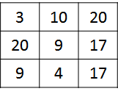
Part B
Explain the following: (CO1, K2)
(a) Playfair cipher.
(b) Vernam cipher in detail.
Discuss in detail about Steganography (CO1, K2)
Compute the ciphertext for the plaintext “SECURE WORLD” using the playfair cipher with key “CRYPTO. Also verify whether it is feasible to generate back the plaintext, (CO1, K3)
”Explain the OSI security architecture. (CO1, K2)
Explain various transposition ciphers in detail. (CO1, K2)
Explain in detail about various types of attacks. (CO1, K2)
Illustrate the legal and ethical aspects of security (CO1, K3)
Explain in detail (CO1, K2)
Product cryptosystem
Perfect security
Compute the ciphertext using Hill cipher for the plaintext “PAY ORE MONEY” and key given below. Verify whether your ciphertext reproduces plaintext. (CO1,K3)
Describe a classification of computer crime based on the role that the computer plays in the criminal activity. (CO1,K2)
Explain in detail about copyright. (CO1,K2)
Describe the Digital Millennium Copyright Act. (CO1,K2)
Describe the principal categories of users of digital rights management systems. (CO1,K2)
Summarize the Law Enforcement of Cybercrimes with the vicious cycle of cybercrime. (CO1,K2)
Explain the role of Information theory in Cryptography. (CO1, K2)

Slide 73
CS8792 – Cryptography and Network security Unit - II
Department: Computer Science and Engineering
&
Information Technology
Batch/Year: 2017-2021/IV
Created by: Dr.A.Thilagavathy
Dr.G.Amudha
Dr.Praveena
Ms.S.A. Angayarkanni
Mr.A.Madhu
Date:29-07-2020

Slide 74
ALGEBRAIC STRUCTURES
Abstract Algebra or Modern Algebra is a mathematical filed which deals with study of algebraic structures.
An algebraic structure consists of a nonempty set A, a collection of operations on A of finite arity (typically binary operations), and a finite set of identities, known as axioms, that these operations must satisfy.
Set
Set is a well-defined collection of distinct objects. The individual objects that make up a set are called its elements.
Finite Set: It has finite number of elements.
Example: {1, 2, 3, 4, 5, 6}. It is finite and has cardinality of 6.
Infinite Set: A set that is not finite is called infinite.
Example: Z = {...-3, -2, -1, 0, 1, 2, 3, ...}
Operations
Arity is the number of arguments or operands a function or operation takes. A binary operation is an operation of arity two. Examples of binary operations includes arithmetic operations like addition, subtraction, multiplication.
GROUPS
A group G, sometimes denoted by {G, ·} is a set of elements with a binary operation, denoted by ·, that associates to each ordered pair (a, b) of elements in G an element (a · b) in G, such that the following axioms are obeyed:
(A1) Closure: If a and b belong to G, then a · b is also in G.
(A2) Associative: a · (b · c) = (a · b) · c for all a, b, c in G.
(A3) Identity element: There is an element e in G such that a · e = e · a = a for all a in G.
(A4) Inverse element: For each a in G there is an element a' in G such that a · a' = a' · a = e.

Slide 75
If a group has a finite number of elements, it is referred to as a finite group, and the order of the group is equal to the number of elements in the group. Otherwise, the group is an infinite group.
ABELIAN GROUP
A group is said to be abelian if it satisfies the following additional condition:
(A5) Commutative: a #b = b #a for all a, b in G.
The set of integers (positive, negative, and 0) under addition is an abelian group.
The set of nonzero real numbers under multiplication is an abelian group.
CYCLIC GROUP
A group G is cyclic if every element of G is a power a^{k} (k is an integer) of a fixed element a ε. G. The element a is said to generate the group or to be a generator of G. A cyclic group is always abelian and may be finite or infinite.
RINGS
A ring R, sometimes denoted by {R, +, x}, is a set of elements with two binary operations, called addition and multiplication, such that for all a, b, c in R the following axioms are obeyed:
(A1-A5) R is an abelian group with respect to addition; that is, R satisfies axioms A1 through A5. For the case of an additive group, we denote the identity element as 0 and the inverse of a as a.
(M1) Closure under multiplication: If a and b belong to R, then ab is also in R.
(M2) Associativity of multiplication: a(bc) = (ab)c for all a, b, c in R.
(M3) Distributive laws:
a(b + c) = ab + ac for all a, b, c in R.
(a + b)c = ac + bc for all a, b, c in R.

Slide 76
In essence, a ring is a set in which we can do addition, subtraction [a b = a + (-b)], and multiplication without leaving the set.
With respect to addition and multiplication, the set of all -square matrices over the real numbers is a ring.
COMMUTATIVE RING
A ring is said to be commutative if it satisfies the following additional condition:
(M4) Commutativity of multiplication: ab = ba for all a, b in R.
Let S be the set of even integers (positive, negative, and 0) under the usual operations of addition and multiplication. S is a commutative ring.
INTEGRAL DOMAIN
An integral domain is a commutative ring that obeys the following axioms.
(M5) Multiplicative identity: There is an element 1 in R such that a1 = 1a = a for all a in R.
(M6) No zero divisors: If a, b in R and ab = 0, then either a = 0 or b = 0.
Let be the set of integers, positive, negative, and 0, under the usual operations of addition and multiplication. S is an integral domain.
FIELDS
A field F, sometimes denoted by {F, +, x}, is a set of elements with two binary operations, called addition and multiplication, such that for all a, b, c in F the following axioms are obeyed:
(A1-M6) F is an integral domain; that is, F satisfies axioms A1 through A5 and M1 through M6.
(M7) Multiplicative inverse: For each a in F, except 0, there is an element a-1 in F such that aa-1 = (a-1)a = 1.
In essence, a field is a set in which we can do addition, subtraction, multiplication, and division without leaving the set. Division is defined with the following rule: a/b = a(b⁻¹).

Slide 77
Familiar examples of fields are the rational numbers, the real numbers, and the complex numbers. Note that the set of all integers is not a field, because not every element of the set has a multiplicative inverse; in fact, only the elements 1 and –1 have multiplicative inverses in the integers.
FINITE FIELDS (GALOIS FIELD)
Finite Field is a field with finite number of elements. Order of the field is equal to the number of elements in the field. The finite field of order p^{n} is generally written GF (p^{n}).
GF (p)
Z_{p} = {0, 1, ..., (p - 1)} where p is prime.
GF (p) is the set Z_{p} together with arithmetic operations modulo p.
The binary operations + and × are defined over the set. The operations of addition, subtraction, multiplication, and division can be performed without leaving the set. Each element of the set other than 0 has a multiplicative inverse.
Example: GF (7)
Table: Addition Modulo 7 Table: Multiplication Modulo 7
+ | 0 | 1 | 2 | 3 | 4 | 5 | 6
0 | 0 | 1 | 2 | 3 | 4 | 5 | 6
1 | 1 | 2 | 3 | 4 | 5 | 6 | 0
2 | 2 | 3 | 4 | 5 | 6 | 0 | 1
3 | 3 | 4 | 5 | 6 | 0 | 1 | 2
4 | 4 | 5 | 6 | 0 | 1 | 2 | 3
5 | 5 | 6 | 0 | 1 | 2 | 3 | 4
6 | 6 | 0 | 1 | 2 | 3 | 4 | 5
× | 0 | 1 | 2 | 3 | 4 | 5 | 6
0 | 0 | 0 | 0 | 0 | 0 | 0 | 0
1 | 0 | 1 | 2 | 3 | 4 | 5 | 6
2 | 0 | 2 | 4 | 6 | 1 | 3 | 5
3 | 0 | 3 | 6 | 2 | 5 | 1 | 4
4 | 0 | 4 | 1 | 5 | 2 | 6 | 3
5 | 0 | 5 | 3 | 1 | 6 | 4 | 2
6 | 0 | 6 | 5 | 4 | 3 | 2 | 1

Slide 78
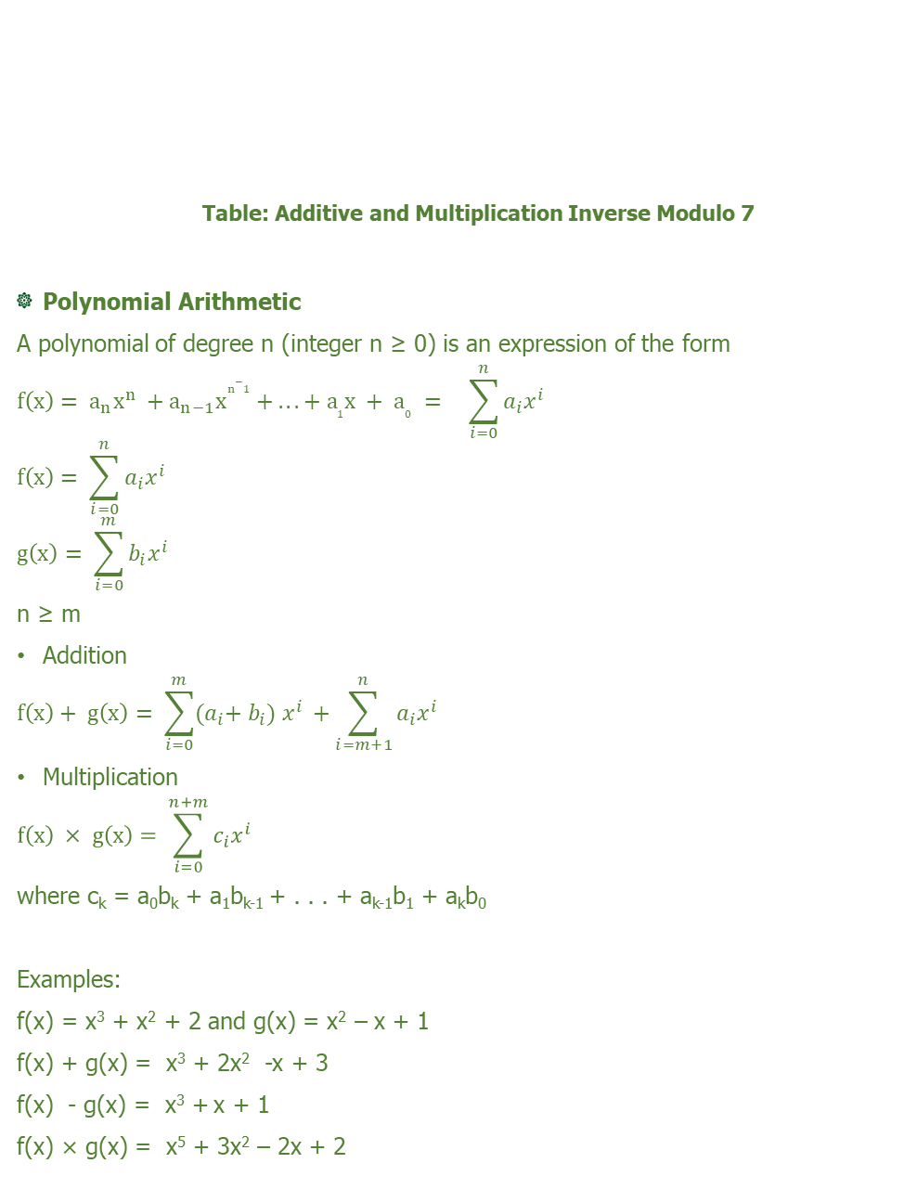
Table: Additive and Multiplication Inverse Modulo 7
Polynomial Arithmetic
A polynomial of degree n (integer n ≥ 0) is an expression of the form
$$f\left(x\right)= a_{n}x^{n} +a_{n−1}x^{n−1} + . . . + a_{1}x + a_{0} = \sum_{i=0}^{n}{a_{i}x^{i}}$$
$$f\left(x\right)= \sum_{i=0}^{n}{a_{i}x^{i}}$$
$$g\left(x\right)= \sum_{i=0}^{m}{b_{i}x^{i}}$$
n ≥ m
Addition
$$f\left(x\right)+ g\left(x\right)= \sum_{i=0}^{m}{{(a}_{i}{+ b_{i}) x^{i} +\sum_{i=m+1}^{n}{a_{i}x^{i}}}_{}}$$
Multiplication
$$f\left(x\right) × g\left(x\right)= \sum_{i=0}^{n+m}{c_{i}{x^{i} }_{}}$$
where c_{k} = a₀b_{k} + a₁b_{k-1} + . . . + a_{k-1}b₁ + a_{k}b₀
Examples:
f(x) = x³ + x² + 2 and g(x) = x² – x + 1
f(x) + g(x) = x³ + 2x² -x + 3
f(x) - g(x) = x³ +x + 1
f(x) × g(x) = x⁵ + 3x² – 2x + 2
w | 0 | 1 | 2 | 3 | 4 | 5 | 6
-w | 0 | 6 | 5 | 4 | 3 | 2 | 1
w⁻¹ | - | 1 | 4 | 5 | 2 | 3 | 6

Slide 79
Irreducible Polynomial
A polynomial f(x) over a field is called irreducible if and only if f(x) cannot be expressed as a product of two polynomials, both over F, and both of degree lower than that of f(x). By analogy to integers, an irreducible polynomial is also called a prime polynomial. The primary use of irreducible polynomials is in the construction of larger finite fields.
Example: The polynomial f(x) = x⁴ + 1 over GF (2) is reducible, because
x⁴+1 = (x+1) (x³ + x² + x + 1)
The polynomial f(x) = x⁴ + x+ 1 over GF (2) is irreducible.
GF (2^{n})
Addition of two polynomials in GF (2^{n}) corresponds to a bitwise XOR operation.
Example:
f(x) = x⁶ + x4 + x² + x + 1
g(x) = x⁷ + x + 1
Polynomial Notation: (x⁶ + x⁴ + x² + x + 1) + (x⁷ + x + 1)
= x⁷ + x⁶ + x⁴ + x²
Binary Notation: 01010111 ⊕ 10000011 = 11010100
Hexadecimal Notation: {57} ⊕ {83} = {D3}
Multiplication
Finite Field used in AES is GF (2⁸) and irreducible polynomial used is m(x) = x⁸ + x⁴ + x³ + x + 1.
X⁸ mod m(x) = [m(x) – x⁸] = x⁴ + x³ + x + 1
In general, in GF (2^{n}) with an nth-degree polynomial p(x), we have
x^{n} mod p(x) = [p(x) – x^{n}]
Polynomial in GF (2⁸), has the form:
f(x) = b₇x⁷ + b₆x⁶ + b₅x⁵ + b₄x⁴ + b₃x³ + b₂x² + b₁x + b₀.

Slide 80
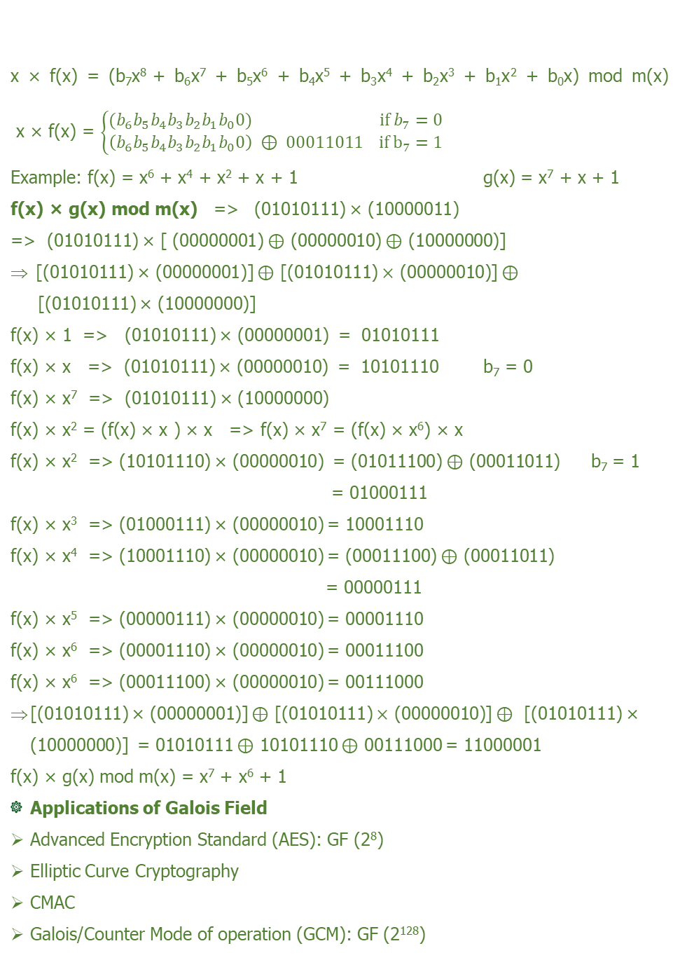
x × f(x) = (b₇x⁸ + b₆x⁷ + b₅x⁶ + b₄x⁵ + b₃x⁴ + b₂x³ + b₁x² + b₀x) mod m(x) x × f(x) = $\left\{\begin{aligned}{(b}_{6}b_{5}b_{4}b_{3}b_{2}b_{1}b_{0}0) if b_{7}=0 \\ \left(b_{6}b_{5}b_{4}b_{3}b_{2}b_{1}b_{0}0\right) ⊕ 00011011 if b_{7}=1\end{aligned}\right.$
Example: f(x) = x⁶ + x⁴ + x² + x + 1 g(x) = x⁷ + x + 1
f(x) × g(x) mod m(x) =>(01010111) × (10000011)
=> (01010111) × [ (00000001) $⊕$ (00000010) $⊕$ (10000000)]
[(01010111) × (00000001)] $⊕$ [(01010111) $×$ (00000010)] $⊕$
[(01010111) × (10000000)]
f(x) × 1 => (01010111) × (00000001) = 01010111
f(x) × x => (01010111) × (00000010) = 10101110 b₇ = 0
f(x) × x⁷ => (01010111) × (10000000)
f(x) × x² = (f(x) × x ) × x => f(x) × x⁷ = (f(x) × x⁶) × x
f(x) × x² => (10101110) × (00000010) = (01011100) $⊕$ (00011011) b₇ = 1
= 01000111
f(x) × x³ => (01000111) × (00000010) = 10001110
f(x) × x⁴ => (10001110) × (00000010) = (00011100) $⊕$ (00011011)
= 00000111
f(x) × x⁵ => (00000111) × (00000010) = 00001110
f(x) × x⁶ => (00001110) × (00000010) = 00011100
f(x) × x⁶ => (00011100) × (00000010) = 00111000
[(01010111) × (00000001)] $⊕$ [(01010111) $×$ (00000010)] $⊕$ [(01010111) × (10000000)] = 01010111 $⊕$ 10101110 $⊕$ 00111000 = 11000001
f(x) × g(x) mod m(x) = x⁷ + x⁶ + 1
Applications of Galois Field
Advanced Encryption Standard (AES): GF (2⁸)
Elliptic Curve Cryptography
CMAC
Galois/Counter Mode of operation (GCM): GF (2¹²⁸)

Slide 81
MODULAR ARITHMETIC
Divisors
Given positive integers a and b, we use the notation a|b to indicate that a divides b, that is, b is a multiple of a. If a|b, then we know that there is some integer k, such that b=ak. The following properties of divisibility follow immediately from this definition.
If a|b and b|c, then a|c.
If a|b and a|c, then a|(ib+jc), for all integers i and j.
If a|b and b|a, then a=b or a=-b.
Any a ≠ 0 divides 0.
Examples: The positive divisors of 24 are 1, 2, 3, 4, 6, 8, 12, and 24. 13|182; -5|30; 17|289; -3|33; 17|0
Floor Function
The floor function ⌊x⌋ , also called the greatest integer function or integer value, gives the largest integer less than or equal to x.
Examples:
⌊10/2⌋ = ⌊2.5⌋ = 2
⌊-10/2⌋ = ⌊-2.5⌋ = -3
Division algorithm
Given any positive integer n and any nonnegative integer a, if we divide a by n, we
get an integer quotient q and an integer remainder r that obey the following relationship:
a = qn + r 0 ≤ r < n; q = ⌊a/n⌋
where ⌊x⌋ is the largest integer less than or equal to x. The above equation is referred to as the division algorithm.

Slide 82
MODULUS
If a is an integer and n is a positive integer, we define a mod n to be the remainder when a is divided by n. The integer n is called the modulus.
a = qn + r 0 ≤ r < n; q= ⌊a/n⌋
a = ⌊a/n⌋ × n + (a mod n)
Examples:
13 mod 7 = 6; -13 mod 7 = 1
13 = ⌊13/7⌋ × 7 + 6 = ⌊1.857⌋ × 7 + 6 = 1 × 7 + 6
-13 = ⌊-13/7⌋ × 7 + 1 = ⌊-1.857⌋ × 7 + 1 = -2 × 7 + 1
Congruence
Two integers a and b are said to be congruent modulo n, if (a mod n) = (b mod n). This is denoted as a ≡ b (mod n).
Properties of Congruences
a ≡ b (mod n) if n | (a-b).
a ≡ b (mod n) implies b ≡ a (mod n).
a ≡ b (mod n) and b ≡ c (mod n) implies a ≡ c (mod n)
Examples:
29 ≡ 4 (mod 5) 5 | (29-4) => 5 | 25
29 ≡ 4 (mod 5) => 4 ≡ 29 (mod 5)
29 ≡ 4 (mod 5) and 4 ≡ 24 (mod 5) => 29 ≡ 24 (mod 5)
Modular Arithmetic Operations
Modular arithmetic exhibits the following properties:
[(a mod n) + (b mod n)] mod n = (a + b) mod n
[(a mod n) - (b mod n)] mod n = (a - b) mod n
[(a mod n) × (b mod n)] mod n = (a × b) mod n

Slide 83
Examples:
Addition:
[(12 mod 7 ) + (13 mod 7)] mod 7 = (12 + 13) mod 7
(5+6) mod 7 = 25 mod 7
=> 11 mod 7 = 25 mod 7
11 mod 7 = 4 => 11 ≡ 4 mod 7
Subtraction
[(12 mod 7 ) - (13 mod 7)] mod 7 = (12 - 13) mod 7
(5-6) mod 7 = -1 mod 7 => -1 ≡ 6 (mod 7)
Multiplication
[(12 mod 7 ) ✕ (13 mod 7)] mod 7 = (12 ✕ 13) mod 7
(5✕6) mod 7 = 156 mod 7
30 mod 7 = 156 mod 7 => 2 mod 7 = 2 mod 7
Exponentiation
7¹⁹ mod 11
(7¹⁶ × 7² × 7¹) mod 11 = (7¹⁶ mod 11 × 7² mod 11 × 7¹ mod 11) mod 11
7² mod 11 = 49 mod 11 = 5 => 7² = 49 ≡ 5 mod 11
7⁴ mod 11 = (7² mod 11 × 7² mod 11) mod 11
= 5 × 5 (mod 11) = 3 mod 11 => 7⁴ ≡ 3 mod 11
7¹⁶ mod 11 = (7⁴ mod 11 × 7⁴ mod 11 × 7⁴ mod 11 × 7⁴ mod 11) mod 11
= (3 mod 11 × 3 mod 11 × 3 mod 11 × 3 mod 11) mod 11
= 81 (mod 11) = 4 => 7¹⁶ ≡ 4 (mod 11)
7¹⁹ mod 11 = (7¹⁶ × 7² × 7¹) mod 11
= (4 × 5 × 7) mod 11 = 140 mod 11 = 8
7¹⁹ ≡ 8 mod 11 (or) 7¹⁹ mod 11 = 8

Slide 84
Properties of Modular Arithmetic
Residue Class (or) Congruence Class
The set (represented by Z_{n} = {0, 1, 2…, (n-1)}) of nonnegative integers less than n is referred to as the set of residues or residue classes modulo n or congruence classes modulo n.
Example: The residue classes (mod 6) are
[0] = {..., -18, 12, -6, 0, 6, 12, 18, ...} [1] = {..., -17, -11, -5, 1, 7, 13, 19, ...}
[2] = {..., -16, -10, -4, 2, 8, 14, 20, ...} [3] = {..., -15, -9, -3, 3, 9, 15, 21, ...}
[4] = {..., -14, -8, -2, 4, 10, 16, 22, ...} [5] = {..., -13, -7, -1, 5, 11, 17, 23, ...}
Of all the integers in a residue class, the smallest nonnegative integer is the one used to represent the residue class.
If (a + b) ≡ (a + c) (mod n) then b ≡ c (mod n)
Example: (7 + 23) ≡ (7 + 7) (mod 8); 23 ≡ 7 (mod 8)
If (a × b) ≡ (a × c) (mod n) then b ≡ c (mod n) if a is relatively prime to n
An integer has a multiplicative inverse in Z_{n} if that integer is relatively prime to n.
Table: Properties of Modular Arithmetic for Integers in Z_{n}
Property | Expression
Commutative Laws | (w + x) mod n = (x + w) mod n (w × x) mod n = (x × w) mod n
Associative Laws | [(w + x) + y] mod n = [w + (x + y)] mod n [(w × x) + y] mod n = [w × (x × y)] mod n
Distributive Law | [w × (x + y)] mod n = [(w × x) + (w × y)] mod n
Identities | (0 + w) mod n = w mod n (1 × w) mod n = w mod n
Additive Inverse (–w) | For each w ε Z_{n}, there exists a z such that w + z = 0 mod n

Slide 85
EUCLID ALGORITHM
Euclidean algorithm is used for determining the greatest common divisor of two positive integers.
The notation gcd (a, b) is used to mean the greatest common divisor of a and b. The greatest common divisor of a and b is the largest integer that divides both a and b. The gcd (0, 0) = 0.
Since gcd is positive, gcd (a, b) = gcd (|a|, |b|)
gcd (a, 0) = |a| because all nonzero integers divide 0
Relatively Prime or Co-Prime
Two integers a and b are relatively prime if their only common positive integer factor is 1. Equivalently we can say that if gcd (a, b) = 1, then a and b are relatively prime.
Example: gcd (8, 9)
Positive divisors of 8 are 1, 2, 4, and 8.
Positive divisors of 9 are 1, 3, and 9.
Only common positive divisor of 8 and 9 is 1. So, 8 and 9 are relatively prime.
Euclid Algorithm Formula
Step 1: gcd (a, b) = gcd (b, a mod b)
Step 2: Step 1 is repeated till we get the form gcd (a, 0)
Step 3: gcd (a, 0) = a gives the gcd (a, b)
Euclid Algorithm can be expressed as Recursive Function:
Euclid (a, b)
if (b=0) then return a;
else return Euclid (b, a mod b);
#Problem 1: Determine gcd (5264, 15472) using Euclid Algorithm.
Solution:
gcd (a, b) = gcd (b, a mod b) gcd (a, 0) = a

Slide 86
gcd (5264, 15472) = gcd (15472, 5264)
gcd (15472,5264) = gcd (5264, 15472 mod 5264)
= gcd (5264, 4944)
= gcd (4944, 5264 mod 4944)
= gcd (4944, 320)
= gcd (320, 4944 mod 320)
= gcd (320, 144)
= gcd (144, 320 mod 144)
= gcd (144, 32)
= gcd (32, 144 mod 32)
= gcd (32, 16)
= gcd (16, 32 mod 16)
= gcd (16, 0)
= 16
gcd (5264, 15472) = 16
EXTENDED EUCLID ALGORITHM
It is used to find multiplicative inverse of an integer. If a and b are relatively prime, then b has a multiplicative inverse modulo a.
EXTENDED EUCLID (m, b)
A₁, A₂, A₃ ← 1, 0, m B₁, B₂, B₃ ← 0, 1, b
If B₃ = 0 return no inverse
If B₃ =1 return B₂ = b⁻¹ mod m
Q = ⌊A₃/B₃⌋
T₁, T₂, T₃ ← A₁ – QB₁, A₂ - QB₂, A₃ – QB₃
A₁, A₂, A₃ ← B₁, B₂, B₃
B₁, B₂, B₃ ← T₁, T₂, T₃
Goto Step 2

Slide 87
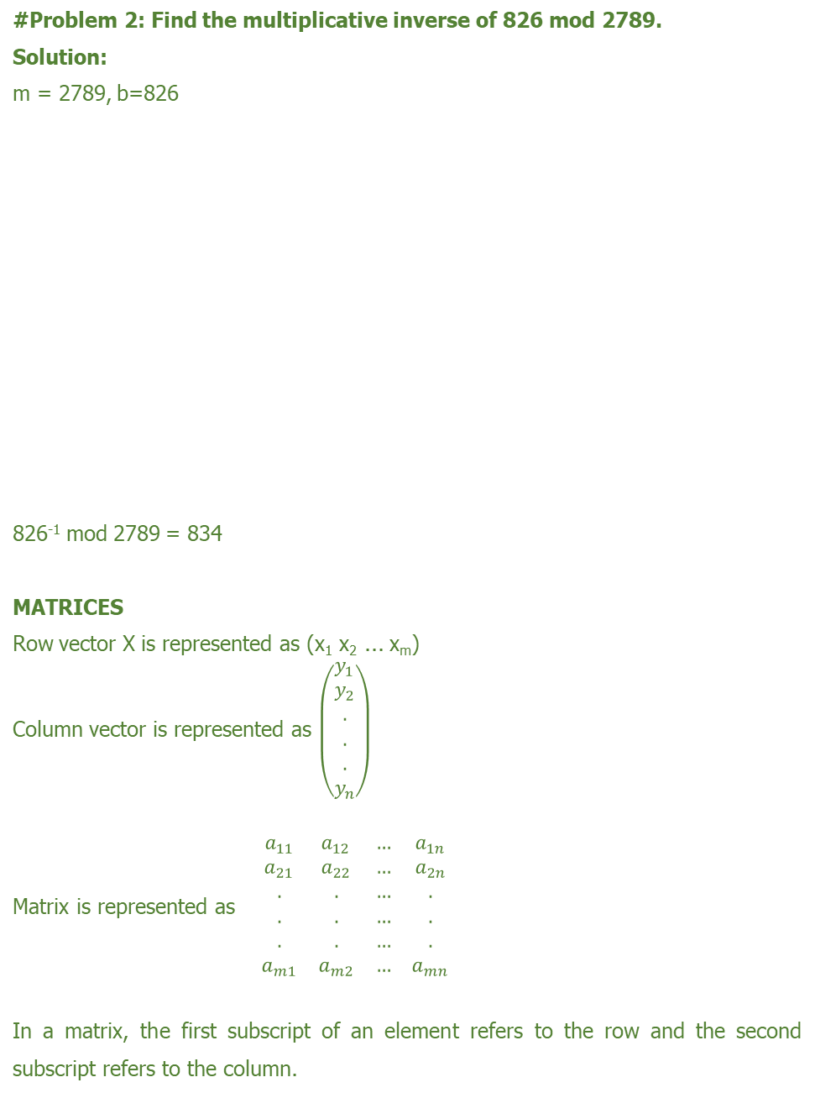
#Problem 2: Find the multiplicative inverse of 826 mod 2789.
Solution:
m = 2789, b=826
826⁻¹ mod 2789 = 834
MATRICES
Row vector X is represented as (x₁ x₂ ... x_{m})
Column vector is represented as $\left(\begin{aligned}y_{1} \\ y_{2} \\ . \\ . \\ . \\ y_{n}\end{aligned}\right)$
Matrix is represented as $\begin{matrix}a_{11} & a_{12} & … & a_{1n} \\ a_{21} & a_{22} & … & a_{2n} \\ . & . & … & . \\ . & . & … & . \\ . & . & … & . \\ a_{m1} & a_{m2} & … & a_{mn}\end{matrix}$
In a matrix, the first subscript of an element refers to the row and the second subscript refers to the column.
A₁ | A₂ | A₃ | B₁ | B₂ | B₃ | Q= ⌊A₃/B₃⌋
1 | 0 | m | 0 | 1 | b
1 | 0 | 2789 | 0 | 1 | 826 | 3
0 | 1 | 826 | 1 | -3 | 311 | 2
1 | -3 | 311 | -2 | 7 | 204 | 1
-2 | 7 | 204 | 3 | -10 | 107 | 1
3 | -10 | 107 | -5 | 17 | 97 | 1
-5 | 17 | 97 | 8 | -27 | 10 | 9
8 | -27 | 10 | -77 | 260 | 7 | 1
-77 | 260 | 7 | 85 | -287 | 3 | 2
85 | -287 | 3 | -247 | 834 | 1

Slide 88
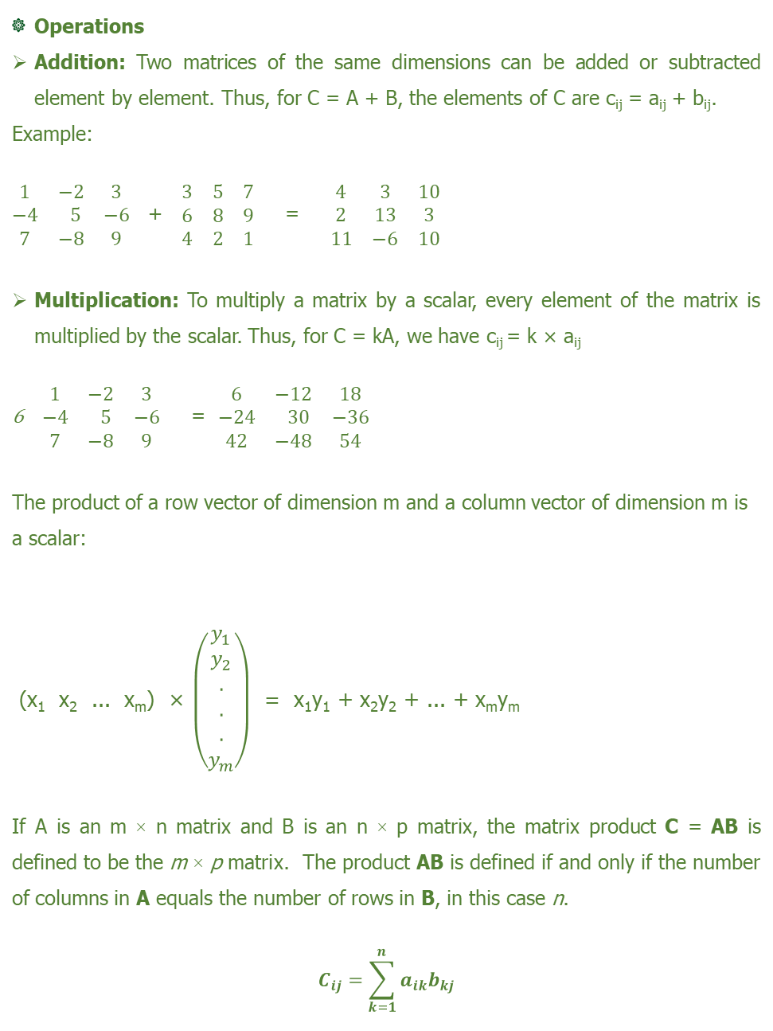
Operations
Addition: Two matrices of the same dimensions can be added or subtracted element by element. Thus, for C = A + B, the elements of C are c_{ij} = a_{ij} + b_{ij}.
Example:
$\begin{matrix}1 & −2 & 3 \\ −4 & 5 & −6 \\ 7 & −8 & 9\end{matrix}$ + $\begin{matrix}3 & 5 & 7 \\ 6 & 8 & 9 \\ 4 & 2 & 1\end{matrix}$ = $\begin{matrix}4 & 3 & 10 \\ 2 & 13 & 3 \\ 11 & −6 & 10\end{matrix}$
Multiplication: To multiply a matrix by a scalar, every element of the matrix is multiplied by the scalar. Thus, for C = kA, we have c_{ij}= k × a_{ij}
$\begin{matrix}1 & −2 & 3 \\ −4 & 5 & −6 \\ 7 & −8 & 9\end{matrix}$ = $\begin{matrix}6 & −12 & 18 \\ −24 & 30 & −36 \\ 42 & −48 & 54\end{matrix}$
The product of a row vector of dimension m and a column vector of dimension m is a scalar:
(x₁ x₂ ... x_{m}) × $\left(\begin{aligned}y_{1} \\ y_{2} \\ . \\ . \\ . \\ y_{m}\end{aligned}\right)$ = x₁y₁ + x₂y₂ + ... + x_{m}y_{m}
If A is an m × n matrix and B is an n × p matrix, the matrix product C = AB is defined to be the m × p matrix. The product AB is defined if and only if the number of columns in A equals the number of rows in B, in this case n.
$$C_{ij}=\sum_{k=1}^{n}{a_{ik}b_{kj}}$$

Slide 89
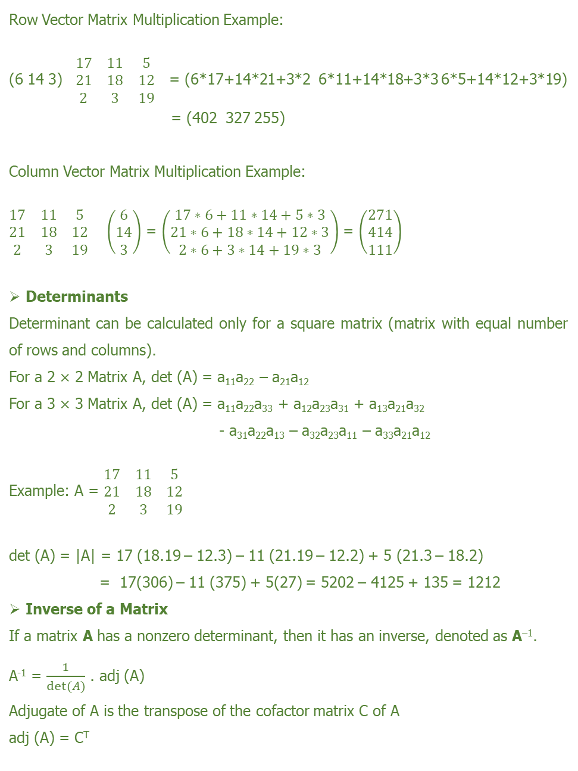
Row Vector Matrix Multiplication Example:
(6 14 3) $\begin{matrix}17 & 11 & 5 \\ 21 & 18 & 12 \\ 2 & 3 & 19\end{matrix}$ = (6*17+14*21+3*2 6*11+14*18+3*3 6*5+14*12+3*19)
= (402 327 255)
Column Vector Matrix Multiplication Example:
$\begin{matrix}17 & 11 & 5 \\ 21 & 18 & 12 \\ 2 & 3 & 19\end{matrix}\left(\begin{aligned}6 \\ 14 \\ 3\end{aligned}\right)$ = $\left(\begin{aligned}17∗6+11∗14+5∗3 \\ 21∗6+18∗14+12∗3 \\ 2∗6+3∗14+19∗3\end{aligned}\right)$ = $\left(\begin{aligned}271 \\ 414 \\ 111\end{aligned}\right)$
Determinants
Determinant can be calculated only for a square matrix (matrix with equal number of rows and columns).
For a 2 × 2 Matrix A, det (A) = a₁₁a₂₂ – a₂₁a₁₂
For a 3 × 3 Matrix A, det (A) = a₁₁a₂₂a₃₃ + a₁₂a₂₃a₃₁ + a₁₃a₂₁a₃₂
- a₃₁a₂₂a₁₃ – a₃₂a₂₃a₁₁ – a₃₃a₂₁a₁₂
Example: A = $\begin{matrix}17 & 11 & 5 \\ 21 & 18 & 12 \\ 2 & 3 & 19\end{matrix}$
det (A) = |A| = 17 (18.19 – 12.3) – 11 (21.19 – 12.2) + 5 (21.3 – 18.2)
= 17(306) – 11 (375) + 5(27) = 5202 – 4125 + 135 = 1212
Inverse of a Matrix
If a matrix A has a nonzero determinant, then it has an inverse, denoted as A^{–1}.
A⁻¹ = $\frac{1}{det⁡(A)}$ . adj (A)
Adjugate of A is the transpose of the cofactor matrix C of A
adj (A) = C^{T}

Slide 90
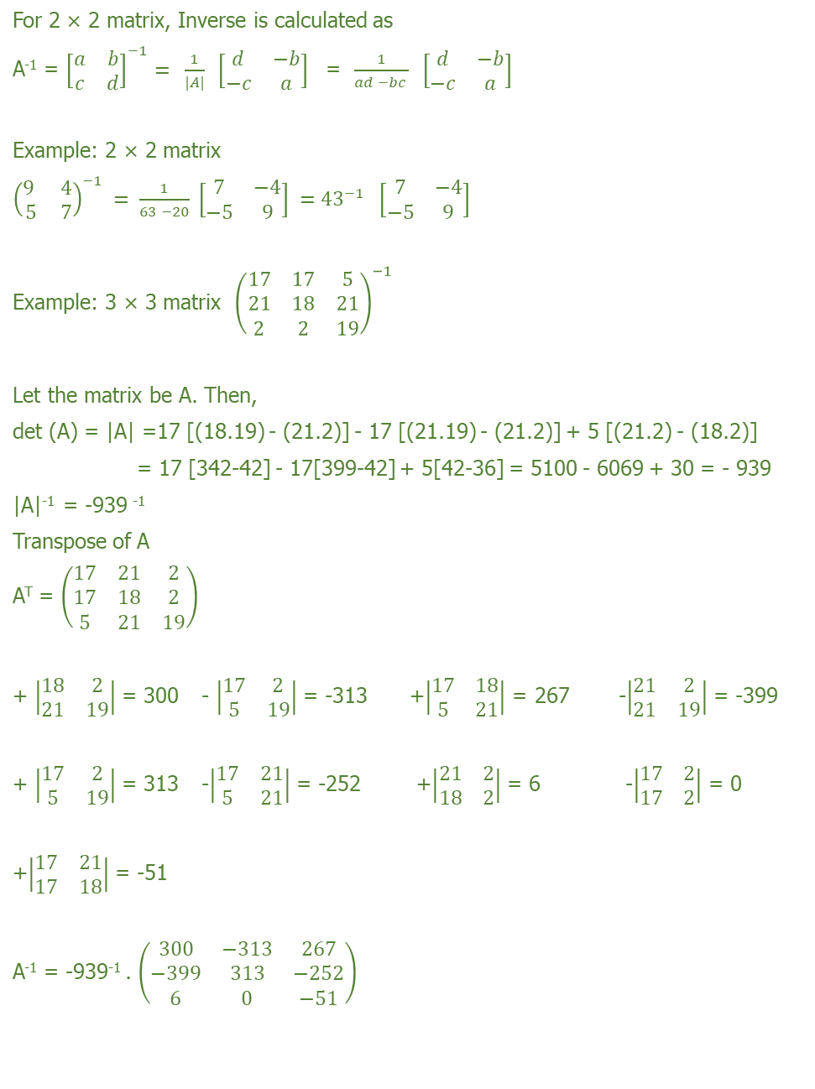
For 2 × 2 matrix, Inverse is calculated as
A⁻¹ = ${\left[\begin{matrix}a & b \\ c & d\end{matrix}\right]}^{−1}= \frac{1}{|A|}\left[\begin{matrix}d & −b \\ −c & a\end{matrix}\right]$ = $\frac{1}{ad −bc } \left[\begin{matrix}d & −b \\ −c & a\end{matrix}\right]$
Example: 2 × 2 matrix
$${\left(\begin{matrix}9 & 4 \\ 5 & 7\end{matrix}\right)}^{−1} = \frac{1}{63 −20} \left[\begin{matrix}7 & −4 \\ −5 & 9\end{matrix}\right] ={43}^{−1}\left[\begin{matrix}7 & −4 \\ −5 & 9\end{matrix}\right]$$
Example: 3 × 3 matrix ${\left(\begin{matrix}17 & 17 & 5 \\ 21 & 18 & 21 \\ 2 & 2 & 19\end{matrix}\right)}^{−1}$
Let the matrix be A. Then,
det (A) = |A| =17 [(18.19) - (21.2)] - 17 [(21.19) - (21.2)] + 5 [(21.2) - (18.2)]
= 17 [342-42] - 17[399-42] + 5[42-36] = 5100 - 6069 + 30 = - 939
|A|⁻¹ = -939 ⁻¹
Transpose of A
A^{T} = $\left(\begin{matrix}17 & 21 & 2 \\ 17 & 18 & 2 \\ 5 & 21 & 19\end{matrix}\right)$
+ $\left|\begin{matrix}18 & 2 \\ 21 & 19\end{matrix}\right|$ = 300 - $\left|\begin{matrix}17 & 2 \\ 5 & 19\end{matrix}\right|$ = -313 +$\left|\begin{matrix}17 & 18 \\ 5 & 21\end{matrix}\right|$ = 267 -$\left|\begin{matrix}21 & 2 \\ 21 & 19\end{matrix}\right|$ = -399
+ $\left|\begin{matrix}17 & 2 \\ 5 & 19\end{matrix}\right|$ = 313 -$\left|\begin{matrix}17 & 21 \\ 5 & 21\end{matrix}\right|$ = -252 +$\left|\begin{matrix}21 & 2 \\ 18 & 2\end{matrix}\right|$ = 6 -$\left|\begin{matrix}17 & 2 \\ 17 & 2\end{matrix}\right|$ = 0
+$\left|\begin{matrix}17 & 21 \\ 17 & 18\end{matrix}\right|$ = -51
A⁻¹ = -939⁻¹ . $\left(\begin{matrix}300 & −313 & 267 \\ −399 & 313 & −252 \\ 6 & 0 & −51\end{matrix}\right)$

Slide 91
SDES
SDES is Simplified Data Encryption Standard developed by a professor at Santa Clara University to understand the concepts of original DES algorithm.
There are five ingredients in any conventional algorithm like
1. Plaintext
2. Secret Key
3. Encryption algorithm
4. Cipher text
5. Decryption algorithm
All operations of encryption and decryption are based on Permutation and Substitution. SDES Encryption algorithm takes 8 bit as an input and generates a 8 bit output. Message or Plain text is divided into two halves as L₀ and R_{0 .} Where L₀ consists of the first 4 bits and R₀ will have next 4 bits. Key K is of 10 bits length and two keys will be generated from that 10 bit key each of length 8 bits each for each round. Initially initial permutation will be carried out followed by function f_{k}. Then a swapping is done followed by performing function f_{k}. Finally inverse initial permutation will be performed to generate 8 bit cipher text.

Slide 92
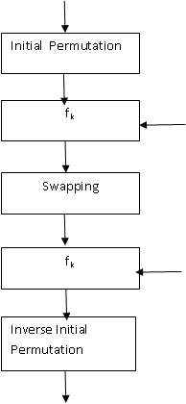
Decryption is reverse of the encryption where 8 bit cipher text will be taken as input and will generate 8 bit plain text. The keys used in the decryption process will be in reverse order. That is k₂ for first round of decryption and k₁ for second round of decryption.
The main part of the encryption process is a function f(R_{i-1},K_{i}) that takes a 8-bit input
SDES Encryption
8 bits Plain text Input
K
8 bits Cipher text Input

Slide 93
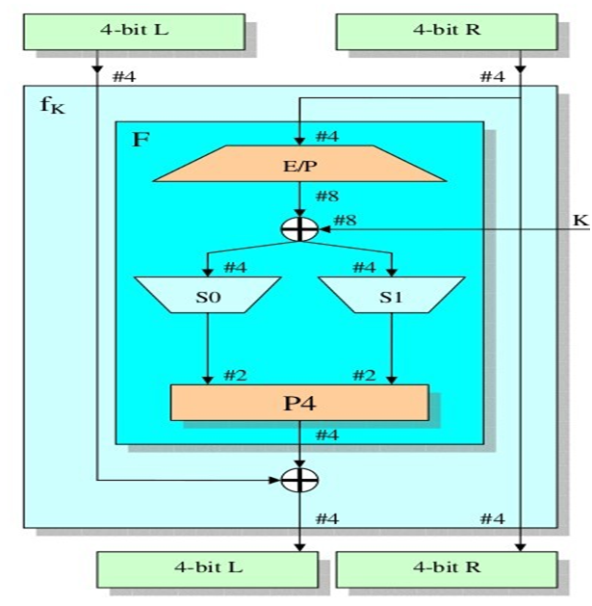
S DES f_{k} implementation
Courtesy: Internet source
As depicted in the above figure , the 8 bits input is divided into two halves as L and R . Function F is implemented for the right half of the data. Then left part of the data is XORed with the output of function F. It can be written as
L_{i} = R_{i-1} and R_{i} = L_{i-1} XOR F(R_{i-1},K_{i})

Slide 94
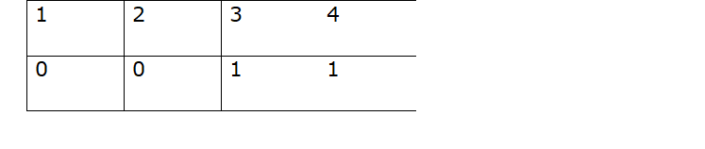
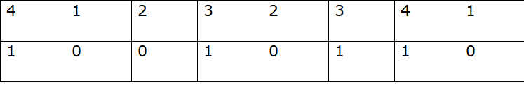
Function F:
Function F comprises of four functionalities like
1. Expansion / Permutation
2. XOR
3. S-Box Substitution
4. Permutation
Consider an example eight bits as 10100011 where right part four bits are 0011
Expansion / Permutation
In this the number of bits is expanded from 4 bits to 8 bits and the order of bits is rearranged.
E/P

Slide 95
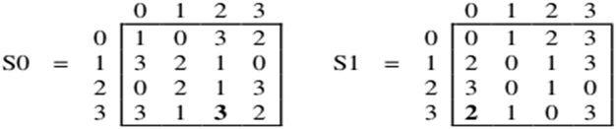
Place the four bits in the specified permutation order.
After E/P , the output will be XORed with key which is of 8 bits.
Say the key k as 11010110
Output generated after XOR operation is 01000000
Next S-Box substitution is performed where four bits will be reduced to 2 bits. First two bits will determine the row value in S-Box and last two bits will determine the column value in S-Box. Consider the S-Box as
output generated is 01000000. For S0 bits considered are 0100 and for S1 it is 0000
When first two bit 01 is considered which results in row 1 and next two bit 00 is considered it is resulted in column 0. So the value in that row 1 and column 0 is 3 which will be written as 11.
Similarly, S1 value will be 00.
Final output after S-Box substitution is 1100. This will be rearranged using permutation function 2431.

Slide 96
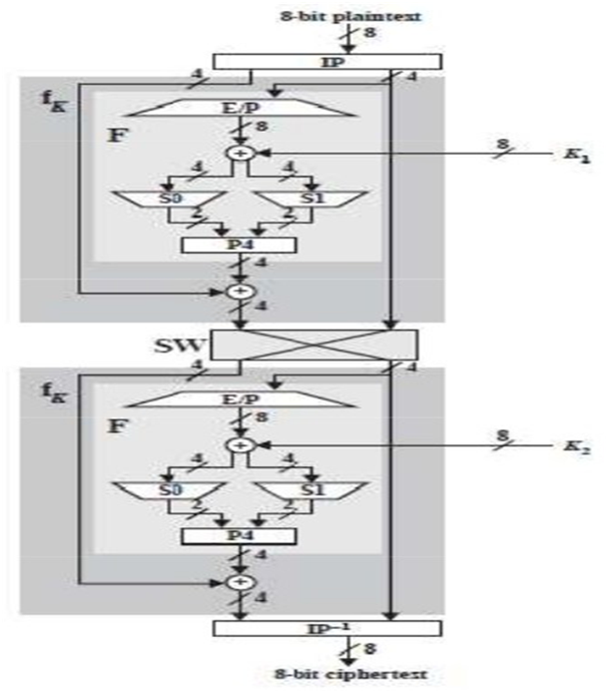
After permutation the output of function F is 1001. In f_{k} next step is to perform XOR operation with left half of the input. From the input left half bits are 1010 which will be XORed with 1001(output of F) to generate 0011. These four bits will be the left half to the swapping function and right half bits are considered directly to the swapping function as depicted in the below figure. Same process will be repeated and finally inverse permutation will be performed to get the cipher text.

Slide 97
BLOCK CIPHER PRINCIPLES
Most of all symmetric block encryption algorithms are based on the Feistel structure. Before examining the principles of Feistel structure, let us discuss about stream cipher and block cipher.
Stream Cipher: Any cipher algorithm which encrypts a single bit or byte data at a time it is termed as stream cipher.
Examples of stream cipher : Auto keyed Vigenere cipher and vernam cipher
Block Cipher: Any algorithm which takes a block of inputs as input to generate cipher text block. A block size is of 64 bits or 128 bits.Examples of block cipher are DES, AES.
Motivation for the Feistel Cipher Structure
Feistel structure is used in block ciphers. As said earlier a block cipher takes n bit block as input for encryption and generates n bit cipher text block. Each cipher text block should be unique to make encryption process as reversible process. This transformation is reversible or nonsingular.
Consider an example transformation for 2 bit blocks.
Reversible Mapping
Plaintext Ciphertext
00 11
01 10
10 00
11 01
In the above plain text and cipher text there is an unique cipher text for each plain text blocks.

Slide 98
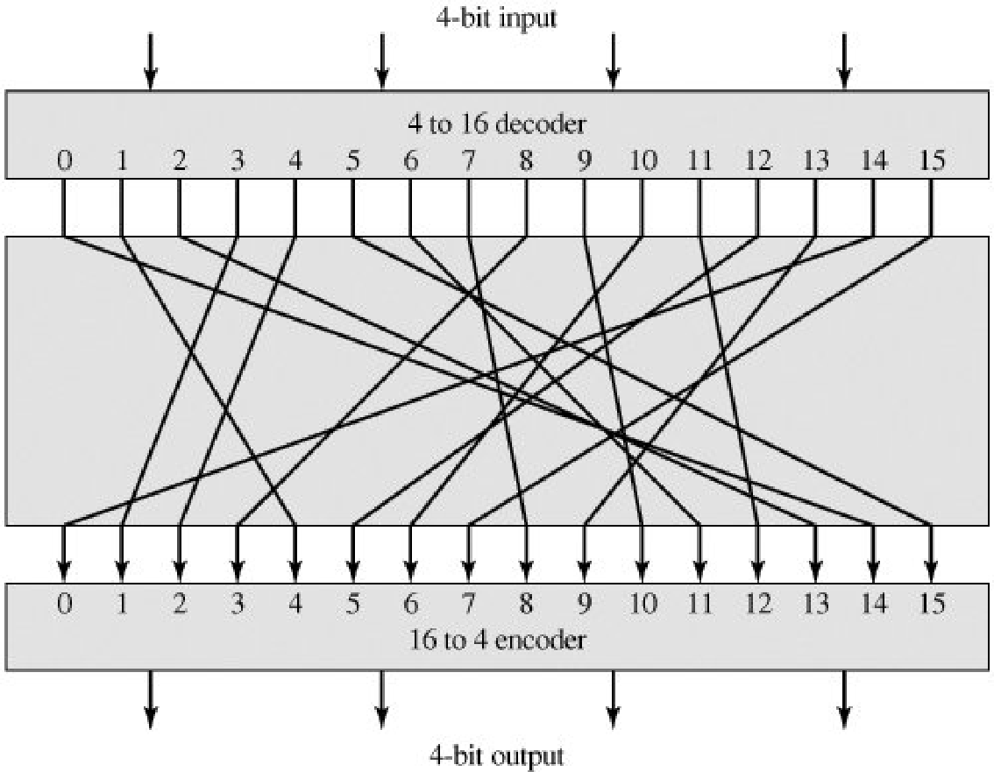
Irreversible Mapping
Plaintext Ciphertext
00 11
01 10
10 01
11 01
In this there are two plain text blocks 10 and 11 which are encrypted to the same cipher text block 01. So reverse mapping is alone considered where there are 2n! possible transformations.
Ideal Block cipher:
Maximum numbers of possible encryption mappings are possible in an ideal block cipher. If suppose the number of bits are less say 4 bits, then this block cipher is similar to substitution techniques. So it is vulnerable to statistical analysis of the plain text. When the number of bits is more in number and reversible substitution is performed between plain text and cipher text then it is not easy to perform statistical analysis.
General n-bit-n-bit Block Substitution (shown with n = 4)

Slide 99
Consider an example transformation for 4 bit blocks.
Plaintext Ciphertext
0000 1110
0001 0100
0010 1101
etc.,
For the above transformation , the key is the mapping itself.
The Feistel Cipher
Feistel proposed a concept based on product cipher to approximate the ideal block cipher. Product cipher is that sequentially two or more ciphers will be executed and the output generated is cryptographically stronger. This approach is to develop a block cipher with a key length of k bits and a block cipher of n bits with the possible transformations as 2k instead of 2n! as in case of ideal block cipher. A product cipher proposed by Claude Shannon makes use of confusion and diffusion functions. Feistel proposed similar to that where substitution and permutation functions are used alternatively.
Diffusion and Confusion
These two terms defined by Claude Shannon in-order to thwart cryptanalysis based on statistical analysis. For example in a message of certain languages there are some terms which are frequently used. If these terms are reflected in the cipher text there is a possibility to get the whole key or a part of the key used for encryption process. To make a cipher as strong ideal ciphers, cipher text generated should be independent of the key used. For this to achieve Claude Shannon, suggested diffusion and confusion functions.

Slide 100
In diffusion each plain text digit affects many cipher text digits. It is also equivalent that each cipher text digit is affected by many plain text digits. In a block cipher this function can be achieved by performing repeated permutation followed by the implementation of any function on the permutated input. Hence, statistical relationship between plain text and cipher text becomes complex.
In confusion statistical relationship between cipher text and the key becomes more complex to thwart attempts to discover the key used for encryption process. If suppose an attacker tries to get the pattern used in the key based on the cipher text generated also not able to get the original key due to confusion involved in the substitution algorithms.
Feistel Cipher Structure
As discussed earlier in the block cipher there are block of inputs provided as an input along with the key. Consider the plain text block is of length 2w bits and a key K. This 2w input block is divided into two halves as left part L0 and right part R0. Based on the number of rounds these two halves will be passed for processing. Finally these two halves will combine to generate the output block.
As depicted in the diagram above, all the rounds will have the same structure.

Slide 101
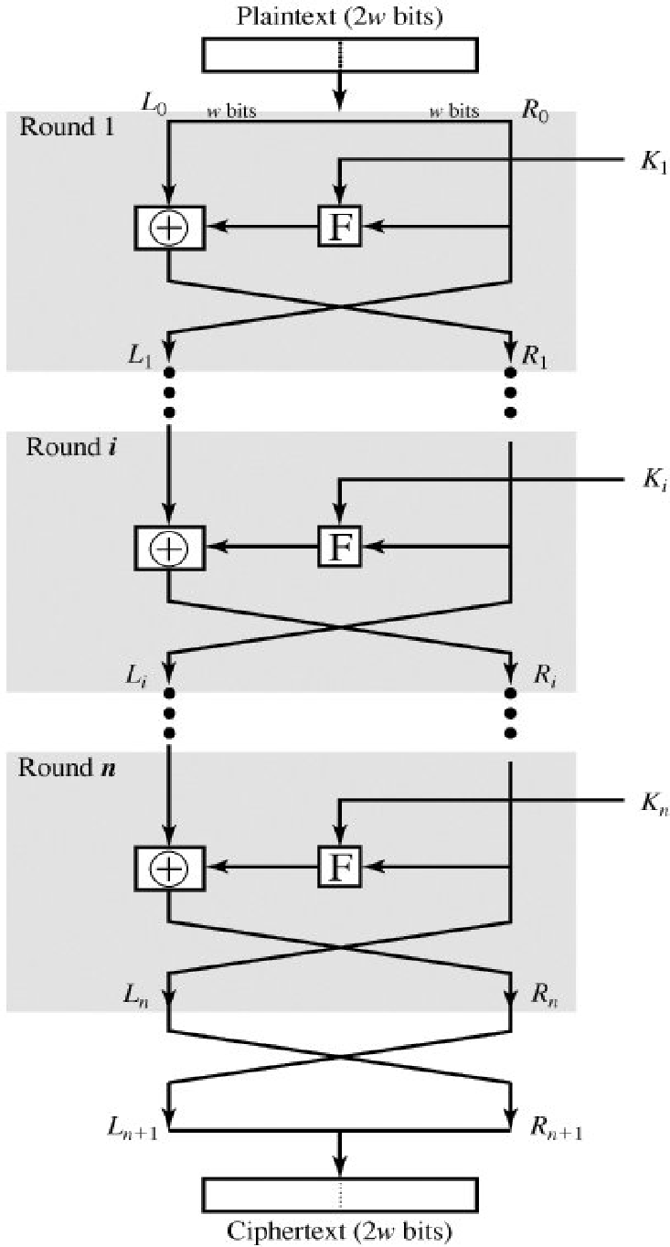
Each round i has as inputs Li-1 and Ri-1, extracted from the previous round, a
subkey Ki, generated from the overall K. Sub keys generated are different from each other and it is also not same as original key K. This is depicted in the below diagram.
Figure Classical Feistel Network

Slide 102
A round function F is performed on the right half of the input and exclusive-OR operation is performed on the output of the function F and left half of the data. Round function performs the same functionality in each round but the key used in each round varies. This is termed as substitution followed by permutation where the two halves of the data are interchanged. This feistel structure is similar to the substitution-permutation network (SPN) proposed by Shannon.
Working of the feistel structure is based on the following parameters like
1. Block size
Larger block size makes the algorithm more secured. As length of the input to be processed is more the speed of the encryption / decryption process gets reduced.
2. Key size
When key size is more, it is tough for performing brute force attacks.
3. Number of rounds
More number of rounds increases the security of the algorithm. A typical size incorporated is 16 rounds.
4. Subkey generation algorithm
This algorithm should be so complex such that cryptanalysis is difficult to perform.
5. Round function
Same as sub key generation algorithm , this function should be too complex to make greater resistance to cryptanalysis.

Slide 103
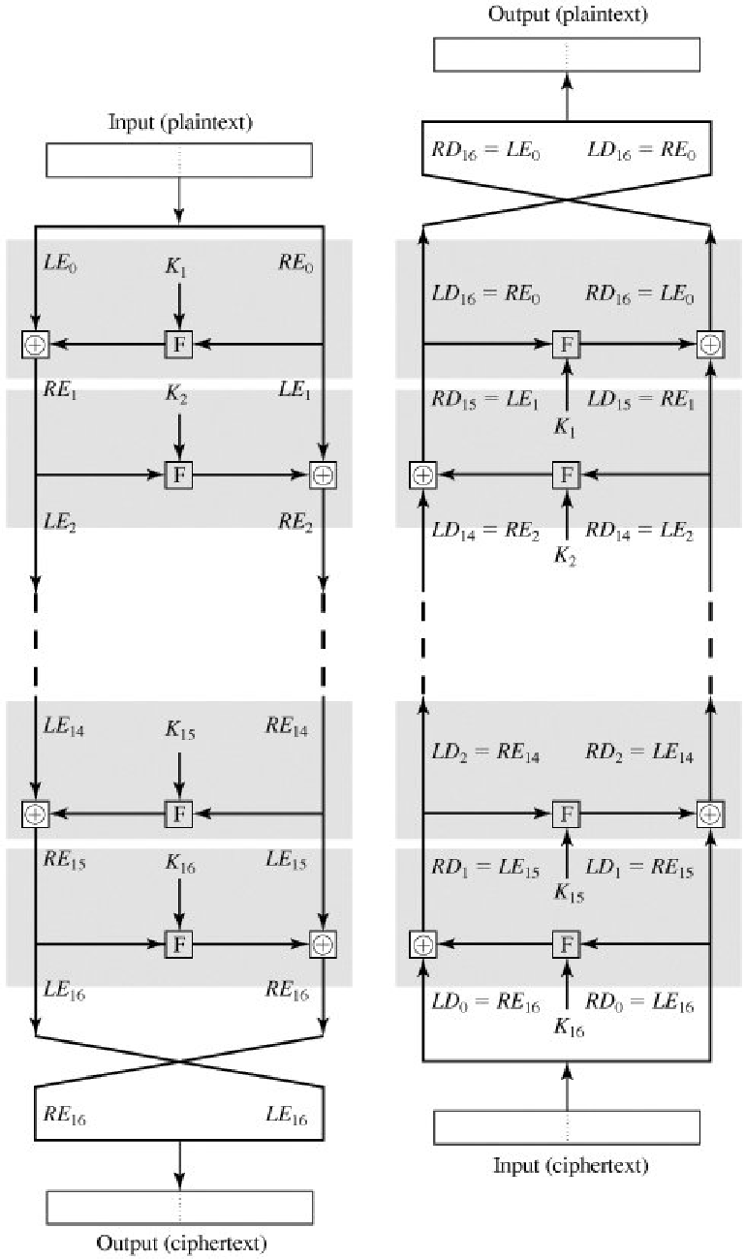
There are two other considerations in the design of a Feistel cipher:
Fast software encryption/decryption
Ease of analysis
Feistel Decryption Algorithm
Similar to the encryption process depicted in the above diagram, the decryption process accepts cipher text as input and the key is provided in reverse order. That is, use K_{n} in the first round, K_{n-1} in the second round, and so on until K₁ is used in the last round. Same algorithm is used for both encryption and decryption.

Slide 104
Above diagram shows that the encryption process is from top to bottom and the decryption process is shown in the right side of the diagram. To differentiate the data provided for the encryption and decryption it is specified as LE_{i} and RE_{i} for data in the encryption algorithm and LD_{i} and RD_{i} in the decryption algorithm. Finally after the last round the two halves output are swapped.
For the ith iteration of the encryption algorithm,
LE_{i} = RE_{i-1}
RE_{i} =LE_{i-1} x F(RE_{i-1}, Ki)
Rearranging terms,
RE_{i-1} = LE_{i}
LE_{i-1} = RE_{i} x F(RE_{i-1}, Ki₂ = RE_{i} x F(LEi, K_{i})
STRENGTH OF DES
There are security concern about key size and the nature of the algorithm of DES.
The Use of 56-Bit Keys
In DES algorithm 56 bits are used as key size. So there are 2⁵⁶ possible keys approximating to 7.2 * 10¹⁶. So to perform brute force attack it is infeasible. Brute force attack is trying all combinations and trying to find the match. In order to break the cipher, a machine capable of performing one encryption per microsecond will take thousand years. As parallel processing comes into existence when 1 million machines are performing one encryption per one micro second parallel then it will take 10 hours to crack the cipher. But the cost incurred is more. It is proven that DES is insecure in July 1998 when Electronic Frontier Foundation has identified the key used in three days using DES cracker. Suppose the text message is compressed before encryption then performing brute force attack is difficult. To attack there is a necessity to know something about the expected plain text and to differentiate garble values from plain text messages.

Slide 105
The Nature of the DES Algorithm
Other than brute force attack there is also an option to perform attack by analyzing the characteristics of DES algorithm. It is termed as cryptanalysis. Main focus is on the eight substitution tables (S–box) used. These S-boxes are constructed in such a way that cryptanalysis is possible if weakness in s-box is known. No one has so far succeeded in identifying the weakness in the S-box.
Timing Attacks
This type of attack is more prominent for public key algorithms. But it is also relevant for symmetric ciphers. How long the algorithms take to perform an operation provide the relationship between the key and the plain text. This makes the attacker possible to crack the key.
Differential and Linear Cryptanalysis
Cryptanalysis is used to analyse and find the encrypted messages without knowing the key. There are two approaches in cryptanalysis as Differential and Linear Cryptanalysis
Differential Cryptanalysis
Trying to discover the non-random behavior of cipher text and using these hints trying to recover the secret key is termed as Differential Cryptanalysis. It uses collection of techniques to find the differences in the transformation performed.DES algorithm is cracked in less than 2⁵⁵ complexity by using Differential Cryptanalysis. Cryptanalysis attack on Data Encryption Standard is performed by choosing 2⁴⁷ plain texts. Behavior of pairs of plain text blocks along each round is observed to perform cryptanalysis.

Slide 106
Consider x as XOR difference between x and x’. Then
x _{i+1} = x_{i+1} XOR x’_{i+1}
= [ x_{i-1} XOR f(x_{i} , K_{i})] XOR [x’_{i-1} XOR f(x’_{i} ,K_{i})]
= x _{i-1} XOR [f(x_{i},K_{i}) XOR f(x’_{i,} K_{i})]
If number of such differences is determined then it is possible to identify the sub keys used by comparing the probable difference and the actual difference.
Linear Cryptanalysis
Based on affine or linear approximations in the transformations performed this attack is possible. In this attack, instead of 2⁴⁷ chosen plain texts as in case of differential cryptanalysis only 2⁴³ known plaintexts are used to find the key.
Consider n bits plain texts and cipher texts and m bit key which is labeled as P[1], ... P[n] , C[1], ... C[n], and K[1], ... K[m] respectively.
Then define
M[i, j, ..., k] = M[i] XOR M[j] XOR ... A[k]
Linear equation is formed as
P[1, 2, ..., a] XOR C[1, 2, ..., b] = K[1, 2, ..., c]

Slide 107
Left hand side result to be computed for a large number of plain text-ciphertext pairs. If the result is zero form more number of plain text and ciphertext pairs then the value of K is considered as zero otherwise it is considered as one. All round values can be combined to get the final key used.
Block Cipher Design Principles
DES Design Criteria:
When DES algorithm is considered there are criteria like design of the S-boxes and P-function.
When S-box is considered there are criteria like
S-box to be designed in such a way that output should not have any relevance with the inputs.
All 16 possible output combinations are included in each row of S-box.
Is there is a single bit variant in the two inputs of S-box, output must differ in at least two bits.
If suppose there is a change in first two bits and it is identical in last two bits in the input to S-box, output generated should not be the same.
The criteria for the permutation P are as follows:
Permutation to be done in such a way that four output bits from each S-box affect six different S-boxes on the next round.

Slide 108
The criteria for the permutation P are as follows:
Permutation to be done in such a way that four output bits from each S-box affect six different S-boxes on the next round.
There are three critical aspects of block cipher design like
a. Number of rounds
b. Design of the function F
c. Key scheduling
Number of Rounds
If the numbers of rounds are more then there is a difficulty in the cryptanalysis even if the function F implemented in each round is weak. So, number of rounds should be chosen such that more cryptanalytic efforts are required to perform attack.
Design of Function F
Main functionality implemented in Feistel block cipher is the function F. Main criteria for designing the function F is that it should be nonlinear. If there is any change in a single bit in the input, there are more number of bits change in the output. It is termed as an avalanche effect.
There are more criteria available as
strict avalanche criterion (SAC)
Bit independence criterion (BIC)

Slide 109
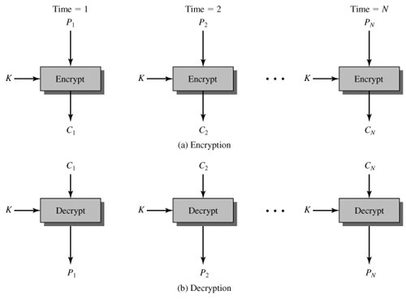
BLOCK CIPHER MODES OF OPERATION
A block cipher considers fixed-length of text block say n bits and key as input and will generate n bit block of cipher text as output. If suppose the length of the input been considered is greater than n bits then the block cipher has to perform the encryption process or decryption process by breaking the input text block into number of blocks with n bits each. Similarly, there is an issue that if the same key been used for multiple blocks there are chances that the key can be compromised. To solve this problem NIST has proposed five modes of operation to apply block cipher in a variety of applications. These five modes can be used in symmetric ciphers like DES and AES. Five modes of Operation:
Electronic codebook (ECB) mode
Cipher block chaining (CBC) mode
Cipher feedback (CFB) mode
Output feedback (OFB) mode
Counter (CTR) mode
Electronic Codebook (ECB) Mode
This is the simplest mode of operation. Here in this approach plain text is considered one block at a time and each block of plain text is been converted into cipher text block with a key k as shown in the figure below. As there is unique cipher text been generated for every plain text block it is termed as codebook.
Courtesy : Cryptography and Network Security by William Stallings

Slide 110
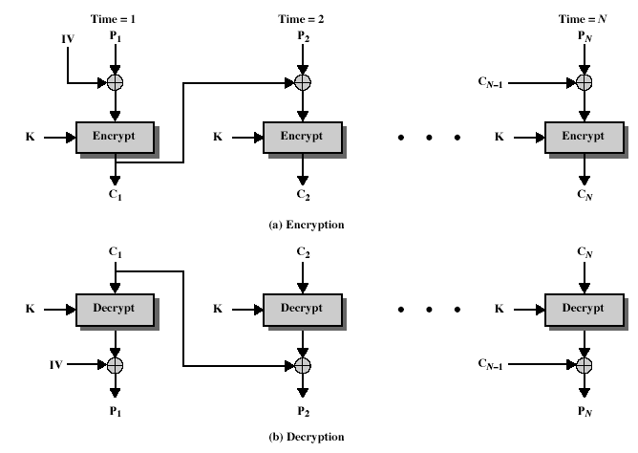
As specified if the plain text block has a greater number of bits then it will be divided into number of blocks each having the length of n bits. Last block may have bits lesser than n bits where padding of bits will be done. Above diagram depicts about encryption and decryption. In encryption plain text P_{i} of n bits considered and key of n bits considered and it is converted to cipher text C_{i} of n bits based on the algorithm used either DES or AES.
Limitations:
If the plain text blocks are repeated in the input the cipher text blocks generated will also be same. For lengthy messages this mode of operation is not appropriate due to its weakness. So mostly this mode can be used if the data is less, for example encryption key.
Cipher block chaining (CBC) mode
To overcome the limitations specified earlier in ECB mode, if the same plain text block appears more than once in the input also it should generate different cipher text blocks.

Slide 111
This is achieved by using Cipher block chaining mode of operation. Here previous block cipher text output is XORed with the current plain text blocks. So, if the same plain text blocks are repeated also will generate new cipher text blocks.The figure depicts that it is like chaining process, repeating pattern bits are not exposed for the cryptanalyst to crack the cipher text. Now initially for the first block processing there is an Initialization vector (IV) been added and to the last block if the length is lesser, as in case of ECB padding bits will be added to match the length of plain text to the encryption algorithm. Decryption is just reverse of the encryption where cipher text blocks will be considered by the decryption algorithm and the output generated will be XORed with the preceding cipher text blocks to produce the plain text blocks as output.
It can be represented as
Encryption:
C_{i} = E ( k [C_{i-1} XOR P_{i}]) ------- (1)
Decryption:
P_{i} = C_{i-1} XOR D (k, C_{i})
From Encryption equation decryption equation can be derived as follows
That is D function applied to cipher text along with key K as D(K, C_{i} )
D(K, C_{i} ) = D(K, E ( k [C_{i-1} XOR P_{i}])) – substituting equation 1
D(K, C_{i} ) = C_{i-1} XOR P_{i} ( Encryption and Decryption gets cancelled)
C_{i-1} XOR D(K, C_{i} ) = C_{i-1} XOR C_{i-1} XOR P _{i} (Applying C_{i-1} XOR on both sides)
C_{i-1} XOR D(K, C_{i} ) = P_{i} ( XOR operation it gets cancelled)

Slide 112
Initial block operation can be specified as
C_{i} = E ( k [ IV XOR P_{i}]) as depicted in the diagram for encryption and
P_{i} = IV XOR D (k, C_{i}) as depicted in the diagram for decryption
Thus, Decryption equation is derived from the encryption formula by applying decryption function.
This initialization vector value has to shared between the sender and the receiver but it is assumed it is not predicted by an adversary or an attacker. So IV can also be shared by encrypting using ECB mode of operation.
Limitation:
If there is any change in the first block output it will be propagated to all the remaining blocks.Consider a scenario that n+1 bits of plain text to converted to cipher text using n bit encryption algorithm. As the number of bits are greater than n bits it will be divided into two blocks as n-bit block and one-bit block. As per the concepts of the two modes of operation if the number of bits is lesser then padding will be done. Here n-1 bits will be padded to make the number of bits as n-bits in the second block. So, for one bit to be converted to cipher text, n-1 values are added which is not necessary. This problem arises due to the concept of block cipher. There are options where block cipher can be converted into stream cipher so for processing stream ciphers there is a necessity of different modes of operation. Here comes these modes of operation Cipher feedback (CFB) mode, output feedback (OFB) mode and Counter (CTR) mode
Cipher feedback (CFB) mode
Padding a message is eliminated in a stream cipher to make the message blocks as an integral number of blocks. If a single character to be transmitted it can be encrypted using stream cipher.

Slide 113
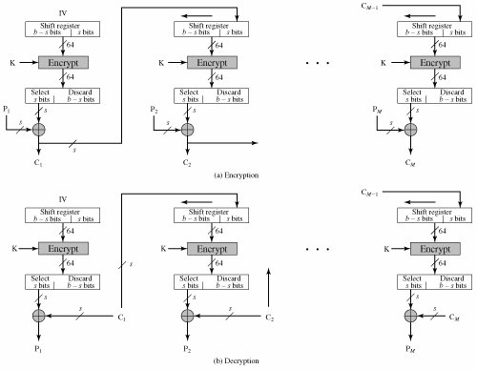
The above diagram depicts the CFB mode of operation. Here the unit of transmission is in bits. Most commonly the bits considered is of length 8. Similar to CBC mode, chaining process is considered. In an encryption process, previous cipher text is provided to n bits shift register. Based on the encryption algorithm number of bits from MSB bits are considered. In the diagram above, 64-bit encryption algorithm is been used. So, 64 MSB bits are taken from the shift register and been provided as input to the algorithm along with key. After encryption process output generated is also represented as 64 bits shift register. Based on the plain text input size, the MSB bits from the shift register considered, which is XORed with plain text to generate the cipher text output. When the next plain text unit to be encrypted the shift register will be shifted left side by s bits, if the number of plain text bits considered is s bits. After shifted the previous cipher text units generated is fed to the LSB of shift register.

Slide 114
This process continues until there are no plain text units to be encrypted. When it is depicted in the diagram for the encryption algorithm input is previous cipher text units along with key K. So in decryption process also the same encryption algorithm been used. In the final stage instead of plain text units to be XORed with the output of encryption algorithm, cipher text units will be XORed to generate plain text units.
It can be represented as
Encryption:
C_{i} = P_{i} XOR MSB(O_{i}) ----- (1)
Decryption:
P_{i} = C_{i} XOR MSB(O_{i}) ----- (2)
Here O_{i} represents the output generated from encryption algorithm.
O_{i =} E(k, I_{i}) where I_{i} is the input considered by the encryption algorithm.
I_{i =} LSB(I_{i-1} || C_{i-1} )
Limitation:
Here the number of bits XORed with plain text also have dependency with the plain text bits. As in case of CFB if there is small change ( bit error) in the input, it will be propagated until the last blocks.
Output feedback (OFB) mode
To avoid error propagation instead of considering cipher text units as fed back units, output generated in the encryption algorithm O_{i} is fed back to the shift register. Similarly, IV is nonce in OFB and it is unique to each execution of the encryption process.
It can be represented as
Encryption:
C_{i} = P_{i} XOR O_{i} ----- (1)
Decryption:
P_{i} = C_{i} XOR O_{i} ----- (2)
Here O_{i} represents the output generated from encryption algorithm.
O_{i =} E(k, I_{i}) where I_{i} is the input considered by the encryption algorithm.
I_{i =} O_{i-1}

Slide 115
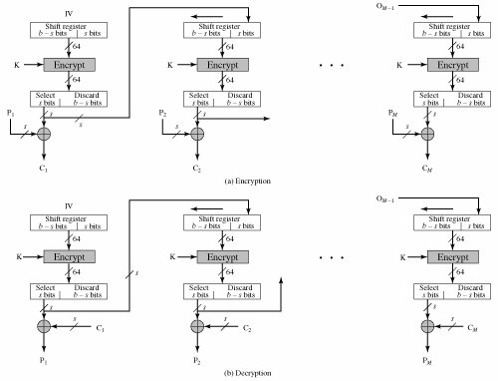
One advantage of the OFB method is that bit errors in transmission do not propagate.
Limitation:
It is vulnerable to message modification attack.
Counter (CTR) mode
In this mode of operation, counter value is used equivalent to the plain text block size. Main requirement is that the counter value should be unique for each block. To make this uniqueness the counter value will be incremented for subsequent blocks. Here there is no chaining process as in case of OFB or CFB. Encryption is done by performing XOR operation with the encrypted counter value and the plain text. In decryption, same order of counter value is used. Encrypted counter value is XORed with cipher text to generate the plain text. Here is the number of bits in the last block is lesser, only those number of bits are considered, remaining bits are discarded. As in case of OFB initial counter value is nonce value considered.

Slide 116
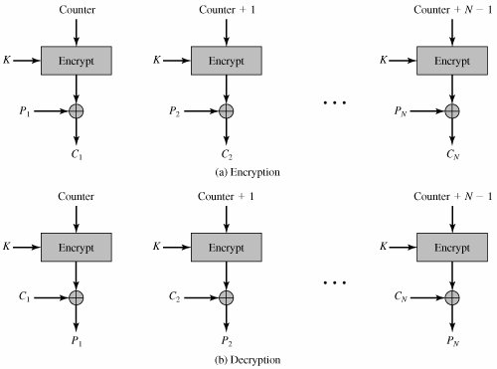
Advantages:
Encryption can be done parallel for multiple blocks of plaintext or ciphertext. As there is no chaining process involved.
Software Efficiency is achieved due to parallelism in process like aggressive pipelining, multiple instruction dispatch per clock cycle.
Preprocessing is achieved because the encryption algorithm does not depend on the plain text.
Random access is possible as any block of inputs can be processed. But in previous modes of operation as previous block output to be provided as input this random access is not possible.
Security is achieved
Simple to use

Slide 117
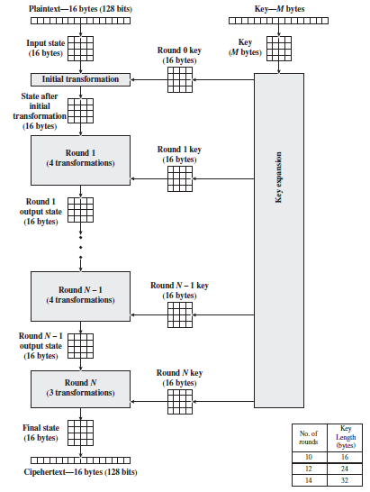
Advanced Encryption Standard
The Advanced Encryption Standard (AES) was published by the National Institute of Standards and Technology (NIST) in 2001. AES is a symmetric block cipher that is intended to replace DES as the approved standard for a wide range of applications.
The cipher takes a plaintext block size of 128 bits, or 16 bytes. The key length can be 16, 24, or 32 bytes (128, 192, or 256 bits). The algorithm is referred to as AES-128, AES-192, or AES-256, depending on the key length.
AES Encryption Process

Slide 118
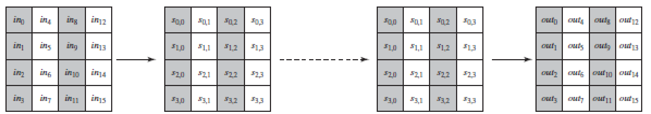
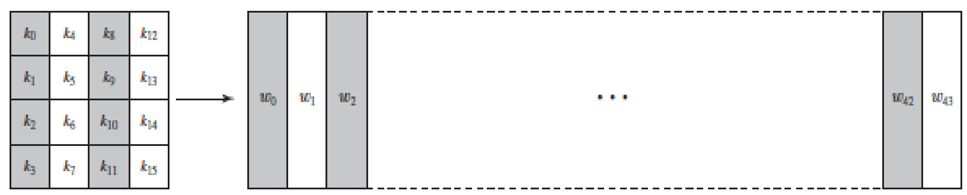
The input to the encryption and decryption algorithms is a single 128-bit block. This block is depicted as a 4 × 4 square matrix of bytes. This block is copied into the State array, which is modified at each stage of encryption or decryption. After the final stage, State is copied to an output matrix. These operations are depicted in the below Figure.
Input, State Array and Output of AES
Similarly, the key is depicted as a square matrix of bytes. This key is then expanded into an array of key schedule words. Below shows the expansion for the 128-bit key. Each word is four bytes, and the total key schedule is 44 words for the 128-bit key.
The AES cipher in more detail, indicating the sequence of transformations in each round and showing the corresponding decryption function. Some comments about the overall AES structure.
AES processes the entire data block as a single matrix during each round using substitutions and permutation.
The key that is provided as input is expanded into an array of forty-four 32-bit words, w[i]. Four distinct words (128 bits) serve as a round key for each round.

Slide 119
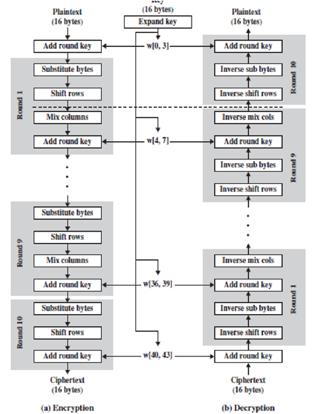
Four different stages are used, one of permutation and three of substitution:
Substitute bytes: Uses an S-box to perform a byte-by-byte substitution of the block
ShiftRows: A simple permutation
MixColumns: A substitution that makes use of arithmetic over
AddRoundKey: A simple bitwise XOR of the current block with a portion of the expanded key
AES ENCRYPTION AND DECRYPTION

Slide 120
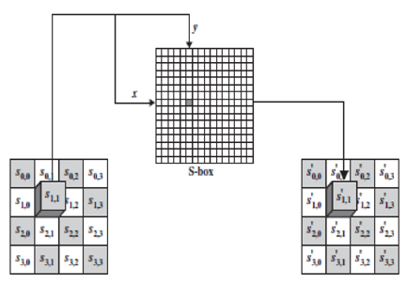
•The structure is quite simple. For both encryption and decryption, the cipher begins with an Add Round Key stage, followed by nine rounds that each includes all four stages, followed by a tenth round of three stages.
•AES processes the entire data block as a single matrix during each round using substitutions and permutation.
Substitute bytes
The forward substitute byte transformation, called SubBytes, is a simple table lookup . AES defines a 16 × 16 matrix of byte values, called an S-box, that contains a permutation of all possible 256 8-bit values.
Each individual byte of State is mapped into a new byte in the following way:
The leftmost 4 bits of the byte are used as a row value and the rightmost 4 bits are used as a column value. These row and column values serve as indexes into the S-box to select a unique 8-bit output value.
For example, the hexadecimal value {95} references row 9, column 5 of the S-box, which contains the value {2A}. Accordingly, the value {95} is mapped into the value {2A}.

Slide 121
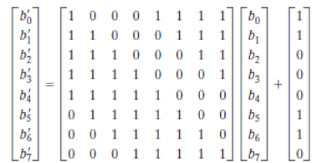
The S-box is constructed in the following fashion:
1.Initialize the S-box with the byte values in ascending sequence row by row. The first row contains {00}, {01}, {02}, …, {0F}; the second row contains {10}, {11}, {12}, …, {1F}, etc.; and so on. Thus, the value of the byte at row x, column y is {xy}.
2. Map each byte in the S-box to its multiplicative inverse in the finite field GF(2⁸); the value {00} is mapped to itself.
3.Consider that each byte in the S-box consists of 8 bits labeled(b7, b6, b5, b4, b3, b2, b1, b0). Apply the following transformation to each bit of each byte in the S-box: , where is the ith bit of byte c with the value {63}; that is, (c₇c₆c₅c₄c₃c₂c₁c₀) = (01100011). The prime (‘) indicates that the variable is to be updated by the value on the right.
The AES standard depicts this transformation in matrix form as follows:
In the above equation, each element in the product matrix is the bitwise XOR of products of elements of one row and one column. Furthermore, the final addition shown in equation is a bitwise XOR. As an example, consider the input value {95}. The multiplicative inverse in GF(28) is {95}-1 = {8A}, which is 10001010 in binary. Using Equation above the result is {2A}, which should appear in row {09} column {05} of the S-box.

Slide 122
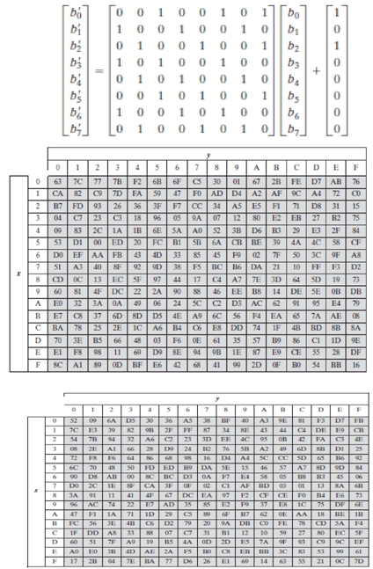
The inverse substitute byte transformation, called InvSubBytes, makes use of the inverse S-box. It could be noted that the input {2A} produces the output {95}, and the input {95} to the S-box produces {2A}. The inverse S-box is constructed by applying the inverse of the transformation in equation stated above, followed by taking the multiplicative inverse in GF(28). The inverse transformation is: where byte d={05}, or 00000101. This transformation could be depicted as follows

Slide 123
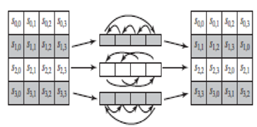
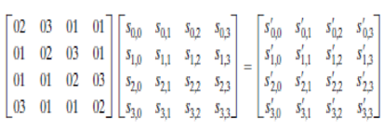
ShiftRows
The forward shift row transformation, called ShiftRows. The first row of State is not altered. For the second row, a 1-byte circular left shift is performed. For the third row, a 2-byte circular left shift is performed. For the fourth row, a 3-byte circular left shift is performed. The inverse shift row transformation, called InvShiftRows, performs the circular shifts in the opposite direction for each of the last three rows, with a 1-byte circular right shift for the second row, and so on.
Mix column
The forward mix column transformation, called Mix Columns, operates on each column individually. Each byte of a column is mapped into a new value that is a function of all four bytes in that column.
The transformation can be defined by the following matrix multiplication on State
Each element in the product matrix is the sum of products of elements of one row and one column. In this case, the individual additions and multiplications are performed in GF(28). The Mix Columns transformation on a single column j(0 ≤ j ≤ 3)of State can be expressed as:

Slide 124


Add round key
In the forward add round key transformation, called Add Round Key, the 128 bits of State are bitwise XORed with the 128 bits of the round key. The operation is viewed as a column wise operation between the 4 bytes of a State column and one word of the round key; it can also be viewed as a byte-level operation. The inverse add round key transformation is identical to the forward add round key transformation, because the XOR operation is its own inverse.
AES Key Expansion
The AES key expansion algorithm takes as input a four-word (16-byte) key and produces a linear array of 44 words (176 bytes).

Slide 125

This is sufficient to provide a four-word round key for the initial Add Round Key stage and each of the 10 rounds of the cipher. The key is copied into the first four words of the expanded key. The remainder of the expanded key is filled in four words at a time. Each added word w[i] depends on the immediately preceding word, w[i-1], and the word four positions back, w[i-4]. In three out of four cases, a simple XOR is used. For a word whose position in the w array is a multiple of 4, a more complex function is used.
The function g consists of the following subfunctions:
•RotWord performs a one-byte circular left shift on a word. This means that an input word [B0, B1, B2, B3] is transformed into [B1, B2, B3, B0].
•SubWord performs a byte substitution on each byte of its input word, using the S-box.
•The result of steps 1 and 2 is XORed with a round constant, Rcon[j].

Slide 126
The round constant is a word in which the three rightmost bytes are always 0. Thus, the effect of an XOR of a word with Rcon is to only perform an XOR on the leftmost byte of the word. The round constant is different for each round and is defined as Rcon[j] = (RC[j], 0, 0, 0),with RC[1] = 1, RC[j] = 2 * RC[j-1] and with multiplication defined over the field GF(2⁸).The values of RC[j] in hexadecimal are
The RC4 Algorithm
•RC4 is a stream cipher RC4 is a stream cipher designed in 1987 by Ron Rivest for RSA Security.
•It is a variable key-size stream cipher with byte-oriented operations. The algorithm is based on the use of a random permutation.
•Eight to sixteen machine operations are required per output byte, and the cipher can be expected to run very quickly in software.
•RC4 is used in the SSL/TLS (Secure Sockets Layer/Transport Layer Security) standards that have been defined for communication between Web browsers and servers.
•It is also used in the WEP (Wired Equivalent Privacy) protocol and the newer WiFi Protected Access (WPA) protocol that are part of the IEEE 802.11 wireless LAN standard. RC4 was kept as a trade
j
j | 1 | 2 | 3 | 4 | 5 | 6 | 7 | 8 | 9 | 10
RC[j] | 01 | 02 | 04 | 08 | 10 | 20 | 40 | 80 | 18 | 36

Slide 127
The RC4 algorithm is remarkably simply and quite easy to explain. A variable-length key of from 1 to 256 bytes (8 to 2048 bits) is used to initialize a 256-byte state vector S, with elements S[0], S[1],..., S[255]. At all times, S contains a permutation of all 8-bit numbers from 0 through 255. For encryption and decryption, a byte k (see Figure 6.8) is generated from S by selecting one of the 255 entries in a systematic fashion. As each value of k is generated, the entries in S are once again permuted.
Initialization of S
•To begin, the entries of S are set equal to the values from 0 through 255 in ascending order; that is; S [0] = 0, S[1] = 1,..., S[255] = 255. A temporary vector, T, is also created. If the length of the key K is
•256 bytes, then K is transferred to T. Otherwise, for a key of length keylen bytes, the first keylen elements of T are copied from K and then K is repeated as many times as necessary to fill out T. These preliminary operations can be summarized as follows:
These preliminary operations can be summarized as follows:
/* Initialization */
for i = 0 to 255 do
S[i] = i;
T[i] = K[i mod keylen];
Next we use T to produce the initial permutation of S. This involves starting with S[0] and going through to S[255], and, for each S[i], swapping S[i] with another byte in S according to a scheme dictated by T[i]:

Slide 128

/* Initial Permutation of S */
j = 0;
for i = 0 to 255 do
j = (j + S[i] + T[i]) mod 256;
Swap (S[i], S[j]);
Because the only operation on S is a swap, the only effect is a permutation. S still contains all the numbers from 0 through 255.
Stream Generation
Once the S vector is initialized, the input key is no longer used. Stream generation involves cycling through all the elements of S[i], and, for each S[i], swapping S[i] with another byte in S according to a scheme dictated by the current configuration of S. After S[255] is reached, the process continues, starting over again at S[0]:

Slide 129
/* Stream Generation */
i, j = 0;
while (true)
i = (i + 1) mod 256;
j = (j + S[i]) mod 256;
Swap (S[i], S[j]);
t = (S[i] + S[j]) mod 256;
k = S[t];
To encrypt, XOR the value k with the next byte of plaintext. To decrypt, XOR the value k with the next byte of ciphertext.

Slide 130

Key Distribution
Keys distribution can be categorized into public key distribution and secret key distribution.
To distribute public keys there are various schemes like
1.Public announcement
2.Publicly available directory
3.Public key authority
4. Public key certificates
Public Announcement of Public Keys
In this distribution scheme the public keys are broadcasted to the large community. The limitation in this public announcement is that anyone can announce the key. Similarly a person A can pretend to be another person B and can publicly announce a public key for that user B. So when all users are sending the messages encrypted using the public key of user B it is actually can be decrypted only by user A.

Slide 131

Publicly Available Directory
To overcome the drawback of the public announcement all users can share their public keys to the public directory which is maintained by an authority. Initially all users has to register in this public directory and each user is authenticated by the authority to access the public directory. So, it is not possible to perform masquerade attack. i.e., user A cannot send another person B’s key. At any point of time the keys can be replaced by the concerned user. This scheme also has a drawback that an adversary can compromise the private key shared between the user and public authority.
Public-Key Authority
To avoid the weakness in the public directory scheme, each participant has to request the public authority for user B’s public key by sending a time stamped request message. After receiving the request message, public key authority sends a response as encrypted message to the user A. Encryption is done using authority’s private key which authenticates that the message is sent by the authority. Encrypted message has B's public key, and the user A’s request message. Now if A wants to communicate with user B , user A will send an encrypted message to user B with a nonce and identifier of user A.

Slide 132

After receiving user B will send the reply as an encrypted message with the nonce sent by A and a new nonce value to uniquely identify the communication and to make an assurance that user B has received the message correctly. Later A will also send the new nonce value encrypted to make an assurance that both intended users are only communicating.
Public-Key Certificates
In the public key authority, as each user has to contact authority in-order to get the public keys. So bottleneck problem occurs. To avoid this issue each user will share the public key to the central authority who is responsible for issuing certificates to the users. Each user will be provided with certificate. So if any user wants to communicate they will exchange the certificates to authenticate themselves. Certificate will have users public key and the central authority’s private key.

Slide 133


Each certificate has
CA = E(PRauth, [T||IDA||PUa])
where PRauth is the private key used by the authority and T is a timestamp.
This certificate can be verified by performing
D(PUauth, CA) = D(PUauth, E(PRauth, [T||IDA||PUa])) = (T||IDA||PUa)
Symmetric Key Distribution

Slide 134


Key distribution center is responsible for distributing the key to the users. User A and B wants to share the secret key. As depicted in the previous figure first user A send both users identity along with nonce value. Then KDC will send encrypted secret key. User A will forward the encrypted content to user B . To ensure authentication user B again transmits with another nonce value. Finally the key is shared among users. These are two methods to share the secret key.
Simple Secret Key Distribution
Secret Key Distribution with Confidentiality and Authentication
Secret key can also be shared using the public key distribution mechanisms discussed previously.

Slide 135
ASSIGNMENT
Find 1234⁻¹ (mod 4321).
Write a program to implement Simplified DES algorithm.
Perform SubByte Transformation, ShiftRows, Mix Columns and AddRoundKey for the following input matrix.
Input Matrix Round Key
Real life case study
Whether symmetric algorithm or Public key cryptography is widely used in current scenario. Explain
12 | C0 | F3 | 57
23 | A9 | B2 | 85
98 | 8A | F1 | B9
39 | 69 | 47 | 07
21 | 0C | 3F | 75
36 | 9A | B2 | 58
88 | AF | 11 | 99
96 | 19 | 74 | 70

Slide 136
TWO MARKS Q & A
Define Group. (CO2, K1)
A group is a set of elements with a single binary operation that satisfies additive closure, additive associativity, additive identity additive inverse axioms.
Example: The set of nonzero real numbers under multiplication is a group.
Define Ring. (CO2, K1)
A ring is a set of elements with two binary operation addition and multiplication that satisfies all the additive axioms like closure, associativity, identity, inverse, commutativity and multiplicative axioms like closure, associativity and distributive laws. Ring is a superset of group and abelian group.
Example: With respect to addition and multiplication, the set of all -square matrices over the real numbers is a ring.
Define Field. (CO2, K1)
A field is a set of elements on which two arithmetic operations (addition and multiplication) have been defined and which has the properties of ordinary arithmetic, such as closure, associativity, commutativity, distributivity, and having both additive and multiplicative inverses.
Define Finite Field. (CO2, K1)
A finite field or Galois Field is simply a field with a finite number of elements. The order or number of elements in finite field is p^{n}. Finite Filed is represented as GF(p^{n})
Mention the use of Galois Field is used in cryptography. (CO2, K2)
Galois field is useful for cryptography because its arithmetic properties allows it to be used for scrambling and descrambling of data.

Slide 137
Mention the role of polynomials in finite fields. (CO2, K2)
The elements of GF(p) are integers, while elements of GF(p^{n}) are polynomials, because integers modulo p^{n} do not form a field. So, to produce finite field of non-prime order (i.e. p^{n} . Only p is prime and p^{n} is non-prime), irreducible polynomials are required.
Differentiate block and stream cipher. (CO2, K2)
A stream cipher is one that encrypts a digital data stream one bit or one byte at a time. Example: RC4
A block cipher is one in which a block of plaintext is treated as a whole and used to produce a ciphertext block of equal length. Typically, a block size of 64 or 128 bits is used. Example: DES, AES.
List out the requirements for block cipher. (CO2, K2)
The plaintext block of n bits produce a ciphertext block of n bits. There are 2^{n} possible different plaintext blocks.
It should be reversible. D(K, E(K, M)) = M for all M (Plaintext block)
Limitations of ideal block cipher. (CO2, K2)
If the block size is small, for example n=4, then it is equivalent to classical substitution cipher and vulnerable to statistical analysis.
If n is large, for example n=64, then for reversible mapping key of length n × 2^{n} bits are required (for n=64, it is 64 × 2⁶⁴ ≈ 10²¹ bits). It is impractical.
Define Feistel Cipher. (CO2, K1)
It is a design or a structure used to construct block cipher. It consists of a number of identical rounds of processing. In each round, a substitution is performed on one half of the data being processed, followed by a permutation that swaps the two halves. The original key is expanded so that a different key is used for each round.

Slide 138
Why larger key size means greater security? (CO2, K2)
Larger key size ensures greater resistance against brute-force attacks and also ensures greater confusion.
How diffusion is achieved in a block cipher? (CO2, K2)
Diffusion can be achieved by repeatedly performing some permutation on the data followed by applying a function to that permutation.
How confusion is achieved in a block cipher? (CO2, K2)
Confusion is achieved by the use of a complex substitution algorithm.
Why larger block size means greater security? (CO2, K2)
Larger block size ensures greater diffusion. So that plain-text patterns are dissipated into cipher-text. Greater diffusion corresponds to greater security.
What is avalanche effect? (CO2, K2)
It is a desirable property of an encryption algorithm in which a small change in either the plaintext or the key should produce a significant change in the ciphertext. In particular, a change in one bit of the plaintext or one bit of the key should produce a change in many bits of the ciphertext.
What is the purpose of the S-boxes in DES? (CO2, K2)
It does substitution function to achieve confusion in cipher. The substitution function is non-linear and hence cryptanalysis will be difficult.
What is differential cryptanalysis? (CO2, K2)
It is a form of chosen plaintext attack. The chosen plaintexts with particular XOR difference patterns are encrypted. The difference patterns of the resulting ciphertext provide information that can be used to determine the encryption key.

Slide 139
Compare Feistel structure and Substitution-Permutation Network (SPN). (CO2, K2)
Compare DES and AES. (CO2, K2)
Mention the weakness of RC4. (CO2, K2)
The weakness is related to key scheduling algorithm. There are large number of weak keys, in which a small part of the secret key determines a large number of bits of the initial permutation (Key Schedule Algorithm output).
Feistel Structure | SPN
In a round, only one half of the data block is involved in transformation. | In a round, the full data block is subjected to transformation and hence desired effect is achieved in fewer rounds.
DES is an example of Feistel structure | AES is an example of SPN
Both use Substitution and Permutation to achieve Confusion and Diffusion respectively.
DES | AES
DES uses Feistel structure. | AES uses SPN network.
DES uses 64 bit plaintext block and 56 bit key. It uses 16 rounds. | AES uses 128 bit plaintext block. Key length can be 128 or 192 or 256 bit. Number of rounds can be 10 or 12 or 14 corresponding to key length.
DES is slower and less secure. It is no longer used for commercial applications. | AES is faster and more secure.

Slide 140
List ways in which secret keys can be distributed to two communicating parties. (CO2, K2)
A can select a key and physically deliver it to B.
A third party can select the key and physically deliver it to A and B.
If A and B have previously and recently used a key, one party can transmit the new key to the other, encrypted using the old key.
If A and B each has an encrypted connection to a third party C, C can deliver a key on the encrypted links to A and B.
Differentiate master key and secret key. (CO2, K2)
Master Key is shared between Key Distribution Center and the end user or system. It is used to encrypt session keys.
Session Key is temporary. It is used to encrypt the communication between the two end systems.
Define Key Distribution Center (KDC). (CO2, K1)
It is a trusted third-party or intermediary. It is responsible for generating session keys for communication between two parties. The session keys are generated and communicated by KDC to the end system using master key.
Give the significance of hierarchical key control. (CO2, K2)
It is useful when the network is large. It minimizes the effort involved in master key distribution. Global KDCs come into play when two entities in different domain needs a shared key. Otherwise local KDCs will involve in key distribution for local domain.
Define nonce. (CO2, K2)
The nonce may be a timestamp, a counter, or a random number. It must differ with each transaction, that is unique.

Slide 141
PART B
1. Find 17 ⁻¹ mod 192 using Extended Euclid Algorithm. (CO2 , K3)
2. Find gcd (12345,2424) using Euclid algorithm. (CO2,K3)
3. Explain groups, abelian group, rings. (CO2,K2)
4. Explain in detail about finite fields ( CO2,K2)
5. Discuss in detail about SDES algorithm. (CO2,k1)
6. Explain in detail about Block Cipher principles.(CO2,K1)
7. Discuss in detail about Block cipher modes of operation.(CO2,K2)
8. Explain in detail about AES algorithm(CO2,K1)
9. Explain in detail about RC4(CO2,K1)
10.Compare and contrast various key distribution mechanisms.(CO2,K3)

Slide 142
CS8792 – Cryptography and Network security Unit - III
Department: Computer Science and Engineering
&
Information Technology
Batch/Year: 2017-2021/IV
Created by: Dr.A.Thilagavathy
Dr.G.Amudha
Dr.Praveena
Ms.S.A. Angayarkanni
Mr.A.Madhu
Date:25-08-2020

Slide 143
MATHEMATICS OF ASYMMETRIC KEY CRYPTOGRAPHY
Prime
An integer p is said to be a prime if p>=2 and its only divisors are the trivial divisors 1 and p.
An integer greater than 2 that is not prime is said to be composite.
Examples of Prime: 2, 3, 5, 7, 11, 13, 17, 19, 23, 29, 31, 37, 41, 43, 47, 53, 59, ...
Examples of Composite: 4, 6, 8, 9, 10, 12, 14, 15,...
Fermat’s Theorem
If p is prime and a is a positive integer not divisible by p, then
a^{p-1} ≡ 1 (mod p)
An alternative form of Fermat’s theorem is also useful: If is prime and is a positive integer, then a^{p} ≡ p (mod p)
Example:
8¹⁹⁻¹ ≡ 1 mod 19
8² ≡ 7 mod 19 8⁴ ≡ 11 mod 19 8⁸ ≡ 7 mod 19 8¹⁶ ≡ 11 mod 19
8¹⁸ ≡ 77 ≡ 1 mod 19
Proof:
Consider a set of positive integers less than p: S = {1, 2, … p-1}
Another set X = {a mod p, 2a mod p, … (p-1)a mod p} which is multiple of a mod p the set S.
None of the elements of X is equal to zero because p does not divide a. All elements of X are unique.
S ≡ X mod p (Since X is permutation of S)
Multiplying the numbers in both sets (S and X) and taking the result mod yields
[1 × 2 × … (p-1)] mod p = [a × 2a × … (p-1)] mod p
[a × 2a × … (p-1)] ≡ [1 × 2 × … (p-1)] mod p
a^{p-1} (p-1)! ≡ (p-1) ! mod p
a^{p-1} ≡ 1 (mod p)

Slide 144

MATHEMATICS OF ASYMMETRIC KEY CRYPTOGRAPHY

Slide 145

MATHEMATICS OF ASYMMETRIC KEY CRYPTOGRAPHY

Slide 146
MATHEMATICS OF ASYMMETRIC KEY CRYPTOGRAPHY
Deterministic Algorithm: AKS Primality Test
This algorithm determines whether a number is prime or not with 100% probability. But this algorithm is not as efficient as Miller-Rabin algorithm.
Miller-Rabin Primality Test
Find integers k, q, with k > 0, q odd, so that (n -1 = 2^{k}q);
Select a random integer a, 1 < a < n-1;
if a^{q} mod n = 1 then return (“inconclusive”);
for j = 0 to k -1 do
if a^{2jq} mod n = n -1 then return (“inconclusive”)
return(“composite”);
Example: n=29
n-1 = 28 = 2² × 7 where k=2 and q=7. Let a=2.
Test 1: To check if a^{q} mod n = 1
2⁷ = 128 ≡ 12 ≢ 1 (So Test 1 fails)
Test 2: To check for j = 0 to k -1 do if a^{2jq} mod n = n -1
j=0, 2^{1×7} mod 29 = 2⁷ mod 29 = 12 ≠ 28
J=1, 2^{2×7} mod 29 = 2¹⁴ ≡ 144 ≡ 28 mod 29 (Test 2 passes)
Therefore 29 is probably prime.
Probability of a composite number passing Miller-Rabin Test is (¼)^{t}, where t is number of trials or tests with t different values of a. So for t=10, the probability that a nonprime number will pass all ten tests is less than 10⁻⁶.
Strong Pseudoprime
If n is composite and passes the Miller-Rabin test for the base a, then n is called a strong pseudoprime to the base.
Example: Show that 2047 is a strong pseudoprime to the base 2.
Let n = 2047 a=2
n-1 = 2046 = 1023 x 2¹
k=1, q=1023

Slide 147

MATHEMATICS OF ASYMMETRIC KEY CRYPTOGRAPHY

Slide 148


Slide 149
Second Assertion:
It follows from rules for modular arithmetic.
If A ↔ (a₁, a₂, ..., a_{k}) and B ↔ (b₁, b₂, ..., b_{k})
then
(A + B) mod M ↔ ((a₁ + b₁) mod m₁, ..., (a_{k} + b_{k}) mod m_{k})
(A - B) mod M ↔ ((a₁ - b₁) mod m₁, ..., (a_{k} - b_{k}) mod m_{k})
(A × B) mod M ↔ ((a₁ × b₁) mod m₁, ..., (a_{k} × b_{k}) mod m_{k})
One of the useful features of the Chinese remainder theorem is that it provides a way to manipulate (potentially very large) numbers mod M in terms of tuples of smaller numbers.
Example:
To represent 959 mod 2491 as a pair of numbers mod 47 and 53.
Given: m₁ = 47 and m₂ = 53 M = 2491 A = 959
M₁ = M/m₁ = 2491/47 = 53 M₂ = M/m₂ = 2491/53 = 47
M₁⁻¹ = 53⁻¹ mod 47 = 6⁻¹ mod 47 = 8 mod 47 M₂⁻¹ = 47⁻¹ ≡ -9 ≡ 44 mod 53
959 is represented as (19, 5) as 959 mod 47 = 19 and 959 mod 53 = 5
To add 648 to 959,
(648) ↔ (648 mod 47, 648 mod 53) = (37, 12)
(648+959) mod 2491 ↔ (37+19 mod 47, 12+5 mod 53) = (9, 17)
To verify: (9, 17) ↔ a₁M₁M₁⁻¹ + a₂M₂M₂⁻¹ mod M
= [ (9) (53) (8) + (17) (47) (44)] mod 2491
= [3816 + 35156] mod 2491 = 1607 (648+959=1607) mod 2491
A1 | A2 | A3 | B1 | B2 | B3 | Q =(A3/B3)
1 | 0 | 53 | 0 | 1 | 47 | 1
0 | 1 | 47 | 1 | -1 | 6 | 7
1 | -1 | 6 | -7 | 8 | 5 | 1
-7 | 8 | 5 | 8 | -9 | 1

Slide 150
MATHEMATICS OF ASYMMETRIC KEY CRYPTOGRAPHY
Order of a (mod n)
If a and n are relatively prime, then there is atleast one integer m that satisfies
a^{m} ≡ 1 (mod n) m is the smallest positive integer
The order of a modulo n is usually written as m = ord_{n}(a)
Example:
7¹ ≡ 7 mod 19 7² ≡ 11 mod 19 7³ ≡ 1 mod 19
m = ord₁₉ (7) = 3
The sequence is periodic 7^{3+j} ≡ 7³7^{j} ≡ 7^{j} mod 19 7¹ ≡ 7⁴ ≡ 7⁷ ≡ 7 mod 19 7² ≡ 7⁵ ≡ 7⁸ ≡ 11 mod 19
Primitive Roots
Any base integer a which generates (via powers) the reduced residue class set modulo n, then such integer a is called as primitive root of modulus n.
If a is a primitive root of n, then its powers a, a², a³, …, a^{φ(n)} are distinct (mod n) and are all relatively prime to n. Moreover a^{φ(n)} ≡ 1 (mod n)
Example 1: 6 is primitive root of 11
6¹ ≡ 6 mod 11 6⁴ ≡ 9 mod 11 6⁷ ≡ 8 mod 11 6¹⁰ ≡ 1 mod 11
6² ≡ 3 mod 11 6⁵ ≡ 10 mod 11 6⁸ ≡ 4 mod 11
6³ ≡ 7 mod 11 6⁶ ≡ 5 mod 11 6⁹ ≡ 2 mod 11
Reduced Residue Set of 11 = {1, 2, 3, 4, 5, 6, 7, 8, 9, 10}
Example 2: 3 is primitive root of 10
3¹ ≡ 3 mod 10 3² ≡ 9 mod 10 3³ ≡ 7 mod 10 3⁴ ≡ 1 mod 10
Reduced Residue Set of 10 = {1, 3, 7, 9}
The integers having primitive roots are 2, 4, p^{n} and 2p^{n}, where p is any odd prime and n is a positive integer.
The number of primitive roots modulo n, if there are any, is equal to ɸ (ɸ(n))

Slide 151
MATHEMATICS OF ASYMMETRIC KEY CRYPTOGRAPHY
Example: To check whether 6 is primitive root of 11
ɸ(n) = ɸ(11) = 10 = 2.5 (prime factors)
Test a=6:
6^{10/5} = 6² ≡ 36 ≡ 3 ≢ 1 mod 11
6^{10/2} = 6⁵ ≡ 3.3.6 ≡ 10 ≢ 1 mod 11
6 is primitive root of 11
Discrete Logarithms (Index)
b ≡ a^{i} (mod p) where 0 ≤ i ≤ (p -1)
This exponent i is referred to as the discrete logarithm of the number b for the base a (mod p). This value is denoted as dlog_{a,p}(b).
dlog_{a,p}(1) = 0 because a⁰ mod p = 1 mod p =1
dlog_{a,p}(b) = 1 because a¹ mod p = b
Methods to compute discrete logarithms:
The Pohlig-Hellman Algorithm
Baby Step, Giant Step
The Index Calculus
Example:
dlog_{2,11} (7) = ? Finding i such that 2^{i} mod 11 = 7
Using Brute-force method:
2 mod 11 = 2 2² mod 11 = 4 2⁷ mod 11 = 7
2³ mod 11 = 8 2⁴ mod 11 = 5
2⁵ mod 11 = 10 2⁶ mod 11 = 9
Even though discrete logarithms is not a one-way trap-door function, it is a hard problem. That is, it is infeasible to compute discrete logarithms.
b | 2 | 4 | 8 | 5 | 10 | 9 | 7
dlog_{2,11} (b) | 1 | 2 | 3 | 4 | 5 | 6 | 7

Slide 152
ASYMMETRIC KEY CIPHERS
RSA
RSA was developed by Ron Rivest, Adi Shamir, and Len Adleman at MIT in 1977.
It is a public-key cryptographic algorithm.
The RSA scheme is a block cipher in which the plaintext and ciphertext are integers between 0 and n - 1 for some n.
A typical size for n is 1024 bits, or 309 decimal digits.
Applications of RSA
Key Exchange in TLS, WTLS etc.
Producing Digital Signatures in SSL Certificate, PGP, S/MIME etc.
Encrypting Symmetric Keys in PGP, S/MIME etc.
Algorithm Description
Let Plaintext block - M, Ciphertext block - C
C = Me mod n
M = C^{d} mod n = (Me)^{d} mod n = M^{ed} mod n
Both sender and receiver must know the value of n.
Sender knows the value of e and only receiver knows the value of d.
Public Key PU = {e, n}
Private Key PR = {d, n}
For this algorithm to be satisfactory for public-key encryption, the following requirements must be met.
It is possible to find values of e, d, n such that M^{ed} mod n = M for all M < n.
It is relatively easy to calculate Me mod n and C^{d} mod n for all values of M < n.
It is infeasible to determine d given e and n.
ɸ(n) = ɸ(pq) = ɸ(p) ɸ(q) = (p-1) (q-1)
ed mod ɸ(n) = 1
ed ≡ 1 mod ɸ(n)
d ≡ e⁻¹ mod ɸ(n)

Slide 153
ASYMMETRIC KEY CIPHERS
RSA Algorithm
User B (Receiver):
Select p,q p and q both prime, p ≠ q
Calculate n = p * q
Calculate ɸ(n) = (p - 1)(q - 1)
Select integer e, gcd (ɸ(n), e) = 1; 1 < e < ɸ(n)
Calculated d d ≡ e⁻¹ mod ɸ(n)
Public key PU = {e, n} Private key PR = {d, n}
Encryption by User A (Sender) with User B’s Public Key:
Plaintext: M < n
Ciphertext: C = Me mod n
Decryption by User B (Receiver) with User B’s Private Key:
Ciphertext: C
Plaintext: M = C^{d} mod n
Decryption using CRT
M = C^{d} mod n
V_{p} = C^{d} mod p V_{q} = C^{d} mod q
V_{p} = C^{d mod (p-1)} mod p V_{q} = C^{d mod (q-1)} mod q
X_{p} = q ✕ (q⁻¹ mod p) X_{q} = p ✕ (p⁻¹ mod q)
M = (V_{p}X_{p} + V_{q}X_{q}) mod n
Fast Modular Exponentiation: To compute a^{b} mod n quickly
Example: 2⁵⁶⁰ mod 561 = 1 (final value of f in the below table)
Initial value of f = 1, a=2, n = 561, b = 560 = (1000110000)₂
f = (f × f) mod n | 1 | 4 | 16 | 256 | 460 | 412 | 166 | 67 | 1 | 1
B_{i} | 1 | 0 | 0 | 0 | 1 | 1 | 0 | 0 | 0 | 0
f = (f × a) mod n | 2 | - | - | - | 359 | 263 | - | - | - | -

Slide 154
ASYMMETRIC KEY CIPHERS
#Problem: Perform encryption and decryption for the parameters
p=3, q=11, e=7, M=5
Solution:
Encryption
C = Me mod n
n = p ✕ q = 3 ✕ 11 = 33
C = 5⁷ mod 33
5³ = 125 ≡ 26 mod 33
5⁶ ≡ 676 ≡ 16 mod 33
5⁷ ≡ 16.5 ≡ 80 ≡ 14 mod 33
C = 14
Decryption
M = C^{d} mod n
ɸ(n) = (p - 1)(q - 1) = 2.10 = 20
d ≡ e⁻¹ mod ɸ(n) => d ≡ 7⁻¹ mod 20 => d=3
M = 14³ mod 33
14² = 196 ≡ 31 mod 33 14³ ≡ 31.14 ≡ 434 ≡ 5 mod 33
M = 5
Decryption Using CRT
C=14, p=3, q=11 n=33
V_{p} = C^{d mod (p-1)} mod p V_{q} = C^{d mod (q-1)} mod q
V_{p} = 14^{3 mod 2} mod 3 V_{q} = 14^{3 mod 10} mod 11
V_{p} = 14 mod 3 = 2 V_{q} = 14³ mod 11 ≡ 3³ mod 11 = 5
X_{p} = 11 ✕ (11⁻¹ mod 3) X_{q} = 3 ✕ (3⁻¹ mod 11)
X_{p} = 11 ✕ (2⁻¹ mod 3) = 11✕2 = 22 X_{q} = 3 ✕ (3⁻¹ mod 11) = 3 ✕ 4 = 12
M = (V_{p}X_{p} + V_{q}X_{q}) mod n = (2.22 + 5.12) mod 33 = (44+60) mod 33 = 5
M = 5

Slide 155
ASYMMETRIC KEY CIPHERS
Security of RSA
Brute force
This involves trying all possible private keys.
Mathematical attacks
There are several approaches, all equivalent in effort to factoring the product of two primes.
Timing attacks
These depend on the running time of the decryption algorithm.
Countermeasures to prevent timing attacks are (i) Constant exponentiation time, (ii) Random delay, and (iii) Blinding
Chosen ciphertext attacks
This type of attack exploits properties of the RSA algorithm.
Factoring Algorithms:
Pollard’s p-1 algorithm
Pollard’s rho algorithm
Elliptic Curve Factorization Method (ECM)
Quadratic Sieve: It is fastest method for factoring integers less than 110 digits.
Generalized number field sieve: It is the most efficient method for factoring integers larger than 110 digits.
Generalized number field sieve and Quadratic sieve are the fastest algorithms and hence mostly used for performing mathematical attacks on RSA.

Slide 156
Key Distribution
Keys distribution can be categorized into public key distribution and secret key distribution.
To distribute public keys there are various schemes like
1.Public announcement
2.Publicly available directory
3.Public key authority
4. Public key certificates
Public Announcement of Public Keys
In this distribution scheme the public keys are broadcasted to the large community. The limitation in this public announcement is that anyone can announce the key. Similarly a person A can pretend to be another person B and can publicly announce a public key for that user B. So when all users are sending the messages encrypted using the public key of user B it is actually can be decrypted only by user A.

Slide 157
Publicly Available Directory
To overcome the drawback of the public announcement all users can share their public keys to the public directory which is maintained by an authority. Initially all users has to register in this public directory and each user is authenticated by the authority to access the public directory. So, it is not possible to perform masquerade attack. i.e., user A cannot send another person B’s key. At any point of time the keys can be replaced by the concerned user. This scheme also has a drawback that an adversary can compromise the private key shared between the user and public authority.
Public-Key Authority
To avoid the weakness in the public directory scheme, each participant has to request the public authority for user B’s public key by sending a time stamped request message. After receiving the request message, public key authority sends a response as encrypted message to the user A. Encryption is done using authority’s private key which authenticates that the message is sent by the authority. Encrypted message has B's public key, and the user A’s request message. Now if A wants to communicate with user B , user A will send an encrypted message to user B with a nonce and identifier of user A.

Slide 158
After receiving user B will send the reply as an encrypted message with the nonce sent by A and a new nonce value to uniquely identify the communication and to make an assurance that user B has received the message correctly. Later A will also send the new nonce value encrypted to make an assurance that both intended users are only communicating.
Public-Key Certificates
In the public key authority, as each user has to contact authority in-order to get the public keys. So bottleneck problem occurs. To avoid this issue each user will share the public key to the central authority who is responsible for issuing certificates to the users. Each user will be provided with certificate. So if any user wants to communicate they will exchange the certificates to authenticate themselves. Certificate will have users public key and the central authority’s private key.

Slide 159
Each certificate has
CA = E(PRauth, [T||IDA||PUa])
where PRauth is the private key used by the authority and T is a timestamp.
This certificate can be verified by performing
D(PUauth, CA) = D(PUauth, E(PRauth, [T||IDA||PUa])) = (T||IDA||PUa)

Slide 160
DIFFIE HELLMAN KEY EXCHANGE
Whittfield Diffie and Martin Hellman are called the inventors of public key
cryptography.
Diffie Hellman key exchange is the first public key algorithm published in 1976. Diffie Hellman is a public key algorithm. It only used for key exchange. Does not used for encryption and decryption. It is based on discrete logarithm. It is widely used in security protocols and commercial products.
Primitive roots
Let ‘P’ be a prime then ‘b’ is a primitive root for P if the powers of b, 1, b, b2 , b3….
by including all of the residue classes mod P except 0. Hence there must be P – 1
power of b.
Example 1:
If P = 7, then 3 is a primitive root for P because the power of 3 are 1, 3, 2, 6, 4, 5.
1, 3, 32, 33, 34 , …
1, 3, 9 mod 7, 27 mod 7, 31 mod 7
1, 3, 2, 6, 4, 5.
Example 2:
If P = 13, then 2 is a primitive root for P because the power of 2 are
1, 2, 22, 23, 24 , 25 , 26 , …
1, 2, 4 mod 13, 8 mod 13, 16 mod 13, 32 mod 13m 128 mod 13, 256 mod 13
1, 2, 4, 8, 3, 6, 12, 11, 9, 5, 10, 7

Slide 161
Diffie Hellman Algorithm
Let ‘q ’ be a prime.
Given α where α < q and α ιs a primitive root of q.
User ‘A’ key generation
Select prime key XA where XA < q.
Calculate public key YA where YA = α ^{XA} mod q.
User ‘B’ generation
Select private key XB where XB < q.
Calculate public key YB where YB = α ^{XB} mod q.
Generation of secret key by user ‘A’
K = (YB)^{XA} mod q
Generation of secret key by user ‘B’
K = (YA) ^{XB} mod q
Derivation
K = (YB)^{XA} mod q
= (α ^{XB} mod q) XA mod q
= (α ^{XB} )^{XA} mod q
= (α ^{XA} )^{XB} mod q
= (α ^{XA} mod q) ^{XB} mod q
K = (YA) ^{XB} mod q

Slide 162
ElGamal cryptosystem
In 1984, T. ElGamal announced a public-key scheme based on discrete logarithms, closely related to the Diffie-Hellman technique. The ElGamal cryptosystem is used in some form in a number of standards including the digital signature standard (DSS) and the S/MIME email standard. As with Diffie-Hellman, the global elements of ElGamal are a prime number q and a, which is a primitive root of q.
Key Generation
User A generates a private/public key pair as shown.
chooses a private -secret key (number): 1 < x_{A} < q-1
compute their public key: y_{A} = a ^{xA} mod q.
A’s private key is X_{A} and A’s public key is {q, a, Y_{A}}.
Encryption
B encrypts a message to send to A computing
Represent message M in range 0 <= M <= q-1
longer messages must be sent as blocks
2. Chose random integer k with 1 <= k <= q-1 one-time key K = y_{A}^{k} mod q
3. Encrypt M as a pair of integers (C₁,C₂) where
C₁ = a^{k} mod q ; C₂ = KM mod q
Decryption
A then recovers message by recovering key K as K = C₁^{xA} mod q and computing M as M = C₂ K⁻¹ mod q
Note: a unique k must be used each time otherwise result is insecure.

Slide 163
Figure The ElGamal Cryptosystem
For example, let us start with the prime field GF(19); that is, q = 19. It has primitive roots {2, 3, 10, 13, 14, 15}, We choose a = 10.
Use field GF(19) q=19 and a=10
Alice computes her key:
A chooses x_{A}=5 & computes y_{A}=10⁵ mod 19 = 3

Slide 164
Bob send message m=17 as (11,5) by
chosing random k=6
computing K = y_{A}^{k} mod q = 3⁶ mod 19 = 7
computing C₁ = a^{k} mod q = 10⁶ mod 19 = 11;
C₂ = KM mod q = 7.17 mod 19 = 5
Alice recovers original message by computing:
recover K = C₁^{xA} mod q = 11⁵ mod 19 = 7
compute inverse K⁻¹ = 7⁻¹ = 11
recover M = C₂ K⁻¹ mod q = 5.11 mod 19 = 17
If a message must be broken up into blocks and sent as a sequence of encrypted
blocks, a unique value of k should be used for each block.
Elliptic Curve Cryptography
A major issue with the use of Public-Key Cryptography, is the size of numbers used, and hence keys being stored. Recently, an alternate approach has emerged, elliptic curve cryptography (ECC), which performs the computations using elliptic curve arithmetic instead of integer or polynomial arithmetic.
The principal attraction of ECC, compared to RSA, is that it appears to offer equal security for a far smaller key size, thereby reducing processing overhead.
Elliptic Curve
An elliptic curve is defined by an equation in two variables with coefficients. In general, cubic equations for elliptic curves take the following form, known as a Weierstrass equation:
y² + axy + by = x³ + cx² + dx + e
where a, b, c, d, e are real numbers and x and y take on values in the real numbers.

Slide 165

Figure Example of Elliptic Curves
For our purpose, it is sufficient to limit ourselves to equations of the form
y² = x³ + ax + b
where x,y,a,b are all real numbers, also define zero point O
consider set of points E(a,b) that satisfy
have addition operation for elliptic curve
geometrically sum of P+Q is reflection of the intersection R
If three points on an elliptic curve lie on a straight line, their sum is O. hence define addition as:
O serves as the additive identity. Thus O = –O; for any point P on the elliptic curve, P + O = P. In what follows, we assume P <> O and Q <> O.
The negative of a point P is the point with the same x coordinate but the negative of the y coordinate; that is, if P = (x, y), then –P = (x, –y). These two points can be joined by a vertical line & that P + (–P) = P – P = O.

Slide 166

To add two points P and Q with different x coordinates, draw a straight line between them and find the third point of intersection R. There is a unique point R that is the point of intersection (unless the line is tangent to the curve at either P or Q, in which case we take R = P or R = Q, respectively). To form a group structure, we need to define addition on these three points as follows: P + Q = –R. ie. P + Q to be the mirror image (with respect to the x axis) of the third point of intersection as shown on slide.
The geometric interpretation of the preceding item also applies to two points, P and –P, with the same x coordinate. The points are joined by a vertical line, which can be viewed as also intersecting the curve at the infinity point. We therefore have P + (–P) = O, consistent with item (2).
To double a point Q, draw the tangent line and find the other point of intersection S. Then Q + Q = 2Q = –S.
With the preceding list of rules, it can be shown that the set E(a, b) is an abelian group.
Elliptic curve arithmetic
Addition of Two Points
Let the points P = (x₁, y₁) and Q= (x₂, y₂) be in the elliptic group E_{p} (a, b), and O is the point at infinity. The rules for addition over the elliptic group E_{p} (a, b) are:
P+O=O+P=P
If x2= x1 and y2 = -y1, that is P = (x1, y1) and Q= (x2, y2)= (x₁, -y₁) = −P, then P+Q=O.
If Q = −P, then the sum P+Q = (x₃, y₃) is given by:
x₃ =$λ$² - x₁- x₂ mod p
y₃ = $λ$ ( x₁- x₃) - y₁ mod p
Where

Slide 167
1
Subtraction of Two Points
Let the points P = (x₁, y₁) and Q = (x₂, y₂) be in the elliptic group E_{p} (a, b). The rules for subtraction over the elliptic group E_{p} (a, b) are:
P−Q=P+(−Q)=P+(inverse of Q), so the inverse of Q is Q(x₂, y₂)= Q(x₂, -y₂)
= Q(x₂, p-y₂).
Multiplication Points by a Constant
Let the points P = (x1, y1) and the integer be k in the elliptic group Ep (a, b). Then Pk= Add P with k times. e.g., 2P = P+P = (x1, y1) + (x1, y1) = (x3, y3).
Point generation on Elliptic Curve
Let P = (3,10) ∈E23(1,1). Then 2P = (x3, y3) is equal to: 2P = P + P = (x1, y1) + (x1, y1) Since P=Q and x2 = x1, the values of λ, x3 and y3 are given by:
Now using extended Euclidean formula: Here, quotient = q, remainder = r and
t = t₁ – qt₂
Since, r₁ = 1. So that, M₁⁻¹ = t_{1.} The extended Euclidean Algorithm gives t₁ = 6. So, the multiplicative inverse ( M⁻¹ ) is 6 mod 23 =6.
x₃ = ² - x₁ - x₂ = 6²−3−3 mod 23 = 30 mod23 = 7
y₃ = (x₁ - x₃ ) - y₁ = 6×(3−7)−10 mod 23 =−34 mod 23 = 12
Therefore 2P = (x₃, y₃) = (7, 12).
The multiplication kP is obtained by doing the elliptic curve addition operation k times by following the same additive rules.
Q | r₁ | r₂ | R | t₁ | t₂ | t
5 | 23 | 4 | 3 | 0 | 1 | -5
1 | 4 | 3 | 1 | 1 | -5 | 6
3 | 3 | 1 | 0 | -5 | 6 | -23
 | 1 | 0 |  | 6 | -23

Slide 168
ECC Diffie-Hellman
The elliptic curve analog of Diffie-Hellman key exchange, which is a close analogy given elliptic curve multiplication equates to modulo exponentiation. Key exchange using elliptic curves can be done in the following manner.
First pick a large integer q, which is either a prime number p or an integer of the form 2^{m} and elliptic curve parameters a and b for Equation
y²mod p = (x³ + ax + b) mod p
This defines the elliptic group of points E_{q}(a, b). Next, pick a base point G = (x₁, y₁) in E_{q}(a, b) whose order is a very large value n. The order n of a point G on an elliptic curve is the smallest positive integer n such that nG = O. So E_{q}(a, b) and G are parameters of the cryptosystem known to all participants. A key exchange between users A and B can then be accomplished as shown. To break this scheme, an attacker would need to be able to compute k given G and kG, which is assumed hard.
A key exchange between users A and B can be accomplished as follows
1. A selects an integer nA less than n. This is A’s private key. A then generates a public key P_{A} = n_{A} * G; the public key is a point in Eq(a, b).
2. B similarly selects a private key n_{B} and computes a public key P_{B}.
3. A generates the secret key k = n_{A} * P_{B}. B generates the secret key
k = n_{B} * P_{A}.
The two calculations in step 3 produce the same result because
n_{A} * P_{B} = n_{A} * (n_{B} * G) = n_{B} * (n_{A} * G) = n_{B} * P_{A}
To break this scheme, an attacker would need to be able to compute k given G and kG, which is assumed to be hard.As an example,6 take p = 211; Ep(0,-4), which is equivalent to the curve y2 = x3 - 4; and G = (2, 2). One can calculate that 240G = O.
A’s private key is n_{A} = 121, so A’s public key is P_{A} = 121(2, 2) = (115, 48).
B’s private key is n_{B} = 203, so B’s public key is 203(2, 3) = (130, 203).
The shared secret key is 121(130, 203) = 203(115, 48) = (161, 69).

Slide 169
ECC Encryption/Decryption
Several approaches to encryption/decryption using elliptic curves have been analyzed in the literature. This one is an analog of the ElGamal public-key encryption algorithm. The sender must first encode any message M as a point on the elliptic curve P_{m}. Note that the ciphertext is a pair of points on the elliptic curve. The sender masks the message using random k, but also sends along a “clue” allowing the receiver who know the private-key to recover k and hence the message. For an attacker to recover the message, the attacker would have to compute k given G and kG, which is assumed hard.
Key Generation:
Each user chooses private key n_{A}<n
compute public key P_{A}=n_{A}G
Encryption:
P_{m} : C_{m}={kG, P_{m}+kP_{b}}, k random
Decryption:
C_{m} compute:
P_{m}+kP_{b}–n_{B}(kG) = P_{m}+k(n_{B}G)–n_{B}(kG) = P_{m}
Let us consider a simple example. The global public elements are q = 257;
Eq(a, b) = E₂₅₇(0, -4), which is equivalent to the curve y² = x³ - 4; and G =(2, 2).
Bob’s private key is n_{B} = 101, and his public key is
P_{B} = n_{B}G = 101(2, 2)
= (197, 167).
Alice wishes to send a message to Bob that is encoded in the elliptic point
P_{m} = (112, 26).

Slide 170
Alice chooses random integer k = 41 and computes kG =41(2, 2) = (136, 128),
kP_{B} = 41(197, 167) = (68, 84)
P_{m} + kP_{B} = (112, 26)+ (68, 84) = (246, 174).
Alice sends the ciphertext
C_{m} = (C₁, C₂) = {(136, 128),(246, 174)} to Bob.
Bob receives the ciphertext and computes
C₂ - n_{B}C₁ =(246, 174) - 101(136, 128)
= (246, 174) - (68, 84)
= (112, 26).
ECC Security
The security of ECC depends on how difficult it is to determine k given kP and P. This is referred to as the elliptic curve logarithm problem. The fastest known technique for taking the elliptic curve logarithm is known as the Pollard rho method. Compared to factoring integers or polynomials, can use much smaller numbers for equivalent levels of security. Comparable Key Sizes for Equivalent Security shown in below table:
Symmetric scheme (key size in bits) | ECC-based scheme (size of n in bits) | RSA/DSA (modulus size in bits)
56 | 112 | 512
80 | 160 | 1024
112 | 224 | 2048
128 | 256 | 3072
192 | 384 | 7680
256 | 512 | 15360

Slide 171
ASSIGNMENT
Find the last 3 digits of 7⁴⁰³
Using Fermat’s theorem, find 3²⁰¹ mod 11
For the given simultaneous linear congruences:
X ≡ 2 (mod 3) X ≡ 3 (mod 5) X ≡ 2 (mod 7)
Solve for X
Perform encryption and decryption using the RSA algorithm for the following: p = 17; q = 31, e = 7;M = 2. Use CRT for decryption.
Users A and B use the Diffie-Hellman key exchange technique, a common prime p=71 and a primitive root g=7 are used. If user A has private key X_{A}=5, what is A’s public key Y_{A}? If user B has private key X_{B}=12, what is B’s public key Y_{B}? What is the shared secret key?
Using Elliptic curve encryption/decryption scheme, key exchange between users A and B is accomplished. The cryptosystem parameters are, elliptic group of points E₁₁(1,6) and point G on the elliptic curve is G=(2,7). B’s secret key is n_{B}=7. Now when
(i) A wishes to encrypt the message P_{m}=(10,9) and chooses the random value K=3. Determine the ciphertext C_{m}.
(ii) How will B recover P_{m} from C_{m}.
(iii) Find out B’s public key P_{B}.

Slide 172
TWO MARKS Q & A
Define one-way function. (CO3, K1)
A one-way function is one that maps a domain into a range such that every function value has a unique inverse, with the condition that the calculation of the function is easy whereas the calculation of the inverse is infeasible:
Y = f(X) easy
X = f⁻¹(Y) infeasible
Define trap-door one-way function. (CO3, K1)
It is one that is easy to calculate in one direction and infeasible to calculate in the other direction unless certain additional information is known. With the additional information the inverse can be calculated in polynomial time.
Y = f_{k}(X) easy, if k and X are known
X = f⁻¹_{k}(Y) easy, if k and Y are known
X = f⁻¹_{k}(Y) infeasible, if Y is known but k is not known
Compare secret key and public key cryptography. (CO3, K2)
S.No. | Secret Key Cryptography | Public Key Cryptography
1 | The key is shared between sender and receiver. It is not known to others. | Private key of b user is known only to that user. Public key of b user is known to group of users.
2 | Encryption and decryption algorithms use same key. Hence it is known bs symmetric key encryption. | Encryption and decryption algorithms use different keys. Hence it is known as asymmetric key encryption.

Slide 173
State Fermat’s theorem. (CO3, K1)
If p is prime and a is a positive integer not divisible by p, then a^{p-1} ≡ 1 (mod p).
Example: 7¹⁸ ≡ 1 (mod 19)
Define Euler’s totient function. (CO3, K1)
It is defined as the number of positive integers less than n and relatively prime to n. It is denoted by φ (n). Example: φ (11) = 10, φ (10) = 4
State Euler’s theorem. (CO3, K1)
If b and n are relatively prime, then a^{φ(n)} ≡ 1 (mod n). Example: 13⁸ ≡ 1 (mod 20)
Define primitive roots. (CO3, K1)
If a is a primitive root of n, then its powers a, a², a³, …, a^{φ(n)} are distinct (mod n) and are all relatively prime to n. Moreover a^{φ(n)} ≡ 1 (mod n).
Define discrete logarithm. (CO3, K1)
b ≡ a^{i} (mod p) where 0 ≤ i ≤ (p -1)
This exponent i is referred to as the discrete logarithm of the number b for the base a (mod p). This value is denoted as dlog_{a,p}(b).
The Miller-Rabin test can determine if a number is not prime but cannot determine if a number is prime. How can such an algorithm be used to test for primality? (CO3, K2)
If the number of Miller-Rabin tests t=1, the probability that a nonprime number will pass the test is less than 0.25. If the number of tests increased to t=10, then probability that a nonprime number will pass all ten tests is less than 10⁻⁶. In general getting false positive is (1/4)^{t}. So by choosing t different value of a, one can close to 100% confidently determine a number as prime.

Slide 174
List out the three broad categories of applications of public-key cryptosystems. (CO3, K2)
Encryption and decryption
Digital Signature
Key Exchange
How is authentication and confidentiality achieved by asymmetric encryption system? (CO3, K2)
Confidentiality is achieved when the sender encrypts the message with the recipient’s public key.
Authentication is achieved when the sender signs a message with its (sender’s) private key.
What is the idea behind the security of RSA?
The security of RSA lies in the fact that Integer Factorization (factoring an integer into their prime factors) is hard.
List out the different primality-testing algorithms. (CO3, K2)
Fermat primality test
Miller-Rabin primality test
Solovay-Strassen primality test
List out the different types of attacks on RSA? (CO3, K2)
Low Exponent attack
Short plaintext attack
Timing attack
Mathematical attack (Factoring)

Slide 175
List out the different factorization algorithms.
Quadratic Sieve
Generalized number field sieve
Elliptic Curve Factorization Method (ECM)
Define man-in-the middle-attack. (CO3, K1)
An attacker interposes during key exchange, acting as the client to the server and as the server to the client. This attack involves persuading the client and server to believe that they are talking to each other when in fact the communication is going through an intermediate attacker.
Define an elliptic curve. (CO3, K1)
An elliptic curve is defined by an equation in two variables with coefficients. For cryptography, the variables and coefficients are restricted to elements in a finite field.
y² = x³ + ax + b

Slide 176
Perform encryption and decryption using RSA Alg. for the following. P=7; q=11; e=17;M=8.
n = pq
n = 7*11=77
Φ(n)=(p-1) (q-1)
=6*10 = 60
e =17 d =27
C = M^e mod n
C = 817 mod 77
= 57
M = Cd mod n
= 5727 mod 77 = 8
Specify the applications of the public key cryptosystem?
The applications of the public-key cryptosystem can classified as follows
Encryption/Decryption: The sender encrypts a message with the recipient’s public key.
Digital signature: The sender “signs” a message with its private key. Signing is achieved by a cryptographic algorithm applied to a message or to a small block of data that is a function of the message.
Key Exchange: Two sides cooperate to exchange a session key. Several different approaches are possible, involving the private key(s) of one or both parties.

Slide 177
List four general characteristics of schema for the distribution of the public key?
The four general characteristics for the distribution of the public key are
Public announcement
Publicly available directory
Public-key authority
Public-key certificate
What is a public key certificate?
The public key certificate is that used by participants to exchange keys without contacting a public key authority, in a way that is as reliable as if the keys were obtained directly from the public-key authority. Each certificate contains a public key and other information, is created by a certificate authority, and is given to a participant with the matching private key.
What is key distribution center?
A key distribution center is responsible for distributing keys to pairs of users such as hosts, processes, applications. Each user must share a unique key with the key distribution center for purposes of key distribution.
List out the attacks to RSA.
Brute force - Trying all possible private keys.
Mathematical attacks - The approaches to factor the product of two prime numbers.
Timing attack - Depends on the running time of the decryption algorithm.

Slide 178
PART B
1.Users Alice and Bob use the Diffie Hellman key exchange technique with
common prime q = 83 and primitive root α = 5.
(i) If Alice has a private key as 6, what is public key of Alice?
(ii) If Bob has a private key as 10 , what is the public key of Bob?
(iii) What is the shared secret key?
2.Users A and B use the Diffie-Hellman key exchange technique, a common
prime p=71 and a primitive root g=7 are used. If user A has private key X A =5,
what is A’s public key Y A ? If user B has private key X B =12, what is B’s public
key Y B ? What is the shared secret key? Explain briefly about man-in-the-middle man attack.
3.Find the secret key shared between user A and user B using Diffie Hellman
algorithm for the following q=353 , α = 3, X A = 45 and X B = 50
4.Explain ElGamal Cryptosystem
5. Explain key distribution techniques.
6.Using Elliptic curve encryption/decryption scheme, key exchange between users A and B is accomplished. The cryptosystem parameters are, elliptic group of points E 11 (1,6) and point G on the elliptic curve is G=(2,7). B’s secret key is n B =7. Now when (i) A wishes to encrypt the message Pm=(10,9) and chooses the random value K=3. Determine the ciphertext Cm. Find out B’s public key PB.

Slide 179
7.State Chinese Remainder Theorem and find X for the given set of congruent equations using CRT
X ≡ 1 (mod 5)
X ≡ 2 (mod 7)
X ≡ 3 (mod 9)
X ≡ 4 (mod 11)
8.Perform encryption and decryption using RSA algorithm. Given: p=5; q=11;
e=3; M=9.Explain the strength of RSA.

Slide 180
CS8792-CRYPTOGRAPHY AND NETWORK SECURITY Unit-IV
Department: Computer Science and Engineering
&
Information Technology
Batch/Year : 2017-2021/IV
Created by:
Dr.A.Thilagavathy
Dr.G.Amudha
Dr.D.Praveena
Ms. S. A. Angarayarkanni
Mr. A. Madhu

Slide 181
UNIT IV MESSAGE AUTHENTICATION AND INTEGRITY
Authentication requirement – Authentication function – MAC – Hash function – Security of hash function and MAC – SHA –Digital signature and authentication protocols – DSS- Entity Authentication: Biometrics, Passwords, Challenge Response protocols- Authentication applications – Kerberos, X.509
AUTHENTICATION REQUIREMENTS
In the context of communication across a network, the following attacks can be identified:
Disclosure – releases of message contents to any person or process not possessing the appropriate cryptographic key.
Traffic analysis – discovery of the pattern of traffic between parties.
Masquerade – insertion of messages into the network fraudulent source.
Content modification – changes to the content of the message, including insertion deletion, transposition and modification.
Sequence modification – any modification to a sequence of messages between parties, including insertion, deletion and reordering.
Timing modification – delay or replay of messages.
Source repudiation – denial of transmission of message by source.
Destination repudiation – denial of transmission of message by destination.
Measures to deal with first two attacks are in the realm of message confidentiality. Measures to deal with 3 through 6 are regarded as message authentication. Item 7 comes under digital signature and dealing with item 8 may require a combination of digital signature and a protocol to counter this attack.
AUTHENTICATION FUNCTIONS
Any message authentication or digital signature mechanism can be viewed as having fundamentally two levels. At the lower level, there may be some sort of function that produces an authenticator: a value to be used to authenticate a message. This lower layer function is then used as primitive in a higher-layer authentication protocol that enables a receiver to verify the authenticity of a message.
The different types of functions that may be used to produce an authenticator are as follows:

Slide 182
Message encryption – the cipher text of the entire message serves as its authenticator.
Message authentication code (MAC) – a public function of the message and a secret key that produces a fixed length value serves as the authenticator.
Hash function – a public function that maps a message of any length into a fixed length hash value, which serves as the authenticator
MESSAGE ENCRYPTION
Message encryption by itself can provide a measure of authentication. The analysis differs from symmetric and public key encryption schemes.
Suppose the message can be any arbitrary bit pattern. In that case, there is no way to determine automatically, at the destination whether an incoming message is the ciphertext of a legitimate message (Figure -4.1). One solution to this problem is to force the plaintext to have some structure that is easily recognized but that cannot be replicated without recourse to the encryption function. We could, for example, append an error detecting code, also known as Frame Check Sequence (FCS) or checksum to each message before encryption
‘A’ prepares a plaintext message M and then provides this as input to a function F that produces an FCS. The FCS is appended to M and the entire block is then encrypted. At the destination, B decrypts the incoming block and treats the result as a message with an appended FCS. B applies the same function F to attempt to reproduce the FCS. If the calculated FCS is equal to the incoming FCS, then the message is considered authentic.

Slide 183



Figure 4.1 . Basic Uses of Message Encryption
Figure 4.2. Internal and External Error Control

Slide 184
As shown in Figure 4.2, In the internal error control, the function F is applied to the plaintext, whereas in external error control, F is applied to the ciphertext (encrypted message).
MESSAGE AUTHENTICATION CODE (MAC)
An alternative authentication technique involves the use of secret key to generate a small fixed size block of data, known as cryptographic checksum or MAC that is appended to the message. This technique assumes that two communication parties say A and B, share a common secret key ‘k’. When A has to send a message to B, it calculates the MAC as a function of the message and the key.
MAC = C(K,M)
Where M – input message
C – MAC function
K – Shared secret key
MAC - Message Authentication Code
The message plus MAC are transmitted to the intended recipient. The recipient performs the same calculation on the received message, using the shared secret key, to generate a new MAC. The received MAC is compared to the calculated MAC. If it is equal, then the message is considered authentic.
A MAC function is similar to encryption. One difference is that MAC algorithm need not be reversible, as it must for decryption. In general, the MAC function is a many-to-one function.
Requirements for MAC:
When an entire message is encrypted for confidentiality, using either symmetric or asymmetric encryption, the security of the scheme generally depends on the bit length of the key. Barring some weakness in the algorithm, the opponent must resort to a brute-force attack using all possible keys. On average, such an attack will require 2^{(k-1)} attempts for a k-bit key.

Slide 185


Figure 4.3 Basic Uses of Message Authentication Code (MAC
In the case of a MAC, the considerations are entirely different. Using brute-force methods, how would an opponent attempt to discover a key?
If confidentiality is not employed, the opponent has access to plaintext messages and their associated MACs. Suppose k>n; that is, suppose that the key size is greater than the MAC size. Then, given a known M₁ and MAC₁, with MAC₁ = C (K,M₁), the cryptanalyst can perform MAC_{i} = C (K_{i.}M₁) for all possible key values K_{i}.
At least one key is guaranteed to produce a match of MAC_{i} = MAC₁.
Note that a total of 2^{k} MACs will be produced, but there are only 2^{n}< 2^{k} different MAC values. Thus, a number of keys will produce the correct MAC and the opponent has no way of knowing which is the correct key. On average, a total of 2^{k}/2^{n} = 2^{(k-n)} keys will produce a match. Thus, the opponent must iterate the attack:
Round 1
Given: M₁, MAC₁ = C(K,M₁)
Compute MAC_{i} = C (K_{i},M₁) for all 2^{k} keys
Number of matches ≈2^{(k-n)}

Slide 186


Round 2
Given: M₂, MAC₂ = C (K,M₂)
Compute MAC_{i} = C (K_{i,}M₂) for the 2^{(k-n)} keys resulting from Round 1
Number of matches ≈2^{(k-2xn)}
and so on. On average, a rounds will be needed if k = a x n. For example, if an 80-bit key is used and the MAC is 32 bits long, then the first round will produce about 2⁴⁸ possible keys. The second round will narrow the possible keys to about 2¹⁶ possibilities. The third round should produce only a single key, which must be the one used by the sender.
If the key length is less than or equal to the MAC length, then it is likely that a first round will produce a single match.
Thus, a brute-force attempt to discover the authentication key is no less effort and may be more effort than that required to discover a decryption key of the same length. However, other attacks that do not require the discovery of the key are possible.
Consider the following MAC algorithm. Let M = (X₁||X₂||...||X_{m}) be a message that is treated as a concatenation of 64-bit blocks X_{i}. Then define
Where is the exclusive-OR (XOR) operation and the encryption algorithm is DES in electronic codebook mode. Thus, the key length is 56 bits and the MAC length is 64 bits. If an opponent observes {M||C(K, M)}, a brute-force attempt to determine K will require at least 2⁵⁶ encryptions. But the opponent can attack the system by replacing X₁ through X_{m-1} with any desired values Y₁ through Y_{m-1} and replacing X_{m} with Y_{m} where Y_{m} is calculated as follows

Slide 187
The opponent can now concatenate the new message, which consists of Y₁ through Y_{m}, with the original MAC to form a message that will be accepted as authentic by the receiver. With this tactic, any message of length 64 x (m-1) bits can be fraudulently inserted.
Then the MAC function should satisfy the following requirements:
The MAC function should have the following properties:
If an opponent observes M and C(K,M), it should be computationally infeasible for the opponent to construct a message M’ such that C(K,M’) = C(K,M)
C_{K}(M) should be uniformly distributed in the sense that for randomly chosen messages, M and M’, the probability that C(K,M) = C(K,M’) is 2^{-n} where n is the number of bits in the MAC.
Let M’ be equal to some known transformation on M. i.e., M’ = f(M).
HASH FUNCTIONS:
A hash function H accepts a variable-length block of data as input and produces a fixed-size hash value h=H(M). A “good” hash function has the property that the results of applying the function to a large set of inputs will produce outputs that are evenly distributed and apparently random.
The kind of hash function needed for security applications is referred to as a cryptographic hash function. A cryptographic hash function is an algorithm for which it is computationally infeasible (because no attack is significantly more efficient than brute force) to find either (a) a data object that maps to a pre-specified hash result (the one-way property) or (b) two data objects that map to the same hash result(the collision-free property). Because of these characteristics, hash functions are often used to determine whether or not data has changed.
the input is padded out to an integer multiple of some fixed length (e.g., 1024bits), and the padding includes the value of the length of the original message in bits. The length field is a security measure to increase the difficulty for an attacker to produce an alternative message with the same hash value.

Slide 188
Figure 4.4 – Hash function
Applications of Cryptographic Hash functions
1.Message Authentication : When a hash function is used to provide message authentication, the hash function value is often referred to as a message digest. More commonly, message authentication is achieved using a message authentication code (MAC), also known as a keyed hash function. Typically, MACs are used between two parties that share a secret key to authenticate information exchanged between those parties.
2. Digital Signature - The hash value of a message is encrypted with a user’s private key. Anyone who knows the user’s public key can verify the integrity of the message that is associated with the digital signature
3. Hash functions are commonly used to create a one-way password file. when a user enters a password, the hash of that password is compared to the stored hash value for verification. This approach to password protection is used by most operating systems.

Slide 189

4. Hash functions can be used for intrusion detection and virus detection. StoreH(F) for each file on a system and secure the hash values (e.g., on a CD-R that is kept secure). One can later determine if a file has been modified by re computingH(F). An intruder would need to change F without changing H(F).
5. A cryptographic hash function can be used to construct a pseudorandom function(PRF) or a pseudorandom number generator (PRNG).A common application for a hash-based PRF is for the generation of symmetric keys.
Simple Hash Functions
All hash functions operate using the following general principles. The input (message, file, etc.) is viewed as a sequence of n-bit blocks. The input is processed one block at a time in an iterative fashion to produce an n-bit hash function.
One of the simplest hash functions is the bit-by-bit exclusive-OR (XOR) of every block. This can be expressed as follows:
Thus, the probability that a data error will result in an unchanged hash value is 2^{n}. With more predictably formatted data, the function is less effective. For example, in most normal text files, the high-order bit of each octet is always zero. So if a 128-bit hash value is used, instead of an effectiveness of 2¹²⁸, the hash function on this type of data has an effectiveness of 2¹¹².

Slide 190
Figure 4.5. Two Simple Hash Functions
A simple way to improve matters is to perform a one-bit circular shift, or rotation, on the hash value after each block is processed. The procedure can be summarized as follows:
Initially set the n-bit hash value to zero.
Process each successive n-bit block of data as follows:
Rotate the current hash value to the left by one bit.
XOR the block into the hash value.
Figure 4.5 illustrates these two types of hash functions for 16-bit hash values.
Given a message consisting
of a sequence of 64-bit blocks X₁,X₂,X₃…X_{N} , define the hash code as h=H(M) as the block-by-block XOR of all blocks and append the hash code as the final block:

Slide 191

4.4.3 REQUIREMENTS AND SECURITY
Before proceeding, we need to define two terms. For a hash value h=H(x), we say that is the preimage of h. That is, is a data block whose hash function, using the function H, is h. Because H is a many-to-one mapping, for any given hash value h, there will in general be multiple preimages.
A collision occurs if we have x ≠ y and H(x) = H(y). Because we are using hash functions for data integrity, collisions are clearly undesirable
Attacks on Hash functions
As with encryption algorithms, there are two categories of attacks on hash functions: brute-force attacks and cryptanalysis.
Brute-Force Attacks
A brute-force attack does not depend on the specific algorithm but depends only on bit length. In the case of a hash function, a brute-force attack depends only on the bit length of the hash value.
Cryptanalysis
A cryptanalysis, in contrast, is an attack based on weaknesses in a particular cryptographic algorithm.

Slide 192

Figure 4. 6 – MD5 algorithm
MD 5
MD5 algorithm was developed by Professor Ronald L. Rivest in 1991. According to RFC 1321, “MD5 message-digest algorithm takes as input a message of arbitrary length and produces as output a 128-bit "fingerprint" or "message digest" of the input …The MD5 algorithm is intended for digital signature applications, where a large file must be "compressed" in a secure manner before being encrypted with a private (secret) key under a public-key cryptosystem such as RSA
MD5 algorithm consists of 5 steps (Figure 4.6):
Step 1. Appending Padding Bits. The original message is "padded" (extended) so that its length (in bits) is congruent to 448, modulo 512. The padding rules are: The original message is always padded with one bit "1" first. Then zero or more bits "0" are padded to bring the length of the message up to 64 bits fewer than a multiple of 512.
Step 2. Appending Length. 64 bits are appended to the end of the padded message to indicate the length of the original message in bytes. The rules of appending length are: The length of the original message in bytes is converted to its binary format of 64 bits. If overflow happens, only the low-order 64 bits are used. Break the 64-bit length into 2 words (32 bits each). The low-order word is appended first and followed by the high-order word.

Slide 193
Step 3. Initializing MD Buffer. MD5 algorithm requires a 128-bit buffer with a specific initial value. The rules of initializing buffer are:
The buffer is divided into 4 words (32 bits each), named as A, B, C, and D.
Word A is initialized to: 0x67452301.
Word B is initialized to: 0xEFCDAB89.
Word C is initialized to: 0x98BADCFE.
Word D is initialized to: 0x10325476.
Step 4. Processing Message in 512-bit Blocks. This is the main step of MD 5 algorithm, which loops through the padded and appended message in blocks of 512 bits each. For each input block, 4 rounds of operations are performed with 16 operations in each round
F (X, Y, Z) = XY or not (X) Z
G (X, Y, Z) = XZ or Y not (Z)
H (X, Y, Z) = X xor Y xor Z
I (X, Y, Z) = Y xor (X or not (Z))
Secure Hash Algorithm (SHA-1)
SHA was designed by NIST & NSA in 1993, revised 1995 as SHA-1
US standard for use with DSA signature scheme
standard is FIPS 180-1 1995, also Internet RFC3174
the algorithm is SHA, the standard is SHS
produces 160-bit hash values
now the generally preferred hash algorithm
based on design of MD4 with key differences

Slide 194
Comparison of SHA Parameters
SHA – 512 ALGORITHM
The Secure Hash Algorithm (SHA) was developed by the National Institute of Standards and Technology (NIST) and published as a federal information processing standard (FIPS 180) in 1993; a revised version was issued as FIPS 180-1 in 1995 and is generally referred to as SHA-1. The actual standards document is entitled Secure Hash Standard.
SHA is based on the hash function MD4 and its design closely models MD4.
SHA-1 is also specified in RFC 3174, which essentially duplicates the material in FIPS 180-1, but adds a C code implementation.
The algorithm takes as input a message with a maximum length of less than 2¹²⁸ bits and produces as output a 512-bit message digest (Figure 4.7). The input is processed in 1024-bit blocks. Below figure depicts the overall processing of a message to produce a digest.
1 . Append padding bits. The message is padded so that its length is congruent to 896 modulo 1024 [length ≡ 896 (mod 1024)]. Padding is always added, even if the message is already of the desired length. Thus, the number of padding bits is in the range of 1 to 1024. The padding consists of a single 1-bit followed by the necessary number of 0-bits.

Slide 195
Append length. A block of 128 bits is appended to the message. This block is treated as an unsigned 128-bit integer (most significant byte first) and contains the length of the original message (before the padding). The outcome of the first two steps yields a message that is an integer multiple of 1024 bits in length. In Figure 4.7, the expanded message is represented as the sequence of 1024-bit blocks M₁, M₂,..., M_{N}, so that the total length of the expanded message is N x 1024 bits.
Initialize hash buffer. A 512-bit buffer is used to hold intermediate and final results of the hash function. The buffer can be represented as eight 64-bit registers (a, b, c, d, e, f, g, h). These registers are initialized to the following 64-bit integers (hexadecimal values):
a = 6A09E667F3BCC908 b = BB67AE8584CAA73B
c = 3C6EF372FE94F82B d = A54FF53A5F1D36F1
e = 510E527FADE682D1 f = 9B05688C2B3E6C1F
g = 1F83D9ABFB41BD6B h = 5BE0CDI9137E2179

Slide 196
Process message in 1024-bit (128-word) blocks. The heart of the algorithm is a module that consists of 80 rounds; this module is labeled F in Figure 3.9. The logic is illustrated in Figure 4.8. Each round takes as input the 512-bit buffer value abcdefgh, and updates the contents of the buffer. At input to the first round, the buffer has the value of the intermediate hash value, H_{i-1}. Each round t makes use of a 64-bit value W_{t} derived from the current 1024-bit block being processed (M_{i}). These values are derived using a message schedule. Each round also makes use of an additive constant K_{t}, where 0 ≤ t ≤ 79 indicates one of the 80 rounds. These words represent the first sixty-four bits of the fractional parts of the cube roots of the first eighty prime numbers. The constants provide a "randomized" set of 64-bit patterns, which should eliminate any regularities in the input data. The output of the eightieth round is added to the input to the first round (H_{i-1}) to produce H_{i}. The addition is done independently for each of the eight words in the buffer with each of the corresponding words in H_{i-1} using addition modulo 2⁶⁴.
Output. After all N 1024-bit blocks have been processed, the output from the N^{th} stage is the 512-bit message digest.
The behavior of SHA-512 can be summarized as follows:
H₀ = IV
H_{i} = SUM₆₄(H_{i-1}, abcdefgh_{i})
MD = H_{N}
where
IV = initial value of the abcdefgh buffer, defined in step 3
abcdefgh_{i} = the output of the last round of processing of the i^{th} message block
N = the number of blocks in the message (including padding and length fields)
SUM₆₄ = Addition modulo 2⁶⁴ performed separately on each word of the pair of inputs.
MD = final message digest value
Each round can be defined mathematically as (Figure 4.9):

Slide 197

ROTR^{n}(x) = circular right shift of x by n bits
W_{t} = word derived from the current input block
K_{t} = additive constant
+ = addition modulo 2⁶⁴
Figure 4.9: Elementary Operations (SHA-512)

Slide 198

Important Observations about round function
It could be observed that six of the eight words are derived out of simple permutation by means of rotation.
Only two output words a, and e are generated by substitution. Word e is a function of the input variables (d, e, f, g, h), W_{t} and K_{t}. Word a is a function of all the input variables except for d, W_{t} and K_{t}.
Figure 4.10 illustrates how the 64-bit word values W_{t} are derived from the 1024-bit message. The first 16 values of W_{t} are taken directly from the 16 words of the current block. The remaining values are defined as
ROTR^{n}(x) = circular right shift of x by n bits, SHR^{n}(x) = left shift of x by n bits with padding by zeros on the right and + = addition modulo 2⁶⁴
In the first 16 steps of processing, the value of W_{t} is equal to the corresponding word in the message block. For the remaining 64 steps, the value of W_{t} consists of the circular left shift by one bit of the XOR of four of the preceding values of W_{t}, with two of those values subjected to shift and rotate operations. This introduces a great deal of redundancy and interdependence into the message blocks that are compressed, which complicates the task of finding a different message block that maps to the same compression function output.
The SHA-512 algorithm has the property that every bit of the hash code is a function of every bit of the input. The complex repetition of the basic function F produces results that are well mixed; that is, it is unlikely that two messages chosen at random, even if they exhibit similar regularities, will have the same hash code. Unless there is some hidden weakness in SHA-512, which has not so far been published, the difficulty of coming up with two messages having the same message digest is on the order of 2²⁵⁶ operations, while the difficulty of finding message with a given digest is on the order of 2⁵¹² operations.

Slide 199

Figure 4.10: Input Sequence Creation (SHA-512)
HMAC
MAC derived from a cryptographic hash function. The motivations for this interest are
1. Cryptographic hash functions such as MD5 and SHA generally execute faster in
software than symmetric block ciphers such as DES.
2. Library code for cryptographic hash functions is widely available.
HMAC Design Objectives
RFC 2104 lists the following design objectives for HMAC.
• To use, without modifications, available hash functions. In particular, to use hash functions that perform well in software and for which code is freely and widely available.

Slide 200
Figure 4.11- HMAC Structure
• To allow for easy replaceability of the embedded hash function in case faster or more secure hash functions are found or required.
• To preserve the original performance of the hash function without incurring a significant degradation.
• To use and handle keys in a simple way.
• To have a well understood cryptographic analysis of the strength of the authentication mechanism based on reasonable assumptions about the embedded hash function.
HMAC Algorithm
Figure 4.11 illustrates the overall operation of HMAC. Define the following terms.
H = embedded hash function (e.g., MD5, SHA-1, RIPEMD-160)
IV = initial value input to hash function

Slide 201

M = message input to HMAC (including the padding specified in the embedded hash function)
Yi _ i th block of M, 0 ≤ i ≤ (L – 1)
L _ number of blocks in M
b _ number of bits in a block
n _ length of hash code produced by embedded hash function
K _ secret key; recommended length is ≥ n; if key length is greater than b,
the key is input to the hash function to produce an n-bit key
The algorithm can be explained as the following sequence of steps.
1. Append zeros to the left end of K to create a b-bit string K+(e.g., if K is of length 160 bits and b= 512 then K will be appended with 44 zero bytes 0 x 00).
2. XOR (bitwise exclusive-OR) K+ with ipad to produce the b-bit block Si.
3.Append M to Si.
4.Apply H to the stream generated in step 3.
5.XOR K+ with opad to produce the b-bit block So
6.Append the hash result from step 4 to So
7.Apply H to the stream generated in step 6 and output the result.
Figure 4.13 - Data Authentication Algorithm (DAA)

Slide 202
MAC BASED ON BLOCK CIPHERS: DAA and CMAC
MAC based on DES
One of the most widely used MACs, referred to as Data Authentication Algorithm (DAA) is based on DES.
The algorithm can be defined as using cipher block chaining (CBC) mode of operation of DES with an initialization vector of zero (figure 4.13). The data to be authenticated are grouped into contiguous 64-bit blocks: D1,D2 … Dn. if necessary, the final block is padded on the right with zeros to form a full 64-bit block. Using the DES encryption algorithm and a secret key, a data authentication code (DAC) is calculated.
CMAC – Cipher Based Message Authentication Code
First, let us consider the operation of CMAC when the message is an integer multiple n of the cipher block length b. For AES, b = 128 and for triple DES, b = 64. The message is divided into n blocks, M1,M2,...,Mn. The algorithm makes use of a k-bit encryption key K and an n-bit constant K1. For AES, the key size k is 128, 192, or 256 bits; for triple DES, the key size is 112 or 168 bits. CMAC is calculated as follows:

Slide 203
If the message is not an integer multiple of the cipher block length, then the final block is padded to the right (least significant bits) with a 1 and as many 0s as necessary so that the final block is also of length b.
The CMAC operation then proceeds as before, except that a different n-bit key K2 is used instead of K1.
The two n-bit keys are derived from the k-bit encryption key as follows:
Figure 4.14 - Cipher-Based Message Authentication Code (CMAC)

Slide 204
where multiplication (·) is done in the finite field (2n) and x and x2 are first and second order polynomials that are elements of GF(2n) Thus the binary representation of x consists of n - 2 zeros followed by 10; the binary representation of x2 consists of n - 3 zeros followed by 100.
The finite field is defined with respect to an irreducible polynomial that is lexicographically first among all such polynomials with the minimum possible number of nonzero terms.
For the two approved block sizes, the polynomials are and x64 + x4 + x3 + x + 1 and x128 + x7 + x2 + x + 1.
To generate K₁ and K₂, the block cipher is applied to the block that consists entirely of 0 bits. The first sub key is derived from the resulting ciphertext by a left shift of one bit and, conditionally, by XORing a constant that depends on the block size. The second sub key is derived in the same manner from the first sub key.

Slide 205

DIGITAL SIGNATURE STANDARD
The most important development from the work on public-key cryptography is the digital signature. Message authentication protects two parties who exchange messages from any third party. However, it does not protect the two parties against each other either fraudulently creating, or denying creation, of a message. A digital signature is analogous to the handwritten signature, and provides a set of security capabilities that would be difficult to implement in any other way. It must have the following properties:
• It must verify the author and the date and time of the signature
• It must to authenticate the contents at the time of the signature
• It must be verifiable by third parties, to resolve disputes
Thus, the digital signature function includes the authentication function.
Bob can sign a message using a digital signature generation algorithm. The inputs to the algorithm are the message and Bob's private key. Any other user, say Alice, can verify the signature using a verification algorithm, whose inputs are the message, the signature, and Bob's public key.

Slide 206
The following lists the following types of attacks, in order of increasing severity. Here A denotes the user whose signature is being attacked and C denotes the attacker.
Key-only attack: C only knows A's public key.
Known message attack: C is given access to a set of messages and signatures.
Generic chosen message attack: C chooses a list of messages before attempting to breaks A's signature scheme, independent of A's public key. C then obtains from A valid signatures for the chosen messages. The attack is generic because it does not depend on A's public key; the same attack is used against everyone.
Directed chosen message attack: Similar to the generic attack, except that the list of messages is chosen after C knows A's public key but before signatures are seen.
Adaptive chosen message attack: C is allowed to use A as an "oracle." This means the A may request signatures of messages that depend on previously obtained message-signature pairs.
[GOLD88] then defines success as breaking a signature scheme as an outcome in which C can do any of the following with a non-negligible probability:
Total break: C determines A's private key. • Universal forgery: C finds an efficient signing algorithm that provides an equivalent way of constructing signatures on arbitrary messages.
Selective forgery: C forges a signature for a particular message chosen by C.
Existential forgery: C forges a signature for at least one message. C has no control over the message. Consequently this forgery may only be a minor nuisance to A.

Slide 207

The DSS uses an algorithm that is designed to provide only the digital signature function. Unlike RSA, it cannot be used for encryption or key exchange .Nevertheless, it is a public-key technique. Figure below contrasts the DSS approach for generating digital signatures to that used with RSA.
Figure : Two Approaches to Digital Signatures
In the RSA approach, the message to be signed is input to a hash function that produces a secure hash code of fixed length. This hash code is then encrypted using the sender’s private key to form the signature. Both the message and the signature are then transmitted. The recipient takes the message and produces a hash code. The recipient also decrypts the signature using the sender’s public key. If the calculated hash code matches the decrypted signature, the signature is accepted as valid. Because only the sender knows the private key, only the sender could have produced a valid signature.

Slide 208
The DSS approach also makes use of a hash function. The hash code is provided as input to a signature function along with a random number generated for this particular signature. The signature function also depends on the sender’s private key (PRa) and a set of parameters known to a group of communicating principals. We can consider this set to constitute a global public key (PUG) The result is a signature consisting of two components, labeled s and r.
At the receiving end, the hash code of the incoming message is generated. This plus the signature is input to a verification function. The verification function also depends on the global public key as well as the sender’s public key (PUG) , which is paired with the sender’s private key. The output of the verification function is a value that is equal to the signature component if the signature is valid. The signature function is such that only the sender, with knowledge of the private key, could have produced the valid signature.
The Digital Signature Algorithm
There are three parameters that are public and can be common to a group of users. A 160-bit prime number is chosen. Next, a prime number is selected with a length between 512 and 1024 bits such that q divides (p - 1). Finally, g is chosen to be of the form mod p, where h is an integer between 1 and (p-1) with a restriction that g must be greater than 1.
With these numbers in hand, each user selects a private key and generates a
public key. The private key x must be a number from 1 to (q-1) and should be chosen randomly or pseudorandomly

Slide 209

The Digital Signature Algorithm (DSA) is shown below

Slide 210

To create a signature, a user calculates two quantities, and , that are functions of the public key components (p,q,g) , the user’s private key (x) , the hash code of the message H(M), and an additional integer K that should be generated randomly or pseudorandomly and be unique for each signing. At the receiving end, verification is performed .The receiver generates a quantity that is a function of the public key components, the sender’s public key, and the hash code of the incoming message. If this quantity matches the component of the signature, then the signature is validated. Figure below depicts the functions of signing and verifying.
Indeed, a user could precalculate a number of values of r to be used to sign documents as needed

Slide 211
ENTITY AUTHENTICATION
Entity authentication is a technique designed to let one party prove the identity of another party. An entity can be a person, a process, a client, or a server. The entity whose identity needs to be proved is called the claimant; the party that tries to prove the identity of the claimant is called the verifier
There are two differences between message authentication (data-origin authentication) and entity authentication.
Message authentication might not happen in real time; entity authentication does.
Message authentication simply authenticates one message; the process needs to be repeated for each new message. Entity authentication authenticates the claimant for the entire duration of a session
Verification Categories
Something Known – This is a secret known only by the claimant that can be checked by the verifier. Examples are a password, a PIN, a secret key and a private key.
Something possessed – This is something that can prove the claimant’s identity.Examples are a passport, a drivers license, a credit card and a smart card.
Something inherent – This is an inherent characteristics of the claimant .Examples are conventional signature, fingerprints, Voice,facial characteristics, retinal pattern and handwriting.
PASSWORDS
The simplest and oldest method of entity authentication is the password-based authentication, where the password is something that the claimant knows
Fixed Password
One-Time Password

Slide 212

Fixed Password
First approach : The system keeps a table ( a file) that is sorted by user identification. To access the system resources ,the user sends the user identification and password, in plaintext, to the system. The system uses the identification to find the password in the table. If it matches, access is granted.
Figure : User ID and password file
Attacks on the first approach
Eavesdropping
Stealing the password
Accessing a password file
Guessing

Slide 213

Second approach : A more secure approach is to store the hash of the password (instead of plaintext password) in the password file. Any user can read the contents of the file, but, because the hash function is a one-way function. It is almost impossible to guess the value of the password
Figure : Hashing the code
Attacks on the second approach
Eavesdropping
Third Approach: This approach is called salting the password. When the password string is created, a random string, called the salt, is concatenated to the password. The salted password is then hashed. The ID the salt and the hash are then stored in the file. Now, when a user asks for access, the system extracts the salt, concatenates it with the received password, makes a hash out of the result, and compares it with the hash stored in the file.

Slide 214

The third approach schematic diagram is shown below.
Figure : Salting the password
Fourth approach : In the fourth approach, two identification techniques are combined. A good example of this type of authentication is the use of an ATM card with a PIN (personal identification number). The card belongs to the category “something possesses” and the PIN belongs to the category ”something known”. The PIN is a password that enhamces the security of the card. If the card is stolen,it cannot be used unless the PIN is known.The PIN number, however, is very short so it is easily remembered by the owner. This makes it vulnerable to the guessing type of attack

Slide 215

One-Time Password
In the first approach, the user and the system agree upon a list of passwords.
In the second approach, the user and the system agree to sequentially update the password.
In the third approach, the user and the system create a sequentially updated password using a hash function.
Lamport one-time password

Slide 216

CHALLENGE-RESPONSE
In password authentication, the claimant proves her identity by demonstrating that she knows a secret, the password. In challenge-response authentication, the claimant proves that she knows a secret without sending it. In challenge-response authentication, the claimant proves that she knows a secret without sending it to the verifier. The challenge is a time-varying value sent by the verifier; the response is the result of a function applied on the challenge.
Four ways in Challenge Response
1) Using a Symmetric-Key Cipher
2) Using Keyed-Hash Functions
3) Using an Asymmetric-Key Cipher
4) Using Digital Signature
Using a Symmetric-Key Cipher
First Approach:
In the first approach, the verifier sends a nonce, a random numberused only once, to challenge the claimant. A nonce must be time-varying every time it is created, it is different. The claimant responds to the challenge using the secret key shared between the claimant and the verifier.
Figure : Nonce challenge

Slide 217

Second Approach
In the second approach, the time-varying value is a timestamp, which changes with time. In this approach the challenge message is the current time sent from the verifier to the claimant. If the client and server clocks are synchronized, the claimant knows the current time. This means that there is no need for the challenge message . The first and the third message can be combined. The result is that authentication can be done using one message.
Figure : Timestamp Challenge
Third Approach
In the third approach, bidirectional authentication is used. The first and second approaches are for unidirectional authentication. Alice is authenticated to Bob but not the other way around. If Alice also needs to be sure about Bob’s identity, we need bidirectional authentication.

Slide 218


The third Approach is shown below
Figure : Bidirectional authentication
Using Keyed-Hash Functions
Instead of using encryption/decryption for entity authentication, we can also use a keyed-hash function (MAC). The advantage is that it preserves the integrity of challenge and response messages and at the time uses a secret key. The timestamp is sent both as plaintext and as text scrambled by the keyed-hash function. When Bob receives the message, he takes the plaintext T, applies the keyed-hash function and then compares his calculation with what he received to determine the authenticity of Alice.
Figure : Keyed-hash function

Slide 219

Using an Asymmetric-Key Cipher
Here the secret key must be the private key of the claimant. The claimant must show that she owns the private key related to the public key that is available to everyone. This means that the verifier must encrypt the challenge using the public key of the claimant. The claimant then decrypts the message using her private key. The response to the challenge is the decyypted challenge. Following are two approaches: one for unidirectional authentication and one for bidirectional authentication.
In the first approach, Bob encrypts the challenge using Alice’s public key. Alice decrypts the message with her private key and sends the nonce to Bob.
Figure : Unidirectional, asymmetric-key authentication
In the second approach, two public keys are used, one in each direction. Alice sends her identity and nonce encrypted with Bob’s public key. Bob responds with his nonce encrypted with Alice’s public key. Finally, Alice responds with Bob’s decrypted nonce.

Slide 220


The second approach using bidirectional, asymmetric-key is shown below.
Figure : Bidirectional, asymmetric-key
Using Digital Signature
Entity authentication can also be achieved using a digital signature. When a digital signature is used for entity authentication, the claimant uses her private key for signing. Two approaches are shown here.
First Approach:
In the first approach, Bob uses a plaintext challenge and Alice signs the response.
Figure : Digital signature, unidirectional

Slide 221

Second Approach:
In the second approach, Alice and Bob authenticate each other.
Figure : Digital signature, bidirectional authentication
BIOMETRICS
Biometrics is the measurement of physiological or behavioral features that identify a person (authentication by something inherent). Biometrics measures features that cannot be guessed, stolen, or shared. Several components are needed for biometrics, including capturing devices, processors, and storage devices..
Enrollment : Before using any biometric techniques for authentication, the corresponding feature of each person in the community should be available in the database. This is referred to as enrollment.
Authentication: Authentication is done by verification or identification
Verification : In verification, a person’s feature is matched against a single record in the database (one-to-one matching) to find if she is who she is claiming to be. This is useful when a bank needs to verify a customer’s signature on a check.

Slide 222

Identification : In identification, a person’s feature is matched against all records in the database(one-to-many matching) to find if she has a record in the database. This is useful when a company needs to allow access to the building only to employees.
BIOMETRIC TECHNIQUES
Biometric techniques are divided into two main categories : Physiological and Behaviorial.
Figure : Biometric Techniques
Requirements for an Ideal Biometric Identifier
1. Universality – Every person should have the biometric characteristic
2. Uniqueness - No two persons should be the same in terms of the biometric characteristic
3. Performance - The biometric characteristic should be invariant over time

Slide 223
4. Collectability - The biometric characteristic should be measurable with some (practical) sensing device
5. Acceptability - One would want to minimize the objections of the users to the measuring/collection of the biometric
DNA (Deoxyribo Nucleic Acid)
One-dimensional unique code for one’s individuality, but identical twins have identical DNA patterns
Issues limiting the utility of DNA
Contamination
Access
Automatic real-time recognition issues
Privacy issues: information about susceptibilities of a person to certain diseases could be gained from the DNA pattern
FINGERPRINT RECOGNITION
There are three levels on which Fingerprint Recognition carry out.
Level 1 : Identify the pattern of Fingerprint
Level 2 : Based on ridge characteristics i.e. ridge minutiae
Level 3 : Based on shape, size of ridges and pores
Advantages of Fingerprint Biometrics
Fingerprint pattern stable through out the lifetime
Fingerprints are unique in nature. It is easily analyzed and compare
Inexpensive device, Oldest form of biometrics
Limitations of Fingerprint Biometrics
It is not right tool for those persons who working in chemical labs

Slide 224
FACE RECOGNITION
◆ Capture Image
◆ Find Face in Image
◆ Features Extract (store template)
◆ Compare Template
◆ Declare Match
HAND GEOMETRY
Hand or fingers geometry is an automated measurement of many dimension of hand and fingers
IRIS RECOGNITION
Iris scanning measures the iris pattern in the colored part of the eye.
RETINA RECOGNITION
Images back of the eye and compare blood vessels with existing date.
VOICE/SPEAKER RECOGNITION
It is a Behavioral Trait. Voice or speaker recognition uses vocal characteristics to recognize individual. A telephone or microphone can act as a sensor.
SIGNATURE VERIFICATION
It is a Behavioral Trait. An automated method of measuring an individual signature. This technology examine speed, direction, pressure of stylus while writing, the time that the stylus is in and out of contact with the paper/tablet

Slide 225
KEYSTROKES DYNAMICS
It is a Behavioral Trait . Keystrokes dynamics is an automated method of examining an individual’s keystrokes on a ‘keyboard’. This technology examine such as speed, pressure, total time taken to type particular words and time elapsed between hitting certain keys
ADVANTAGES OF BIOMETRICS
Effective technique to enhance security.
User friendly.
Does not use any password, PIN or secret code that are compromised.
It used physical and behavioral traits for identification and authentication that are difficult to compromised.
Long lasting performance, because biometrics traits are permanence in nature.
Difficult to fool biometrics system.
DIS-ADVANTAGES OF BIOMETRICS
Retina recognition required closed physical contact of the scanning
device which may not be generally accepted by public.
Costly
Voice recognition requires large amount of computer storage, peoples voice can change, background noise can interfere.
Biometric features may changes over time.
Signature recognition has poor long term reliability, accuracy difficulty to ensure.

Slide 226
Kerberos
trusted key server system from MIT
provides centralised private-key third-party authentication in a distributed network
allows users access to services distributed through out the network
without needing to trust all workstations
rather all trust a central authentication server
two versions in use: Kerberos 4 & Kerberos 5
Kerberos Requirements
Security- A network eavesdropper should not be able to obtain the necessary information to impersonate a user. More generally,Kerberos should be strong enough that a potential opponent does not find it to be the weak link.
Reliability - : For all services that rely on Kerberos for access control, lack of availability of the Kerberos service means lack of availability of the supported services. Hence, Kerberos should be highly reliable and should employ a distributed server architecture with one system able to back up another.
Transparency - Ideally, the user should not be aware that authentication is taking place beyond the requirement to enter a password
Scalability - The system should be capable of supporting large numbers of client and servers.This suggests a modular, distributed architecture.
Kerberos 4 Overview
a basic third-party authentication scheme
have an Authentication Server (AS)
users initially negotiate with AS to identify themselves
AS provides a non-corruptible authentication credential (ticket granting ticket TGT)
have a Ticket Granting server (TGS)
users subsequently request access to other services from TGS on basis of users TGT

Slide 227
A Simple Authentication Dialogue
(1) C -> AS : ID_{C} || P_{C} || ID_{V}
C = client
AS = authentication server
ID_{C} = identifier of user on C
P_{C} = password of user on C
ID_{V} = identifier of server V
C asks user for the password
AS checks that user supplied the right password
An authentication server (AS) that knows the passwords of all users and stores these in a centralized database. In addition, the AS shares a unique secret key with each server
Message 2
(2) AS -> C : Ticket
Ticket = E _{K(V)} [ID_{C} || AD_{C} || ID_{V}]
K(V) = secret encryption key shared by AS and V
AD_{C} = network address of C
Ticket cannot be altered by C or an adversary
Message 3
(3) C -> V: ID_{C} || Ticket
Server V decrypts the ticket and checks various fields
AD_{C} in the ticket binds the ticket to the network address of C

Slide 228
The user logs on to a workstation and requests access to server V. The client module C in the user’s workstation requests the user’s password and then sends a message to the AS that includes the user’s ID, the server’s ID, and the user’s password. The AS checks its database to see if the user has supplied the proper password for this user ID and whether this user is permitted access to server V. If both tests are passed, the AS accepts the user as authentic an must now convince the server that this user is authentic.To do so, the AS creates a ticket that contains the user’s ID and network address and the server’s ID. This ticket is encrypted using the secret key shared by the AS and this server.This ticket is then sent back to C. Because the ticket is encrypted, it cannot be altered by C or by an opponent. With this ticket, C can now apply to V for service. C sends a message to V containing C’s ID and the ticket. V decrypts the ticket and verifies that the user ID in the ticket is the same as the unencrypted user ID in the message. If these two match, the server considers the user authenticated and grants the requested service
Problems:
Each time a user needs to access a different service he/she needs to enter their password
Read email several times
Print, mail, or file server
Assume that each ticket can be used only once (otherwise open to replay attacks)
Password sent in the clear

Slide 229
Authentication Dialogue II
Once per user logon session
(1) C -> AS: ID_{C} || ID_{TGS}
(2) AS -> C: E _{K(C)} [Ticket_{TGS}]
Ticket_{TGS} is equal to
E _{K(TGS)} [ID_{C} || AD_{C} || ID_{TGS} || TS₁ || Lifetime₁ ]
where,
TGS = Ticket-granting server
ID_{TGS} = Identifier of the TGS
Ticket_{TGS} = Ticket-granting ticket or TGT
TS₁ = timestamp
Lifetime₁ = lifetime for the TGT
K _{(C)} = key derived from user’s password
Once per type of service
(3) C -> TGS: ID_{C} || ID_{V} || Ticket_{TGS}
(4) TGS -> C : Ticket_{V}
Ticket_{V} is equal to
E _{K(V)} [ ID_{C} || AD_{C} || ID_{V} || TS₂ || Lifetime₂ ]
Where,
K(V): key shared between V and
TGS is called the service-granting ticket (SGT)
Once per service session
(5) C -> V: ID_{C} || Ticket_{V}
C says to V “I am ID_{C} and have a ticket from the TGS” . Let me in!

Slide 230
The details of the scheme is as follows:
1. The client requests a ticket-granting ticket on behalf of the user by sending its
user’s ID to the AS, together with the TGS ID, indicating a request to use the
TGS service.
2. The AS responds with a ticket that is encrypted with a key that is derived from
the user’s password ( ), which is already stored at the AS.When this response
arrives at the client, the client prompts the user for his or her password, generates the key, and attempts to decrypt the incoming message. If the correct password is supplied, the ticket is successfully recovered.
Now that the client has a ticket-granting ticket, access to any server can be
obtained with steps 3 and 4.
3. The client requests a service-granting ticket on behalf of the user. For this purpose, the client transmits a message to the TGS containing the user’s ID, the ID of the desired service, and the ticket-granting ticket.
4. The TGS decrypts the incoming ticket using a key shared only by the AS and the TGS (K_{tgs}) and verifies the success of the decryption by the presence of its ID. It checks to make sure that the lifetime has not expired.Then it compares the user ID and network address with the incoming information to authenticate the user. If the user is permitted access to the server V, the TGS issues a ticket to grant access to the requested service.
Finally, with a particular service-granting ticket, the client can gain access to
the corresponding service with step 5.
5. The client requests access to a service on behalf of the user. For this purpose, the client transmits a message to the server containing the user’s ID and the service-granting ticket. The server authenticates by using the contents of th ticket.
This new scenario satisfies the two requirements of only one password query per user session and protection of the user password.

Slide 231

KERBEROS REALMS AND MULTIPLE KERBERI
A full-service Kerberos environment consisting of a Kerberos server, a number of clients, and a number of application servers requires the following:
1. The Kerberos server must have the user ID and hashed passwords of all participating users in its database. All users are registered with the Kerberos server.
2. The Kerberos server must share a secret key with each server. All servers are registered with the Kerberos server.
Such an environment is referred to as a Kerberos realm.
3. The Kerberos server in each interoperating realm shares a secret key with the server in the other realm.The two Kerberos servers are registered with each other.
Figure: Overview of Kerberos

Slide 232

The concept of realm can be explained as follows. A Kerberos realm is a set of managed nodes that share the same Kerberos database. The Kerberos database resides on the Kerberos master computer system, which should be kept in a physically secure room. A read-only copy of the Kerberos database might also reside on other Kerberos computer systems. However, all changes to the database must be made on the master computer system. Changing or accessing the contents of a Kerberos database requires the Kerberos master password. A related concept is that of a Kerberos principal, which is a service or user that is known to the Kerberos system. Each Kerberos principal is identified by its principal name. Principal names consist of three parts: a service or user name, an instance name, and a realm name
A user wishing service on a server in another realm needs a ticket for that server. The user’s client follows the usual procedures to gain access to the local TGS and then requests a ticket-granting ticket for a remote TGS (TGS in another realm).The client can then apply to the remote TGS for a service-granting ticket for the desired server in the realm of the remote TGS. The details of the exchanges illustrated below:
The ticket presented to the remote server (Vrem:) indicates the realm in which the user was originally authenticated. The server chooses whether to honor the remote request.

Slide 233
Kerberos Version 5
Kerberos version 5 is specified in RFC 4120 and provides a number of improvements over version 4 .
THE VERSION 5 AUTHENTICATION DIALOGUE
(a) Authentication Service Exchange to obtain ticket-granting ticket
(1) C: AS Options || IDc || Realmc || IDtgs || Times || Nonce1
(2) AS: C RealmC || IDC || Tickettgs || E(Kc, [Kc,tgs || Times || Nonce1 ||
Realmtgs || IDtgs])
Tickettgs = E1Ktgs, [Flags || Kc,tgs || Realmc || IDC || ADC || Times]
(b) Ticket-Granting Service Exchange to obtain service-granting ticket
(3) C: TGS Options || IDv || Times || Nonce2 || Tickettgs || Authenticatorc
(4) TGS: C Realmc || IDC || Ticketv || E(Kc,tgs, [Kc,v || Times || Nonce2 || Realmv ||
IDv])
Tickettgs = E1Ktgs, [Flags || Kc,tgs || Realmc || IDC || ADC || Times]2
Ticketv = E1Kv, [Flags || Kc,v || Realmc || IDC || ADC || Times]2
Authenticatorc = E(Kc,tgs, [IDC || Realmc || TS1])
(c) Client/Server Authentication Exchange to obtain service
(5) C: V Options || Ticketv || Authenticatorc
(6) V: C EKc,v [TS2 || Subkey || SeqZ]
Ticketv = E(Kv, [Flag || Kc,v || Realmc || IDC || ADC|| Times])
Authenticatorc = E1Kc,v, [IDC || Relamc || TS2 || Subkey || SeqZ]
First, consider the authentication service exchange. Message (1) is a client request for a ticket-granting ticket. As before, it includes the ID of the user and the TGS.

Slide 234
The following new elements are added:
• Realm: Indicates realm of user
• Options: Used to request that certain flags be set in the returned ticket
• Times: Used by the client to request the following time settings in the ticket:
—from: the desired start time for the requested ticket
—till: the requested expiration time for the requested ticket
—rtime: requested renew-till time
• Nonce: A random value to be repeated in message (2) to assure that the response is fresh and has not been replayed by an opponent
Message (2) returns a ticket-granting ticket, identifying information for the client, and a block encrypted using the encryption key based on the user’s password. This block includes the session key to be used between the client and the TGS, times specified in message (1), the nonce from message (1), and TGS identifying information. The ticket itself includes the session key, identifying information for the client, the requested time values, and flags that reflect the status of this ticket and the requested options. These flags introduce significant new functionality to version 5.
Kerberos Version 5 Flags
INITIAL - This ticket was issued using the AS protocol and not issued based on a
ticket granting ticket.
PRE-AUTHENT - During initial authentication, the client was authenticated by the
KDC before a ticket was issued.
HW-AUTHENT - The protocol employed for initial authentication required the use
of hardware expected to be possessed solely by the named client.
RENEWABLE - Tells TGS that this ticket can be used to obtain a replacement ticket
that expires at a later date.

Slide 235
MAY-POSTDATE - Tells TGS that a postdated ticket may be issued based on this
ticket-granting ticket.
POSTDATED - Indicates that this ticket has been postdated; the end server can
check the authtime field to see when the original authentication occurred.
INVALID - This ticket is invalid and must be validated by the KDC before use.
PROXIABLE - Tells TGS that a new service-granting ticket with a different network
Address may be issued based on the presented ticket.
PROXY - Indicates that this ticket is a proxy.
FORWARDABLE - Tells TGS that a new ticket-granting ticket with a different
network . Address may be issued based on this ticket-granting ticket.
FORWARDED - Indicates that this ticket has either been forwarded or was issued
based on authentication involving a forwarded ticket-granting ticket.
X.509 CERTIFICATES
X.509 defines a framework for the provision of authentication services by the X.500 directory to its users. The directory may serve as a repository of public-key certificates. X.509 is based on the use of public-key cryptography and digital signatures.
Certificates
The heart of the X.509 scheme is the public-key certificate associated with each
user. These user certificates are assumed to be created by some trusted certification authority (CA) and placed in the directory by the CA or by the user.

Slide 236


Figure below illustrates the generation of a public-key certificate.
Figure below illustrates the X.509 Formats

Slide 237
Version: Differentiates among successive versions of the certificate format; the
default is version 1. If the issuer unique identifier or subject unique identifier are present, the value must be version 2. If one or more extensions are present, the version must be version 3.
Serial number: An integer value unique within the issuing CA that is unambiguously associated with this certificate.
Signature algorithm identifier: The algorithm used to sign the certificate together with any associated parameters. Because this information is repeated in the signature field at the end of the certificate, this field has little, if any, utility.
Issuer name: X.500 is the name of the CA that created and signed this certificate.
Period of validity: Consists of two dates: the first and last on which the certificate is valid.
Subject name: The name of the user to whom this certificate refers.That is, this certificate certifies the public key of the subject who holds the corresponding private key.
Subject’s public-key information: The public key of the subject, plus an identifier of the algorithm for which this key is to be used, together with any associated parameters.
Issuer unique identifier: An optional-bit string field used to identify uniquely the issuing CA in the event the X.500 name has been reused for different entities
Subject unique identifier: An optional-bit string field used to identify uniquelythe subject in the event the X.500 name has been reused for different entities.
Extensions: A set of one or more extension fields. Extensions were added in version 3 and are discussed later in this section.
Signature: Covers all of the other fields of the certificate; it contains the hash code of the other fields encrypted with the CA’s private key.This field includes the signature algorithm identifier.

Slide 238



The standard uses the following notation to define a certificate:
where
= the certificate of user X issued by certification authority Y
= the signing of I by Y. It consists of I with an encrypted hash code
appended
V = version of the certificate
SN = serial number of the certificate
AI = identifier of the algorithm used to sign the certificate
CA = name of certificate authority
UCA = optional unique identifier of the CA
A = name of user A
UA = optional unique identifier of the user A
= public key of user A
= period of validity of the certificate
The CA signs the certificate with its private key. If the corresponding public key is known to a user, then that user can verify that a certificate signed by the CA
is valid.
OBTAINING A USER’S CERTIFICATE
User certificates generated by a CA have the following characteristics:
• Any user with access to the public key of the CA can verify the user public key
that was certified.
• No party other than the certification authority can modify the certificate without
this being detected.

Slide 239


Now suppose that A has obtained a certificate from certification authority and B has obtained a certificate from CA X2. If A does not securely know the public key of X2, then B’s certificate, issued by X2, is useless to A.A can read B’s certificate, but A cannot verify the signature. However, if the two CAs have securely exchanged their own public keys, the following procedure will enable A to obtain B’s public key.
Step 1 A obtains from the directory the certificate of X2 signed by X1. Because A securely knows X1’s public key,A can obtain X2’s public key from its certificate and verify it by means of X1’s signature on the certificate.
Step 2 A then goes back to the directory and obtains the certificate of B signed by X2. Because A now has a trusted copy of X2’s public key,A can verify the signature and securely obtain B’s public key. A has used a chain of certificates to obtain B’s public key. In the notation of
X.509, this chain is expressed as
In the same fashion, B can obtain A’s public key with the reverse chain:
This scheme need not be limited to a chain of two certificates. An arbitrarily long path of CAs can be followed to produce a chain. A chain with N elements would be expressed as
The directory entry for each CA includes two types of certificates:
• Forward certificates: Certificates of X generated by other CAs
• Reverse certificates: Certificates generated by X that are the certificates of other CAs

Slide 240

X.509 suggests that CAs be arranged in a hierarchy as shown below
In the above example, user A can acquire the following certificates from the directory to establish a certification path to B.
REVOCATION OF CERTIFICATES
It may be desirable on occasion to revoke a certificate before it expires, for one of the following reasons.
1. The user’s private key is assumed to be compromised.
2. The user is no longer certified by this CA. Reasons for this include that the subject’s name has changed, the certificate is superseded, or the certificate was not issued in conformance with the CA’s policies.
3. The CA’s certificate is assumed to be compromised.
Each CA must maintain a list consisting of all revoked but not expired certificates issued by that CA, including both those issued to users and to other CAs. These lists should also be posted on the directory.

Slide 241
ASSIGNMENTS
1) Assume that two companies A and B have deployed Kerberos-based systems to secure internal communications inside their respective boundaries (e.g. each company maintains its own independent Kerberos realm). Let KDCA and KDCB be the central Key Distribution Centers for A and B, respectively. Now assume that A and B decide to collaborate on a new product and want to link their two Kerberos networks together so that a Client CA in company A can get Kerberos tickets to a Server SB in company B, and similarly a client CB in company B can get Kerberos tickets to talk to a Server SA in company A. (You may assume that A and B have linked their computer networks so that every client in either A or B has access to the KDC, TGS and Servers of both companies.) Note that only KDCA (respectively KDCB) can authenticate company A (respectively, B) Clients.
Assume that the two companies have exchanged a shared secret key KAB out-of-band and that this key is known only to each company’s KDC. Describe how you would enhance or modify the Kerberos scheme in order to support cross-realm trust.

Slide 242
PART -A
Define Authentication (or) What is message Authentication?
It is a procedure that verifies whether the received message comes from assigned source has not been altered.It uses message authentication codes, hash algorithms to authenticate the message.
2. List the authentication requirements.
Disclosure – releases of message contents to any person or process not possessing the appropriate cryptographic key.
Traffic analysis – discovery of the pattern of traffic between parties.
Masquerade – insertion of messages into the network fraudulent source.
Timing modification – delay or replay of messages.
Source repudiation – denial of transmission of message by source.
Destination repudiation – denial of transmission of message by destination.
3. List the three types of authentication functions.
The different types of functions that may be used to produce an authenticator are as follows:
Message encryption – the cipher text of the entire message serves as its authenticator.
Message authentication code (MAC) – a public function of the message and a secret key that produces a fixed length value serves as the authenticator.
Hash function – a public function that maps a message of any length into a fixed length hash value, which serves as the authenticator
4.What is confidentiality? How it differs from authentication .
Confidentiality is a set of rules or a promise that limits access or places restrictions on certain types of information.
Authentication is the process of ensuring or confirming your own identity.

Slide 243
5.Define MAC (or) What is message authentication?
MAC stands for Message Authentication Code.
MAC involves the use of secret key to generate a small fixed size block of data, known as cryptographic checksum or MAC that is appended to the message. This technique assumes that two communication parties say A and B, share a common secret key ‘k’. When A has to send a message to B, it calculates the MAC as a function of the message and the key.
MAC = C(K,M)
Where M – input message
C – MAC function
K – Shared secret key
MAC - Message Authentication Code
6.Define hash function
A hash function H accepts a variable-length block of data as input and producesa fixed-size hash value h=H(M) .A “good” hash function has the property that the results of applying the function to a large set of inputs will produce outputs that are evenly distributed and apparently random.
The kind of hash function needed for security applications is referred to as a cryptographic hash function.
7. Define Weak-collision resistance.
For any given block x, it is computationally infeasible to find y!=x(not equal) with H(y)=H(x).
It is proportional to 2^{n}
8.Define Weak-collision resistance.
It is computationally infeasible to find any pair (x,Y) such that H(y)=H(x).
It is proportional to 2^{n/ 2}

Slide 244
9. Define one way property of hash function.
The one way property of a hash function states that for any given hash code h, , it is computationally infeasible to find y= x with H(y)=H(x).
10. Specify the properties of hash function.
Hash function H have the following properties:
H can be applied to a block of data of any size
H produces a fixed length output
H(x) is relatively easy to compute for any given x,making both hardware and software implementations practical.
11.Difference between MAC and one way hash function.
MAC involves the use of secret key to generate a small fixed size block of data, known as cryptographic checksum or MAC that is appended to the message. This technique assumes that two communication parties say A and B, share a common secret key ‘k’. When A has to send a message to B, it calculates the MAC as a function of the message and the key.
MAC = C(K,M) Where M – input message
C – MAC function
K – Shared secret key
MAC - Message Authentication Code
The one way property of a hash function states that for any given hash code h, , it is computationally infeasible to find y= x with H(y)=H(x).

Slide 245
12. Difference between direct digital signature and arbitrated digital signature.
The direct digital signature involves only the communicating parties (source, destination). It is assumed that the destination knows the public key of the source. A digital signature may be formed by encrypting the entire message with the sender's private key or by encrypting a hash code of the message with the sender's private key.
Every signed message from a sender X to a receiver Y goes first to an arbiter A, who subjects the message and its signature to a number of tests to check its origin and content. The message is then sent to Y with an indication that it has been verified to the satisfaction of the arbiter. The presence of A solves the problem faced by direct signature schemes: that X might disown the message.The arbiter plays a sensitive and crucial role in this sort of scheme, and all parties must have a great deal of trust that the arbitration mechanism is working properly
13. What is block size of MD5 and message digest size of SHA-1?
block size of MD5 = 128 bit
message digest size of SHA-1 = 160 bits.
14. what is message digest ?
A message digest is a cryptographic hash function cntainig a string of digits created by a one way hashing formula.
Message digest hash numbers represent specific files containing the protected works.
15.Mention the importance of compression function MD5 algorithm.
Compression function mixes two fixed length inputs and produces a single fixed length output of the same size as one of the inputs.

Slide 246
16.Mention any two message digest algorithms and its features.
1.MD5 algorithm
It produces 128 bit message digests.
Maximum message size = infinity
Its quite fast.
2.SHA algorithm
Basic unit of processing = 512 bits.
Maximum message size= 2⁶⁴-1 bits.
Digest length = 160 its.
17. Mention the importance of compression function SHA algorithm.
It takes a fixed length input and returns a shorter and fixed length output.
18.Define Digital signature.
The digital signature is an authentication mechanism that enables the creator of message to attach a code that acts as signature.
It can be formed by taking the hash value of the message and encrypting the message with creator’s private key.
19.How encryption differs from digital signature.
Digital signature is an authentication mechanism that enables the creator of message to attach a code that acts as signature.
Encryption is in which a message is encrypted with a recipient’s public key. It provides confidentiality.
20.Specify the parameters of Elgamal Digital signature algorithm.
H-collision resistance hash function.
p-a large prime such that computing discrete logarithms modulo p is difficult
g randomly chosen generator of the multiplicative group of integers modulo p(g<p)

Slide 247

21. Specify the parameters of Schnorr Digital signature algorithm
Two prime numbers p and q such that q is a prime factor ofp-1.
An integer a,such that a^{q = 1 mod p}
a,p,q comprises the global public key.
A random integer s with 0<s<q represents the user’s private key.
User’s public key ,v=a^{-s} mod p.
22.specify the global components of DSS algorithm.
Global Public-Key Components: p, q and g are the parameters that are public and can be common to a group of users.
23 Define Kerberos.
Kerberos is an authentication service developed as part of project Athena at MIT. The problem that Kerberos address is, assume an open distributed environment in which users at work stations wish to access services on servers distributed throughout the network.
24. What is Kerberos? What are the uses?
Kerberos is an authentication service developed as a part of project Athena at MIT.Kerberos provide a centralized authentication server whose functions is to authenticate servers

Slide 248
.
25. What 4 requirements were defined by Kerberos?
• Secure
• Reliable
• Transparent
• Scalable
26. In the content of Kerberos, what is realm?
A full service Kerberos environment consisting of a Kerberos server, a no. of clients, no.of application server requires the following:
• The Kerberos server must have user ID and hashed password of all participating users in its database.
• The Kerberos server must share a secret key with each server. Such an environment is referred to as “Realm”.
27. What is the purpose of X.509 standard?
X.509 defines framework for authentication services by the X.500 directory to its users.X.509 defines authentication protocols based on public key certificates

Slide 249
PART B
Explain in detail about three different types of Authentication function.
Explain about secure hash algorithm (SHA) in detail.
Explain the process of deriving eighty 64-bit words from the 1024 bits for processing of a single block and also discuss single round function in SHA – 512 algorithm. Show the values of W16, W17, W18 and W19.
Explain about HMAC and CMAC in detail.
Illustrate the digital Signature algorithms in detail.
Highlight and explain the steps in Digital Signature Algorithm (DSA).
Alice chooses Q=101 and P=7879. Assume (q, p, g and y): Alice’s Public key. Alice selects h=3 and calculates g. Alice chooses x=75 as the private key and calculates y. Now, Alice can send a message to Bob. Assume that H (M) = 22 and Alice choose secret no K=50. Verify the Signature.
Explain Entity Authentication in detail.
Explain Kerberos
Explain X.509 in detail.

Slide 250
CS8792-CRYPTOGRAPHY AND NETWORK SECURITY Unit-V
Department: Computer Science and Engineering
&
Information Technology
Batch/Year : 2017-2021/IV
Created by:
Dr.A.Thilagavathy
Dr.G.Amudha
Dr.D.Praveena
Ms. S. A. Angarayarkanni
Mr. A. Madhu

Slide 251
ELECTRONIC MAIL SECURITY
PRETTY GOOD PRIVACY
PGP is an open-source, freely available software package for e-mail security. It provides authentication through the use of digital signature, confidentiality through the use of symmetric block encryption, compression using the ZIP algorithm, and e-mail compatibility using the radix-64 encoding scheme.
PGP incorporates tools for developing a public-key trust model and public-key certificate management.
Operational Description
The actual operation of PGP consists of four services: authentication, confidentiality, compression, and e-mail compatibility.
Authentication
Authentication is provided by using digital signature. The sequence is as follows.
1. The sender creates a message.
2. SHA-1 is used to generate a 160-bit hash code of the message.
3. The hash code is encrypted with RSA using the sender’s private key, and the result is prepended to the message.
4. The receiver uses RSA with the sender’s public key to decrypt and recover the hash code.
5. The receiver generates a new hash code for the message and compares it with the decrypted hash code. If the two match, the message is accepted as authentic.
Digital Signature can be attached to the message or file. But they can also be detached.
Confidentiality
Confidentiality is provided by encrypting messages to be transmitted or to be stored locally as files. In both cases, the symmetric encryption algorithm CAST-128 may be used. Alternatively, IDEA or 3DES may be used. The 64-bit cipher feedback (CFB) mode is used.

Slide 252
Table: Summary of PGP Services
In PGP, each symmetric key (session key) is used only once. That is, a new key is generated as a random 128-bit number for each message. It is bound to the message and transmitted with it. To protect the key, it is encrypted with the receiver’s public key.
Function | Algorithms Used | Description
Digital signature | DSS/SHA or RSA/SHA | A hash code of a message is created using SHA-1. This message digest is encrypted using DSS or RSA with the sender’s private key and included with the message.
Message encryption | CAST or IDEA or Three-key Triple DES with Diffie-Hellman or RSA | A message is encrypted using CAST-128 or IDEA or 3DES with a one-time session key generated by the sender. The session key is encrypted using Diffie-Hellman or RSA with the recipient’s public key and included with the message.
Compression | ZIP | A message may be compressed for storage or transmission using ZIP.
E-mail compatibility | Radix-64 conversion | To provide transparency for e-mail applications, an encrypted message may be converted to an ASCII string using radix-64 conversion.

Slide 253
The sequence of achieving confidentiality is as follows:
1. The sender generates a message and a random 128-bit number to be used as a session key for this message only.
2. The message is encrypted using CAST-128 (or IDEA or 3DES) with the session key.
3. The session key is encrypted with RSA using the recipient’s public key and is prepended to the message.
4. The receiver uses RSA with its private key to decrypt and recover the session key.
5. The session key is used to decrypt the message.
Fig: PGP Cryptographic Functions
Confidentiality and Authentication
First, a signature is generated for the plaintext message and prepended to the message. Then the plaintext message plus signature is encrypted using CAST-128 (or IDEA or 3DES), and the session key is encrypted using RSA. This sequence is preferable to the opposite. It is better for purposes of third-party verification.

Slide 254
Compression
As a default, PGP compresses the message after applying the signature but before encryption. This has the benefit of saving space both for e-mail transmission and for file storage. The compression algorithm used is ZIP.
The signature is generated before compression for two reasons:
It is preferable to sign an uncompressed message so that one can store only the uncompressed message together with the signature for future verification.
Various implementations of the compression algorithm achieve different tradeoffs in running speed versus compression ratio and, as a result, produce different compressed forms.
Message encryption is applied after compression. Because the compressed message has less redundancy than the original plaintext, cryptanalysis is more difficult.
E-mail Compatibility
Many electronic mail systems only permit the use of blocks consisting of ASCII text. But PGP output block consists of a stream of arbitrary 8-bit octets. PGP provides the service of converting the raw 8-bit binary stream to a stream of printable ASCII characters. The scheme used for this purpose is radix-64 conversion.
Fig: Transmission and Reception of PGP Messages

Slide 255
Cryptographic Keys and Key Rings
PGP makes use of four types of keys: one-time session symmetric keys, public keys,
private keys, and passphrase-based symmetric keys. Three separate requirements can be identified with respect to these keys.
1. A means of generating unpredictable session keys is needed.
2. We would like to allow a user to have multiple public-key/private-key pairs for varied reasons. This means that there is not a one-to-one correspondence between users and their public keys. Thus, some means is needed for identifying particular keys.
3. Each PGP entity must maintain a file of its own public/private key pairs as well as a file of public keys of correspondents.
Session Key Generation
Session Keys are generated using random number generator using CAST-128 algorithm. Input to the generator are 128-bit key and two 64-bit plaintext blocks. The plaintext blocks, which are randomized stream, are derived from keystroke timing and the actual key pressed.
Key Identifiers
Any given user may have multiple public/private key pairs. To manage and identify multiple key pairs, the PGP assign a key ID to each public key that is unique within a user ID. The key ID associated with each public key consists of its least significant 64 bits. That is, the key ID of public key PU_{a} is (PU_{a} mod 2⁶⁴ ).
PGP Message Format
A message consists of three components: the message component, a signature (optional), and a session key component (optional).
The message component includes the actual data to be stored or transmitted, as well as a filename and a timestamp that specifies the time of creation.

Slide 256
The signature component includes the following.
Timestamp
Message digest
Leading two octets of message digest
Key ID of sender’s public key
The session key component includes the session key and the identifier of the recipient’s public key that was used by the sender to encrypt the session key.
The entire block is usually encoded with radix-64 encoding.
Key Rings
PGP provides a pair of data structures at each node, one to store the public/private key pairs owned by that node and one to store the public keys of other users known at this node. These data structures are referred to, respectively, as the private-key ring and the public-key ring.

Slide 257
Fig: General Structure of Private- and Public-Key Rings
Storing the private key in Private Key Ring
The procedure is as follows:
1. The user selects a passphrase to be used for encrypting private keys.
2. When the system generates a new public/private key pair using RSA, it asks the user for the passphrase. Using SHA-1, a 160-bit hash code is generated from the passphrase, and the passphrase is discarded.
3. The system encrypts the private key using CAST-128 with the 128 bits of the hash code as the key. The hash code is then discarded, and the encrypted private key is stored in the private-key ring.

Slide 258
PGP Message Generation
Fig: PGP Message Generation (from User A to User B: no compression or radix-64 conversion)
1. Signing the message:
a. PGP retrieves the sender’s private key from the private-key ring using your userid as an index. If your userid was not provided in the command, the first private key on the ring is retrieved.
b. PGP prompts the user for the passphrase to recover the unencrypted private
key.
c. The signature component of the message is constructed.
2. Encrypting the message:
a. PGP generates a session key and encrypts the message.
b. PGP retrieves the recipient’s public key from the public-key ring using her userid as an index.
c. The session key component of the message is constructed.

Slide 259
PGP Message Generation
Fig: PGP Message Reception (from User A to User B; no compression or radix-64 conversion)
1. Decrypting the message:
a. PGP retrieves the receiver’s private key from the private-key ring using the Key ID field in the session key component of the message as an index.
b. PGP prompts the user for the passphrase to recover the unencrypted private key.
c. PGP then recovers the session key and decrypts the message.
2. Authenticating the message:
a. PGP retrieves the sender’s public key from the public-key ring using the Key ID field in the signature key component of the message as an index.
b. PGP recovers the transmitted message digest.
c. PGP computes the message digest for the received message and compares it to the transmitted message digest to authenticate.

Slide 260
Public-Key Management
This whole business of protecting public keys from tampering is the single most difficult problem in practical public key applications. It is the “Achilles heel” of public key cryptography, and a lot of software complexity is tied up in solving this one problem.
Approaches to Public-Key Management
The essence of the problem is this: User A must build up a public-key ring containing the public keys of other users to interoperate with them using PGP. Suppose that A’s key ring contains a public key attributed to B, but in fact the key is owned by C.
The approaches:
1. Physically get the key from B. B could store her public key on a floppy disk and hand it to A.
2. Verify a key by telephone. If A can recognize B on the phone, A could call B and ask her to dictate the key, in radix-64 format, over the phone. As a more practical alternative, B could transmit her key in an e-mail message to A.
3. Obtain B’s public key from a mutual trusted individual D. For this purpose, the introducer, D, creates a signed certificate. The certificate includes B’s public key, the time of creation of the key, and a validity period for the key. D generates an SHA-1 digest of this certificate, encrypts it with her private key, and attaches the signature to the certificate. Because only D could have created the signature, no one else can create a false public key and pretend that it is signed by D. The signed certificate could be sent directly to A by B or D, or it could be posted on a bulletin board.
4. Obtain B’s public key from a trusted certifying authority. Again, a public-key certificate is created and signed by the authority. A could then access the authority, providing a user name and receiving a signed certificate.

Slide 261
The Use of Trust
Fig: PGP Trust Model Example
Trust in PGP is achieved using the web of trust model. The underlying idea of this model, is that you accept the public key of a PGP user if it has been signed by one or more other trustworthy PGP users. In other words, you are relying on trusted PGP
users to introduce others.
When a key is inserted in public-key ring , the user assigns the owner of the key to be:
1. Complete trust: fully trusted to certify others public keys.
2. Marginal trust: marginally trusted to certify others public keys.
3. Not trusted to certify others.
If you insert a new key to your keyring, it is considered valid if it has been signed by
at least one completely trusted key or two marginally trusted keys.

Slide 262
S/MIME
S/MIME is an Internet standard approach to e-mail security that incorporates the same functionality as PGP.
RFC 5322
It specifies the Internet Message Format (IMF), a syntax for text messages that are sent between computer users, within the framework of "electronic mail" messages. It is updated by RFC 6854. It makes no provision for the transmission of images, audio, or other sorts of structured data in electronic mail messages.
A message consists of some number of header lines (the header) followed by unrestricted text (the body). The header is separated from the body by a blank line.
Date: October 8, 2009 2:15:49 PM EDT
From: William Stallings <ws@shore.net>
Subject: The Syntax in RFC 5322
To: Smith@Other-host.com
Cc: Jones@Yet-Another-Host.com
Hello. This section begins the actual message body, which is delimited from the message heading by a blank line.
Multipurpose Internet Mail Extensions
Multipurpose Internet Mail Extension (MIME) is an extension to the RFC 5322 framework that is intended to address some of the problems and limitations of the use of Simple Mail Transfer Protocol (SMTP) or some other mail transfer protocol and RFC 5322 for electronic mail.
Some of the Limitations of SMTP:
SMTP cannot transmit executable files or other binary objects.
SMTP cannot transmit text data that includes national language characters, because these are represented by 8-bit codes with values of 128 decimal or higher, and SMTP is limited to 7-bit ASCII.

Slide 263
MIME is intended to resolve these problems in a manner that is compatible with existing RFC 5322 implementations.
Overview
The MIME specification includes the following elements.
1. Five new message header fields are defined, which may be included in an RFC 5322 header. These fields provide information about the body of the message.
2. A number of content formats are defined, thus standardizing representations that support multimedia electronic mail.
3. Transfer encodings are defined that enable the conversion of any content format into a form that is protected from alteration by the mail system.
The five header fields defined in MIME are:
MIME-Version: Must have the parameter value 1.0. This field indicates that the message conforms to RFCs 2045 and 2046.
Content-Type: Describes the data contained in the body with sufficient detail that the receiving user agent can pick an appropriate agent or mechanism to represent the data to the user or otherwise deal with the data in an appropriate manner.
Content-Transfer-Encoding: Indicates the type of transformation that has been used to represent the body of the message in a way that is acceptable for mail transport.
Content-ID: Used to identify MIME entities uniquely in multiple contexts.
Content-Description: A text description of the object with the body; this is useful when the object is not readable (e.g., audio data).
Canonical Form
An important concept in MIME and S/MIME is that of canonical form. Canonical form is a format, appropriate to the content type, that is standardized for use between systems. This is in contrast to native form, which is a format that may be peculiar to a particular system.

Slide 264
MIME Content Types
Fig: MIME Content Types
MIME Transfer Encodings
Table: MIME Transfer Encodings

Slide 265
S/MIME Functionality
Functions
S/MIME provides the following functions.
Enveloped data: This consists of encrypted content of any type and encrypted content encryption keys for one or more recipients.
Signed data: A digital signature is formed by taking the message digest of the content to be signed and then encrypting that with the private key of the signer. The content plus signature are then encoded using base64 encoding. A signed data message can only be viewed by a recipient with S/MIME capability.
Clear-signed data: Only the digital signature is encoded using base64. As a result, recipients without S/MIME capability can view the message content, although they cannot verify the signature.
Signed and enveloped data: Signed-only and encrypted-only entities may be nested, so that encrypted data may be signed and signed data or clear-signed data may be encrypted.
Cryptographic Algorithms
Table: Cryptographic Algorithms Used in S/MIME

Slide 266
S/MIME Messages
Securing a MIME Entity
S/MIME secures a MIME entity with a signature, encryption, or both. A MIME entity may be an entire message, or if the MIME content type is multipart, then a MIME entity is one or more of the subparts of the message. The MIME entity plus some security-related data, such as algorithm identifiers and certificates, are processed by S/MIME to produce what is known as a PKCS object. A PKCS object is then treated as message content and wrapped in MIME.
Table: S/MIME Content Types
EnvelopedData
The steps for preparing an envelopedData MIME entity are
1. Generate a pseudorandom session key for a particular symmetric encryption algorithm (RC2/40 or triple DES).
2. For each recipient, encrypt the session key with the recipient’s public RSA key.
3. For each recipient, prepare a block known as RecipientInfo that contains an identifier of the recipient’s public-key certificate, an identifier of the algorithm used to encrypt the session key, and the encrypted session key.
4. Encrypt the message content with the session key.
To recover the encrypted message, the recipient first reconverts the base64 encoding and uses his private key to recover the session key. He uses this key to decrypt the message.

Slide 267
SignedData
The steps for preparing a signedData MIME entity are
1. Select a message digest algorithm (SHA or MD5).
2. Compute the message digest (hash function) of the content to be signed.
3. Encrypt the message digest with the signer’s private key.
4. Prepare a block known as SignerInfo that contains the signer’s publickey certificate, an identifier of the message digest algorithm, an identifier of the algorithm used to encrypt the message digest, and the encrypted message digest.
To recover the signed message and verify the signature, the recipient first strips off the base64 encoding. Then the signer’s public key is used to decrypt the message digest. The recipient independently computes the message digest and compares it to the decrypted message digest to verify the signature.
Clear Signing
Clear signing uses the multipart content type in MIME to transmit body and signature separately. The body needs to be encoded in some way so that it is not altered during transit. The second object, the signature, is sent in base64. Thus, only S/MIME enabled mail readers can use the signature.
Registration Request
The public-key certification request includes certificationRequestInfo block, followed by an identifier of the public-key encryption algorithm, followed by the signature of the certificationRequestInfo block made using the sender’s private key. The certificationRequestInfo block includes a name of the certificate subject and a bit-string representation of the user’s public key.
Certificates-only Message
A message containing only certificates or a certificate revocation list (CRL) can be sent in response to a registration request. The steps involved are the same as those for creating a signedData message, except that there is no message content and the signerInfo field is empty.

Slide 268
S/MIME Certificate Processing
S/MIME uses public-key certificates that conform to version 3 of X.509. The key-management scheme used by S/MIME is in some ways a hybrid between a strict X.509 certification hierarchy and PGP’s web of trust. As with the PGP model, S/MIME managers and/or users must configure each client with a list of trusted keys and with certificate revocation lists. That is, the responsibility is local for maintaining the certificates needed to verify incoming signatures and to encrypt outgoing messages. On the other hand, the certificates are signed by certification authorities.
User Agent Role
An S/MIME user has several key-management functions to perform.
Key generation
Registration
Certificate storage and retrieval
Enhanced Security Services
Signed receipts: Returning a signed receipt provides proof of delivery to the originator of a message and allows the originator to demonstrate to a third party that the recipient received the message.
Security labels: The labels may be used for access control, by indicating which users are permitted access to an object. Other uses include priority (secret, confidential, restricted, and so on) or role based, describing which kind of people can see the information (e.g., patient’s health-care team, medical billing agents, etc.).
Secure mailing lists: When a user sends a message to multiple recipients, a certain amount of per-recipient processing is required. It can be solved using S/MIME Mail List Agent (MLA). An MLA can take a single incoming message, perform the recipient-specific encryption for each recipient, and forward the message. The originator of a message need only send the message to the MLA with encryption performed using the MLA’s public key.

Slide 269
IP Security
IP Security overview
The most serious types of attacks includes IP spoofing, in which intruder create packets with false IP address and exploit applications that use authentication based on IP; and various form of eavesdropping and packet sniffing, in which attackers read transmitted information, including logon information and database contents.
By implementing security at the IP level, an organization can ensure secure networking not only for applications that have security mechanisms but for the many security-ignorant applications. IP level security encompasses 3 functional areas: authentication, confidentiality and key management.
Applications of IPsec
IPsec provides the capability to secure communication across a LAN, across private and public WANs and across the internet. Example of its use includes the following.
Secure branch office connectivity over the Internet: A company can build a secure virtual private network over the Internet or over a public WAN. This enables a business to rely heavily on the Internet and reduce its need for private networks, saving costs and network management overhead.
Secure remote access over the Internet: An end user whose system is equipped with IP security protocols can make a local call to an Internet service provider (ISP) and gain secure access to a company network. This reduces the cost of toll charges for traveling employees and telecommuters.
Establishing extranet and intranet connectivity with partners: IPSec can be used to secure communication with other organizations, ensuring authentication and confidentiality and providing a key exchange mechanism.

Slide 270
Enhancing electronic commerce security: Even though some Web and electronic commerce applications have built-in security protocols, the use of IPSec enhances that secure
Benefits of IPsec
When IPsec is implemented in a firewall or router, it provides strong security that can be applied to all traffic crossing the perimeter.
IPsec in a firewall is resistant to bypass if all traffic from the outside must use IP.
IPsec is below the transport layer and so it is transparent to applications.
IPsec can be transparent to the end users.
It can provide security for individual users if needed. IPsec can play a vital role in the routing architecture required for internetworking. IPsec can assure that
A router advertisement comes from an authorized router.
A neighbor advertisement comes from an authorized router.
A redirect message comes from the router to which the initial packet was sent.
A routing update is not forged.
IP security architecture
Architecture: Covers the general concepts, security requirements
Encapsulating Security Payload: Covers the packet format and issues related to encryption
Authentication Header: packet format for authentication
Encryption Algorithm: A set of encryption algorithms
Authentication Algorithm: A set of authentication algorithms
Key Management: Describes the key management schemes
Domain of Interpretation (DOI): contains values that are needed for other documents to relate to each other.

Slide 271
IPsec services
IPsec provides security services at the IP layer by enabling a system to select required security protocols, determine the algorithms to use for the services and put in place any cryptographic keys required to provide the requested services. Two protocols are used to provide security:
Authentication header (AH)
Encapsulating Security Payload (ESP)
The services are as follows: access control, connectionless integrity, data origin authentication, rejection of replayed packets, confidentiality and limited traffic flow confidentiality.
Security associations
A key concept that appears in both the AH and ESP mechanisms for IP is the security association (SA). An association is a one-way relationship between a sender and a receiver that afford security services to the traffic carried on it.
A security association is uniquely identified by 3 parameters:
Security Parameter Index (SPI) – a bit string assigned to this SA and has local significance only.
IP destination address – this is the address of the destination end point of the SA, which may be an end user system or a network system such as a firewall or router.
Security protocol identifier – this indicates whether the association is an AH or ESP security association.

Slide 272

Figure 5. – IPSec Architecture
SA parameters
In each IPsec implementation, there is a nominal security association database that defines the parameter associated with each SA. An SA is normally defined by the following parameters:
Sequence number counter – a 32-bit value used to generate the sequence number field in AH or ESP headers.
Sequence counter overflow – a flag indicating whether overflow of the sequence number counter should generate an auditable event and prevent further transmission of packets on this SA.
Anti-replay window – used to determine whether an inbound AH or ESP packet is a replay.
AH information – authentication algorithms, keys, key lifetimes and related parameters being used with AH.

Slide 273
ESP information – encryption and authentication algorithms, keys, key lifetimes and related parameters being used with ESP.
Lifetime of this SA – a time interval or byte count after which an SA must be replaced with a new a SA or terminated.
IPsec protocol mode – tunnel transport or wildcard mode
Path MTU – any observed path maximum transmission unit and aging variables required for all implementations.
SA selectors
The means by which IP traffic is related to specific SAs is the nominal security policy database (SPD). In its simplest form, an SPD contains entries, each of which defines a subset of IP traffic and points to an SA for that traffic. In more complex environments, there may be multiple entries that potentially relate to a single SA or multiple SAs associated with a single SPD entry. Each SPD entry is defined by a set of IP and upper layer protocol field values, called selectors. In effect, these selectors are used to filter outgoing traffic in order to map it into a particular SA.
Transport and Tunnel modes
Both AH and ESP support two modes of use: transport and tunnel mode.
Transport mode
Transport mode provides protection primarily for upper layer protocols. i.e., protection extends to the payload of an IP packet. Transport mode is used for end-to-end communication between two hosts. ESP in transport mode encrypts and optionally authenticates the IP payload but not the IP header. AH in transport mode authenticates the IP payload and selected portions of IP header.

Slide 274

Tunnel mode
Tunnel mode provides protection to the entire IP packet. To achieve this, after the AH or ESP fields are added to the IP packet, the entire packet plus the security fields is treated as the payload of new ‘outer’ IP packet with a new outer IP header. The entire original, or inner packet travels through a ‘tunnel’ from one point of an IP network to another; no router along the way are able to examine the inner IP header. Tunnel mode is used when one or both ends of an SA is a security gateway, such as a firewall or router that implements IPsec.
AUTHENTICATION HEADER
The authentication header provides support for data integrity and authentication of IP packets. It also prevents the address spoofing attacks observed in today’s internet. The AH also guards against the replay attack. Authentication is based on the use of a message authentication code (MAC); hence the two parties must share a secret key.
The authentication header consists of the following fields:
Next header (8-bits) – identifies the type of header immediately following this header.
Payload length (8-bits) – length of authentication header in 32-bit word, minus 2.
Reserved (16-bits) – for future use.
Security parameter index (32-bits) – identifies a security association.
Sequence number (32-bits) – a monotonically increasing counter value.
Authentication data (variable) – a variable length field that contains the integrity check value or MAC, for this packet.
Figure 5. – Authentication Header

Slide 275
Anti-replay service
A replay attack is one in which an attacker obtains a copy of an authenticated packet and later transmits it to the intended destination. The receipt of duplicate authenticated IP packets may disrupt service in some way or may have some other undesired consequence. The sequence number is designed to thwart such attacks.
When a new SA is established, the sender initializes a sequence number counter to 0. Each time when a packet is sent on this SA, the sender increments the counter and places the value in the sequence number field. If anti-replay is enabled, the sender must not allow the sequence number to cycle past 2³²-1 back to 0. if the limit of 2³² -1 is reached, the sender should terminate this SA and negotiate a new SA with a new key.
The IPsec authentication document dictates that the receiver should implement a window of size w. The right edge of the window represents the highest sequence number N, so far received for a valid packet. For any packet with a sequence number in the range from N-w+1 to N that has been correctly received, the corresponding slot in the window is marked.
Inbound processing proceeds as follows when a packet is received.
If the receiver packet falls within the window and is new, the MAC is checked. If the packet is authenticated, the corresponding slot in the window is marked.
If the received packet is to the right of the window and is new, the MAC is checked. If the packet is authenticated, the window is advanced so that this sequence number is in the right edge of the window, and the corresponding slot in the window is marked.
If the received packet is to the left of the window, or if authentication fails, the packet is discarded.
Transport and tunnel modes
For transport mode AH using IPv4, the AH is inserted after the original IP header and before the IP payload (e.g., TCP segment). Authentication covers the entire packet, excluding mutable fields in the IPv4 header that are set to zero for MAC calculation.
In the context of IPv6, AH appears after the IPv6 base header and the hop-by-hop, routing and fragment extension headers. The destination options extension header could appear before or after the AH header.

Slide 276

Figure 5 Scope of AH Authentication
For tunnel mode AH, the entire original IP packet is authenticated and the AH is inserted between the original IP header and a new outer IP header. The inner IP header carries the ultimate source and destination addresses, while an outer IP header may contain different IP addresses (e.g., addresses of firewalls or gateways).
With tunnel mode, the entire inner IP packet, including the entire inner IP header, is protected by AH. The outer IP header is protected except for mutable and unpredictable fields.

Slide 277

ENCAPSULATING SECURITY PAYLOAD
The encapsulating security payload provides confidentiality services, including confidentiality of message contents and limited traffic flow confidentiality.
ESP format:
Security parameter index (32-bits) – identifies a security association.
Sequence number (32-bits) – a monotonically increasing counter value; this provides an anti-replay function.
Payload data (variable) – this is a transport level segment or IP packet that is protected by encryption.
Pad length (8-bits) – identifies the number of pad bytes immediately preceding this field.
Next header (8-bits) – identifies the type of data contained in the payload data field by identifying the first header in that payload.
Authentication data (variable) – a variable length field that contains the integrity check value computed over the ESP packet minus the authentication data field.
Padding – the padding field serves several purposes:
If an encryption algorithm requires the plaintext to be multiple of some number of bytes (e.g., the multiple of a single block for a block cipher), the padding field is used to expand the plaintext (consisting of payload data, padding, pad length and next header fields) to the required length.
Figure 5 ESP HEADER

Slide 278

The ESP format requires that pad length and next header fields be right aligned within a 32-bit word. Equivalently, the cipher text must be an integer multiple of 32-bits. The padding field is used to assure this alignment.
Additional padding may be added to provide partial traffic flow confidentiality by concealing the actual length of the payload.
Transport and tunnel modes:
Transport mode ESP is used to encrypt and optionally authenticate the data carried by IP. For this mode using IPv4, the ESP header is inserted into the IP packet immediately prior to the transport layer header (e.g., TCP, UDP, ICMP) and an ESP trailer (padding, pad length and next header fields) is placed after the IP packet; if authentication is selected, the ESP authentication data field is added after the ESP trailer. The entire transport layer segment plus the ESP trailer are encrypted. Authentication covers all of the cipher text plus the ESP header.
In IPv6, the ESP header appears after the IPv6 base header and the hop-by-hop, routing and fragment extension headers. For IPv6, encryption covers the entire transport level segment plus the ESP trailer plus the destination options extension header if it occurs after the ESP header.
Tunnel mode ESP is used to encrypt an entire packet. For this mode, the ESP header is prefixed to the packet and the packet plus the ESP trailer is encrypted. This method can be used to counter traffic analysis.

Slide 279
COMBINING SECURITY ASSOCIATIONS
An individual SA can implement either AH or ESP protocol but not both. Sometimes a particular traffic flow will call for the services provided by both AH and ESP. further, a particular traffic flow may require IPsec services between hosts and for that same flow, separate services between security gateways such as firewalls. In all of these cases, multiple SAs must be employed for the same traffic flow to achieve the desired IPsec services. The term security association bundle refers to a sequence of SAs through which traffic must be processed to provide a desired set of IPsec services. The SAs in a bundle may terminate at different endpoints or at the same endpoints.
Security associations may be combined into bundles in two ways:
Transport adjacency – refers to applying more than one security protocol to the same IP packet, without invoking tunneling. This approach to combining AH and ESP allows for only one level of combination; further nesting yields no added benefit since the processing is performed at one IPsec instance; the destination.
Iterated tunneling – refers to the application of multiple layers of security protocols through IP tunneling. This approach allows for multiple levels of nesting, since each tunnel can originate or terminate at a different IPsec site along the path.
Basic combinations of security associations:
In case-1, all security is provided between end systems that implement IPsec. In case-2, security is provided between gateways (routers, firewalls, etc) and no host implement IPsec. Case-3 builds on case-2 by adding end-to-end security. Case-4 provides support for a remote host that uses the internet to reach an organizations’ firewall and then to gain access to some server or workstation behind the firewall.

Slide 280

Figure – Basic Combinations of Security Associations

Slide 281

WEB SECURITY
Web now widely used by business, government, individuals but Internet & Web are vulnerable
It has variety of threats
integrity
confidentiality
denial of service
authentication
need added security mechanisms
SSL (Secure Socket Layer)
transport layer security service
originally developed by Netscape
version 3 designed with public input
subsequently became Internet standard known as TLS (Transport Layer Security)
uses TCP to provide a reliable end-to-end service
SSL has two layers of protocols
SSL Architecture

Slide 282
SSL session
an association between client & server
created by the Handshake Protocol
define a set of cryptographic parameters
may be shared by multiple SSL connections
SSL connection
a transient, peer-to-peer, communications link
associated with 1 SSL session
A session state is defined by the following parameters.
Session identifier: An arbitrary byte sequence chosen by the server to identify an active or resumable session state.
Peer certificate: An X509.v3 certificate of the peer. This element of the state may be null.
•Compression method: The algorithm used to compress data prior to encryption.
Cipher spec: Specifies the bulk data encryption algorithm (such as null, AES, etc.) and a hash algorithm (such as MD5 or SHA-1) used for MAC calculation. It also defines cryptographic attributes such as the hash_size.
Master secret: 48-byte secret shared between the client and server.
Is resumable: A flag indicating whether the session can be used to initiate new connections.
A connection state is defined by the following parameters.
Server and client random: Byte sequences that are chosen by the server and client for each connection.
• Server write MAC secret: The secret key used in MAC operations on data sent by the server.

Slide 283
Client write MAC secret: The secret key used in MAC operations on data sent by the client.
Server write key: The secret encryption key for data encrypted by the server and decrypted by the client.
Client write key: The symmetric encryption key for data encrypted by the client and decrypted by the server.
Initialization vectors: When a block cipher in CBC mode is used, an initialization vector (IV) is maintained for each key.This field is first initialized by the SSL Handshake Protocol. Thereafter, the final ciphertext block from each
record is preserved for use as the IV with the following record.
Sequence numbers: Each party maintains separate sequence numbers for transmitted and received messages for each connection.When a party sends or receives a change cipher spec message, the appropriate sequence number is set to zero. Sequence numbers may not exceed .
SSL Record Protocol
The SSL Record Protocol provides two services for SSL connections:
Confidentiality: The Handshake Protocol defines a shared secret key that is used for conventional encryption of SSL payloads.
Message Integrity: The Handshake Protocol also defines a shared secret key that is used to form a message authentication code (MAC).

Slide 284
SSL Alert Protocol
conveys SSL-related alerts to peer entity
severity
warning or fatal
specific alert
unexpected message, bad record mac, decompression failure, handshake failure, illegal parameter
close notify, no certificate, bad certificate, unsupported certificate, certificate revoked, certificate expired, certificate unknown
compressed & encrypted like all SSL data
SSL Handshake Protocol
allows server & client to:
authenticate each other
to negotiate encryption & MAC algorithms
to negotiate cryptographic keys to be used
comprises a series of messages in phases
Establish Security Capabilities
Server Authentication and Key Exchange
Client Authentication and Key Exchange
Finish

Slide 285

SSL Handshake Protocol

Slide 286
Viruses and Related Threats
Most types of threats to computer systems are created by programs that are executed with vulnerabilities.
Malicious Programs
S.No | Name | Description
1 | Virus | Attaches itself to a program and propagates copies of itself to other programs
2 | Worm | Program that propagates copies of itself to other computers
3 | Logic bomb | Triggers action when condition occurs
4 | Trojan horse | Program that contains unexpected additional functionality
5 | Backdoor (trapdoor) | Program modification that allows unauthorized access to functionality
6 | Exploits | Code specific to a single vulnerability or set of vulnerabilities
7 | Downloaders | Program that installs other items on a machine that is under attack. Usually, a downloader is sent in an e-mail.
8 | Auto-rooter | Malicious hacker tools used to break into new machines remotely
9 | Kit (virus generator) | Set of tools for generating new viruses automatically
10 | Spammer programs | Used to send large volumes of unwanted e-mail

Slide 287
Malicious software can be divided into two as
(i) those that need a host program. Viruses, logic bombs, and backdoors are examples.
(ii) those that are independent. Worms and zombie programs are examples.
Similarly software threats based on replication feature as
(i) software threats that do not replicate and programs or fragments of programs that are activated by a trigger. Examples are logic bombs, backdoors, and zombie programs.
(ii) a program fragment or an independent program that, when executed, may produce one or more copies of itself to be activated later on the same system or some other system. Viruses and worms are examples.
S.No | Name | Description
11 | Flooders | Used to attack networked computer systems with a large volume of traffic to carry out a denial of service (DoS) attack
12 | Keyloggers | Captures keystrokes on a compromised system
13 | Rootkit | Set of hacker tools used after attacker has broken into a computer system and gained root-level access
14 | Zombie | Program activated on an infected machine that is activated to launch attacks on other machines.

Slide 288
Backdoor
A backdoor, also known as a trapdoor, allows users to gain access without passing through the usual security access procedures. It can also be said as a secret entry point into a program. Mainly this has been used by the programmers legitimately to debug and to test the programs developed. This become as threat when unscrupulous programmers use to gain unauthorized access. It is difficult to implement OS controls for backdoor.
Logic Bomb
One of the oldest types of program threat, predating viruses and worms, is the logic bomb. Code is embedded in legitimate program which explodes when certain conditions are met. Embedded code is termed as logic bomb. Triggers can be presence or absence of certain files, a particular day of the week or date, or a particular user running the application. Once any of the condition (trigger) specified is satisfied, a bomb may alter or delete data or entire files, cause a machine halt, or do some other damage.

Slide 289
Trojan Horses
A Trojan horse is a useful, program which contains hidden code that, when invoked, performs some unwanted or harmful function. Trojan horse programs can be used to perform functions indirectly that an unauthorized user could not perform directly. For example, to gain access to the files of another user on a shared system, a user could create a Trojan horse program that, when executed, changed the invoking user's file permissions so that the files are readable by any user. An example of a Trojan horse program that would be difficult to detect is a compiler that has been modified to insert additional code into certain programs as they are compiled, such as a system login program. The code creates a backdoor in the login program that permits the author to log on to the system using a special password. This Trojan horse can never be discovered by reading the source code of the login program. Another common motivation for the Trojan horse is data destruction. The program appears to be performing a useful function (e.g., a calculator program), but it may also be quietly deleting the user's files.
Zombie
A zombie is a program that secretly takes over another Internet-attached computer and then uses that computer to launch attacks that are difficult to trace to the zombie's creator. Zombies are used in denial of-service attacks, typically against targeted Web sites. The zombie is planted on hundreds of computers belonging to unsuspecting third parties, and then used to overwhelm the target Web site by launching an overwhelming onslaught of Internet traffic.

Slide 290
The Nature of Viruses
A piece of software infects other program by modifying the program is termed as virus. Modification is that a copy of the virus program is attached with legitimate program which affects the system or other programs. A computer virus carries in its instructional code the recipe for making perfect copies of itself. A virus can do anything that other programs do. The typical virus becomes embedded in a program on a computer. Then, whenever the infected computer comes into contact with an uninfected piece of software, a fresh copy of the virus passes into the new program. The only difference is that it attaches itself to another program and executes secretly when the host program is run. Once a virus is executing, it can perform any function, such as erasing files and programs. Thus, the infection can be spread from computer to computer by unsuspecting users who send programs to one another over a network. In a network environment, the ability to access applications and system services on other computers provides a perfect culture for the spread of a virus.
A typical virus goes through the following four phases:
Dormant phase
In this phase, virus is idle. It will be activated by some event like date or presence of a file etc., Not all viruses have this stage.
Propagation phase
In this phase the virus places an identical copy of itself into other programs. Each infected program will contain a copy of the virus (clone), which will itself enter a propagation phase.

Slide 291

Triggering phase
In this phase the virus is activated to perform the function. As with the dormant phase, the triggering phase can be caused by a variety of system events.
Execution phase
In this phase exact function is performed. The function may be harmless without affecting the native system, such as a message on the screen, or may be harm to the system, such as the destruction of programs and data files. Most virus are designed to take advantage of the details and weaknesses of particular systems.
Virus Structure
A virus can be prepended or postpended to an executable program, or it can be embedded in some other fashion. The key to its operation is that the infected program, when invoked, will first execute the virus code and then execute the original code of the program.

Slide 292
An infected program begins with the virus code and works as follows.
1. The first line of code is a jump to the main virus program.
2. The second line is a special marker that is used by the virus to determine whether or not a potential victim program has already been infected with this virus.
3. When the program is invoked, control is immediately transferred to the main virus program.
4. The virus program first seeks out uninfected executable files and infects them.
5. Next, the virus may perform some action, usually detrimental to the system.
6. This action could be performed every time the program is invoked, or it could be a logic bomb that triggers only under certain conditions.
7. Finally, the virus transfers control to the original program.
A virus is easily detected because an infected version of a program is longer than the corresponding uninfected one. A way to thwart such a simple means of detecting a virus is to compress the executable file so that both the infected and uninfected versions are of identical length.

Slide 293
Types of Viruses
● Parasitic virus
The traditional and still most common form of virus. A parasitic virus attaches itself to executable files and replicates, when the infected program is executed, by finding other executable files to infect.
● Memory-resident virus
Lodges in main memory as part of a resident system program. From that point on, the virus infects every program that executes.
● Boot sector virus
Infects a master boot record or boot record and spreads when a system is booted from the disk containing the virus.
● Stealth virus
A form of virus explicitly designed to hide itself from detection by antivirus software.
● Polymorphic virus
A virus that mutates with every infection, making detection by the "signature" of the virus impossible.
● Metamorphic virus
As with a polymorphic virus, a metamorphic virus mutates with every infection. The difference is that a metamorphic virus rewrites itself completely at each iteration, increasing the difficulty of detection. Metamorphic viruses may change their behavior as well as their appearance.

Slide 294
Macro Viruses
A macro virus is platform independent. Macro viruses are easily spread. Virtually all of the macro viruses infect Microsoft Word documents. Macro viruses infect documents, not executable portions of code. Most of the information introduced onto a computer system is in the form of a document rather than a program. Macro viruses take advantage of a feature found in Word and other office applications such as Microsoft Excel, namely the macro.
E-mail Virus
A more recent development in malicious software is the e-mail virus. The first rapidly spreading e-mail viruses, such as Melissa, made use of a Microsoft Word macro embedded in an attachment. If the recipient opens the e-mail attachment, the Word macro is activated. Then the e-mail virus sends itself to everyone on the mailing list in the user's e-mail package. The virus does local damage. A new virus which can be activated merely by opening an e-mail that contains the virus rather than opening an attachment. The virus uses the Visual Basic scripting language supported by the e-mail package.
Worm
A worm is a program that can replicate itself and send copies from computer to computer across network connections. Upon arrival, the worm may be activated to replicate and propagate again. In addition to propagation, the worm usually performs some unwanted function. A worm actively seeks out more machines to infect and each machine that is infected serves as an automated launching pad for attacks on other machines.

Slide 295
Virus Countermeasures
Antivirus Approaches
The ideal solution to the threat of viruses is prevention. Otherwise these steps can be done
Detection
Once the infection has occurred, determine that it has occurred and locate the virus.
Identification
Once detection has been achieved, identify the specific virus that has infected a
program.
Removal
Once the specific virus has been identified, remove all traces of the virus from the infected program and restore it to its original state. Remove the virus from all infected systems so that the disease cannot spread further.
Four generations of antivirus software
● First generation: simple scanners
● Second generation: heuristic scanners
● Third generation: activity traps
● Fourth generation: full-featured protection

Slide 296
Firewall
Information systems in corporations, government agencies, and other organizations have undergone changes like
● Centralized data processing system, with a central mainframe supporting a number of directly connected terminals
● Local area networks (LANs) interconnecting PCs and terminals to each other and the mainframe
● Premises network, consisting of a number of LANs, interconnecting PCs, servers, and perhaps a mainframe or two
● Enterprise-wide network, consisting of multiple, geographically distributed premises networks interconnected by a private wide area network (WAN)
● Internet connectivity, in which the various premises networks all hook into the Internet and may or may not also be connected by a private WAN
However, while Internet access provides benefits to the organization, it enables the outside world to reach and interact with local network assets. This creates a threat to the organization.
Firewall Characteristics
All traffic from inside to outside, and vice versa, must pass through the firewall.
Only authorized traffic, as defined by the local security policy, will be allowed to pass.
The firewall itself is immune to penetration.

Slide 297
Limitations of Firewall
1. The firewall cannot protect against attacks that bypass the firewall.
2. The firewall does not protect against internal threats, such as a disgruntled employee or an employee who unwittingly cooperates with an external attacker.
3. The firewall cannot protect against the transfer of virus-infected programs or files.
Types of Firewalls
1. packet filters
2. application-level gateways
3. circuit-level gateways
Packet-Filtering Router
A packet-filtering router applies a set of rules to each incoming and outgoing IP packet and then forwards or discards the packet. Filtering rules are based on information contained in a network packet like Source IP address , Destination IP address , Source and destination transport-level address , IP protocol field and Interface.
The packet filter is typically set up as a list of rules based on matches to fields in the IP or TCP header. If there is a match to one of the rules, that rule is invoked to determine whether to forward or discard the packet. If there is no match to any rule, then a default action is taken.
Two default policies are possible:
● Default = discard (That which is not expressly permitted is prohibited.)
● Default = forward (That which is not expressly prohibited is permitted.)

Slide 298


Slide 299
Attacks on Packet Filtering Router and its Countermeasures
● IP address spoofing
The intruder transmits packets from the outside with a source IP address field containing an address of an internal host (spoofed address). The countermeasure is to discard packets with an inside source address if the packet arrives on an external interface.
● Source routing attacks
The source station specifies the route that a packet should take as it crosses the Internet, in the hopes that this will bypass security measures that do not analyze the source routing information. The countermeasure is to discard all packets that use this option.
● Tiny fragment attacks
The intruder uses the IP fragmentation option to create extremely small fragments and force the TCP header information into a separate packet fragment. Typically, a packet filter will make a filtering decision on the first fragment of a packet. All subsequent fragments of that packet are filtered out solely on the basis that they are part of the packet whose first fragment was rejected. A countermeasure is to enforce a rule that the first fragment of a packet must contain a predefined minimum amount of the transport header. If the first fragment is rejected, the filter can remember the packet and discard all subsequent fragments.

Slide 300
Application-Level Gateway
An application-level gateway, also called a proxy server, acts as a relay of application-level traffic. The user contacts the gateway using a TCP/IP application, such as Telnet or FTP, and the gateway asks the user for the name of the remote host to be accessed. When the user responds and provides a valid user ID and authentication information, the gateway contacts the application on the remote host and relays TCP segments containing the application data between the two endpoints. If the gateway does not implement the proxy code for a specific application, the service is not supported and cannot be forwarded across the firewall.
Application-level gateways tend to be more secure than packet filters. Rather than trying to deal with the numerous possible combinations that are to be allowed and forbidden at the TCP and IP level, the application-level gateway need only scrutinize a few allowable applications. In addition, it is easy to log and audit all incoming traffic at the application level.
A prime disadvantage of this type of gateway is the additional processing overhead on each connection.
Circuit-Level Gateway
A third type of firewall is the circuit-level gateway. A circuit-level gateway does not permit an end-to-end TCP connection; instead, the gateway sets up two TCP connections,
1. between itself and a TCP user on an inner host
2. between itself and a TCP user on an outside host.

Slide 301
Once the two connections are established, the gateway typically relays TCP segments from one connection to the other without examining the contents. A typical use of circuit-level gateways is a situation in which the system administrator trusts the internal users. The gateway can be configured to support application-level or proxy service on inbound connections and circuit-level functions for outbound connections. The gateway incurs the processing overhead of examining incoming application data for forbidden functions but does not incur that overhead on outgoing data.
Bastion Host
A bastion host is a system identified by the firewall administrator as a critical strong point in the network's security. Typically, the bastion host serves as a platform for an application-level or circuit level gateway.
Common characteristics
The bastion host hardware platform executes a secure version of its operating system, making it a trusted system. Only the services like Telnet, DNS, FTP, SMTP, and user authentication that the network administrator considers essential are installed on the bastion host. The bastion host may require additional authentication before a user is allowed access to the proxy services.
1.Each proxy service may require its own authentication before granting user access.
2. Each proxy is configured to support only a subset of the standard application's command set.
3. Each proxy is configured to allow access only to specific host systems. 4. Each proxy maintains detailed audit information by logging all traffic, each connection, and the duration of each connection.

Slide 302
5. Each proxy module is a very small software package specifically designed for network security.
6. Each proxy is independent of other proxies on the bastion host. If there is a problem with the operation of any proxy, it can be uninstalled without affecting the operation of the other proxy applications. Also, if the user requires new service, the network administrator can easily install the required proxy on the bastion host.
7. Each proxy runs as a non privileged user in a private and secured directory on the bastion host.
Firewall Configurations
There are three configurations like
1. screened host firewall, single-homed bastion configuration
2. screened host firewall, dual-homed bastion configuration
3. screened subnet firewall configuration

Slide 303


Slide 304
screened host firewall, single-homed bastion
In this configuration the firewall consists of two systems:
(i) a packet-filtering router (ii) a bastion host.
Typically, the router is configured so that
(i) For traffic from the Internet, only IP packets destined for the bastion host are allowed in.
(ii)For traffic from the internal network, only IP packets from the bastion host are allowed out.
The bastion host performs authentication and proxy functions. This configuration has greater security because
1. This configuration implements both packet-level and application-level filtering, allowing for considerable flexibility in defining security policy.
2. An intruder must generally penetrate two separate systems before the security of the internal network is compromised.
screened host firewall, dual-homed bastion
The advantages of dual layers of security that are in the previous configuration are available here also. Again, an information server or other hosts can be allowed direct communication with the router.
screened subnet firewall configuration
It is the most secure configuration. In this configuration, two packet-filtering routers are used,
1. between the bastion host and the Internet
2. between the bastion host and the internal network.

Slide 305
This configuration creates an isolated sub network, which may consist of simply the bastion host. Typically, both the Internet and the internal network have access to hosts on the screened subnet, but traffic across the screened subnet is blocked.
Advantages
● There are now three levels of defense to thwart intruders.
● The outside router advertises only the existence of the screened subnet to the Internet; therefore, the internal network is invisible to the Internet.
● Similarly, the inside router advertises only the existence of the screened subnet to the internal network; therefore, the systems on the inside network cannot construct direct routes to the Internet.

Slide 306
Assignments
Assess security risks, threats and vulnerabilities to the organisation and implement appropriate information security protection mechanisms by analysing requirements, plans and IT security policies.
Perform Firewall setup along with its configuration

Slide 307
PART A Q&A
Mention four SSL protocols.
SSL Record Protocol
Handshake Protocol.
Change Cipher Spec Protocol.
Alert Protocol.
What do you mean by S/MIME?
S/MIME (Secure/Multipurpose Internet Mail Extensions) is a standard for public keyencryption and signing of MIME data. S/MIME is on an IETFstandards track and defined in a number of documents, most importantly RFCs (3369,3370,3850,3851). S/MIME was originally developed by RSA Data Security Inc.S/MIME provides the following cryptographic security services for electronic messaging applications: authentication, message integrity, non-repudiation of origin (using digital signatures), privacy and data security (using encryption)
What is the purpose of S/MIME?
Abbreviated as : Secure/Multipurpose Internet Mail ExtensionSpecified as a standard way of encoding arbitrary data in email such as pictures, rich text,video clips ,binary files etc., along with adding signed and encrypted data
Write about PGP?
Secure Mail Protocol
Abbreviated as Pretty Good Privacy
Proposed by Phil Zimmermann
PGP performs encryption and integrity protection on files
PGP uses public key cryptography for personal use
Certificates are optional in PGP

Slide 308
What are the services provided by PGP ?
Digital signature
Message encryption
Compression
E-mail compatibility
Segmentation
Explain the reasons for using PGP?
a) It is available free worldwide in versions that run on a variety of platforms, including DOS/windows, UNIX, Macintosh and many more.
b) It is based on algorithms that have survived extensive public review and are considered extremely secure.
E.g.) RSA, DSS and Diffie-Hellman for public key encryption, CAST-128, IDEA, 3DES for conventional encryption, SHA-1for hash coding.
Why E-mail compatibility function in PGP needed?
Electronic mail systems only permit the use of blocks consisting of ASCII text.To accommodate this restriction PGP provides the service converting the row 8-bit binary stream to a stream of printable ASCII characters. The scheme used forthis purpose is Radix-64 conversion
Name any cryptographic keys used in PGP?
a) One-time session conventional keys.
b) Public keys.
c) Private keys.
d) Pass phrase based conventional keys

Slide 309
What are the key algorithms used in S/MIME?
Digital signature standards.
Diffie Hellman.
RSA algorithm.
What are the function areas of IP security?
Authentication
Confidentiality
Key management
Give the application of IP security?
Provide secure communication across private & public LAN.
Secure remote access over the Internet.
Secure communication to other organization
Give the benefits of IP security?
Provide security when IP security implement in router or firewall.
IP security is below the transport layer is transparent to the application.
IP security transparent to end-user.
IP security can provide security for individual user
What are the protocols used to provide IP security?
Authentication header (AH) protocol.
Encapsulating Security Payload(ESP).

Slide 310
Specify the IP security services?
Access control.
Connectionless interpretty.
Data origin authentication
Rejection of replayed packet.
Confidentiality.
Limited traffic for Confidentiality
What do you mean by Security Association? Specify the parameters that identifies the Security Association?
An association is a one-way relationship between a sender and receiver thataffords security services to the traffic carried on. A key concept that appears in both the authentication and confidentialitymechanism for ip is the security association (SA). A security Association is uniquely identified by 3 parameters:
Security Parameter Index (SPI).
IP Destination Address.
Security Protocol Identifier
Define Intruder. Name three different classes of intruder.
Intruder is a person who can access the network or system without proper permission or rights.
Classes of Intruders
Masquerader
Misfeasor
Clandestine user

Slide 311
What do you mean by Trojan horse?
A Trojan Horse is a malicious security-breaking program that appears to be a benign and legitimate program, but it is designed to have destructive effects on a computer and may open a backdoor. Unlike a virus, a Trojan Horse does not replicate itself. One example is a free game that someone could download, but it actually is a Trojan Horse that holds viruses and worms that invade your computer.
Define: Malicious software.
Malware, short for malicious software, is software used to disrupt computer operation, gather sensitive information, or gain access to private computer systems.
Malware includes computer viruses, ransomware, worms, trojan horses, rootkits, keyloggers, dialers, spyware, adware, malicious BHOs, rogue security software and other malicious programs
Define Intrusion.
The process of accessing a network or system without proper permission or rights.
Give few examples for worms.
A worm is a program that can replicate itself and send copies from computer to computer across network connections. Upon arrival, the worm may be activated to replicate and propagate again. In addition to propagation, the worm usually performs some unwanted function. An e-mail virus has some of the characteristics of a worm because it propagates itself from system to system

Slide 312
Define virus. Specify the types of viruses?
A virus is a program that can infect other program by modifying them the modification includes a copy of the virus program, which can then go on to infect other program, Types: 1) Parasitic virus 2) Memory-resident virus 3) Boot sector virus 4) Stealth virus 5) Polymorphic virus
List the design goals of firewalls?
1. All traffic from inside to outside, and vice versa, must pass through the firewall. 2. Only authorized traffic, as defined by the local security policy, will be allowed to pass.
3. The firewall itself is immune to penetration.
What are the different phases a virus go through his lifetime?
1. Dormant phase 2. Propagation phase 3. Triggering Phase 4. Execution phase
Define the roles / functions of firewall?
A firewall acts as a barrier between a trusted network and and an untrusted network. A firewall controls access to the resources of a network through a positive control model
What are the types of firewalls?
The three types of firewalls are
Packet Filtering Router
Application Level gateway
Circuit level gateway

Slide 313
What is honey pot?
Honey pots are decoy system that is designed to lure a potential attacker away from critical systems. Honey pots are designed to Divert an attacker from accessing critical systems Collect information about the attacker’s activity Encourage the attacker to stay on the system long enough for administrators to respond.
Define ZOMBIE?
This program secretly over another internet takes attached computer and the uses that computer launch attacks that are difficult to trace zombie’s creator

Slide 314
PART B Q’s
Explain in detail about the security services (PGP, S/MIME) for E-mail.
Explain the operation description of PGP
Explain in detail about architecture of IP Security
Discuss authentication , header and ESP in detail with their packet format
Describe the SSL Architecture in detail
Explain Web security
What is Malicious software? Explain Viruses and its types in detail
Explain firewalls

